Slide 1
Polling on Health Care Policy in 2017
Ashley Kirzinger, PhD
Kaiser Family Foundation
PAPOR CONFERENCE 2017
Notes:
Today I am presenting the most recent work conducted by the Kaiser Family Foundation from our Health Tracking Poll. KFF has been conducting a health tracking poll examining attitudes towards health policy and experiences with various aspects of the health care system since 1996. At the beginning, it was a bimonthly survey and for the past ten years, and especially since passage of the 2010 Affordable Care Act it has been a monthly project. This year, while some days seemed like months, and months seemed like years, we conducted 11 surveys.

Slide 2
Key Takeaways
The public’s health care priorities are VERY DIFFERENT than politicians’ health care priorities
The public is still divided in their attitudes of the Affordable Care Act (ACA)
Health care policy is complicated and on most issues some attitudes can be shifted after hearing counter-arguments
The Republican replacement plans for the ACA were even less popular
Increase in support for a national health plan is driven by independents and attitudes are malleable
We are ready for a vacation ☺
Notes:
I am going to be discussing each of these key takeways and drawing special attention to the last item on my list.

Slide 3
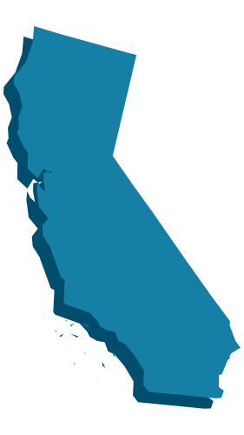
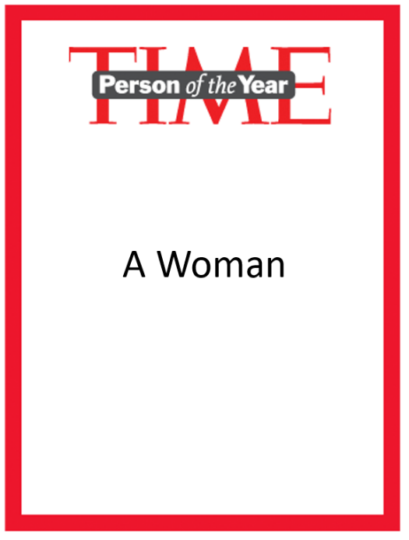
Kaiser Family Foundation’s Health Tracking Polls in 2017
13,142 interviews conducted across the year (February – November, 2 surveys in April)
6311 interviews with female respondents
3259 interviews with Republicans
4241 interviews with Democrats
5326 interviews with Independents (1331 non-leaning)
3224 interviews with Millennials
2051 interviews with members of the Greatest Generation
1376 interviews with California residents
3092 interviews with people with Medicare
945 interviews with people with Medicaid
558 interviews with people without health insurance
SOURCE: Kaiser Family Foundation Health Tracking Polls

Slide 4
Methodology Details
Computer-assisted telephone interviews of adults ages 18 and older, living in the United States, including Alaska and Hawaii (note: persons without a telephone could not be included in the random selection process).
Both the random digit dial landline and cell phone samples were provided by Marketing Systems Group (MSG). Paid for by Kaiser Family Foundation. Interviews carried out in English and Spanish and conducted by SSRS/or PSRAI.
For the landline sample, respondents were selected by asking for the youngest adult male or female currently at home based on a random rotation. If no one of that gender was available, interviewers asked to speak with the youngest adult of the opposite gender. For the cell phone sample, interviews were conducted with the adult who answered the phone.
The combined landline and cell phone sample was weighted to balance the sample demographics to match estimates for the national population using data from the Census Bureau’s 2016 American Community Survey (ACS) on sex, age, education, race, Hispanic origin, and region along with data from the 2010 Census on population density. The sample was also weighted to match current patterns of telephone use using data from the most current National Health Interview Survey. The weight takes into account the fact that respondents with both a landline and cell phone have a higher probability of selection in the combined sample and also adjusts for the household size for the landline sample. All statistical tests of significance account for the effect of weighting.
Kaiser Family Foundation’s Public Opinion and Survey Research is a proud member of the AAPOR Transparency Initiative

Slide 5
More Methods Information
Date of Survey | N (unweighted) | M.O.S.E.
November 8th-13th | 1,201 | ±3 percentage points
October 5th-10th | 1,215 | ±3 percentage points
September 13th-18th | 1,179 | ±3 percentage points
August 1st-6th | 1,211 | ±3 percentage points
July 5th-10th | 1,183 | ±3 percentage points
June 14th-19th | 1,208 | ±3 percentage points
May 16th-22nd | 1,205 | ±3 percentage points
Late April (April 17th-23rd) | 1,171 | ±3 percentage points
Early April (March 28th- April 3rd) | 1,203 | ±3 percentage points
March 6th-12th | 1,206 | ±3 percentage points
February 13th-19th | 1,160 | ±3 percentage points
SOURCE: Kaiser Family Foundation Health Tracking Polls

Slide 6
Key Takeaways
The public’s health care priorities are VERY DIFFERENT than politicians’ health care priorities
The public is still divided in their attitudes of the Affordable Care Act (ACA)
Health care policy is complicated and on most issues some attitudes can be shifted after hearing counter-arguments
The Republican replacement plans for the ACA were even less popular
Increase in support for a national health plan is driven by independents and attitudes are malleable
We are ready for a vacation ☺

Slide 7
Where We Started the Year: The Public’s Top 5 Health Care Priorities
Percent who say each of the following things President Trump and Congress might try to do in the coming months should be a top priority:
The public were mostly concerned with health care costs
SOURCE: Kaiser Family Foundation Health Tracking Polls

Slide 8
Where We Ended the Year: The Public’s Top 5 Health Care Priorities
Percent who say each of the following things President Trump and Congress might try to do in the coming months should be a top priority:
NOTE: Items asked of half samples. Question wording modified. See topline for full question wording.
SOURCE: Kaiser Family Foundation Health Tracking Polls

Slide 9
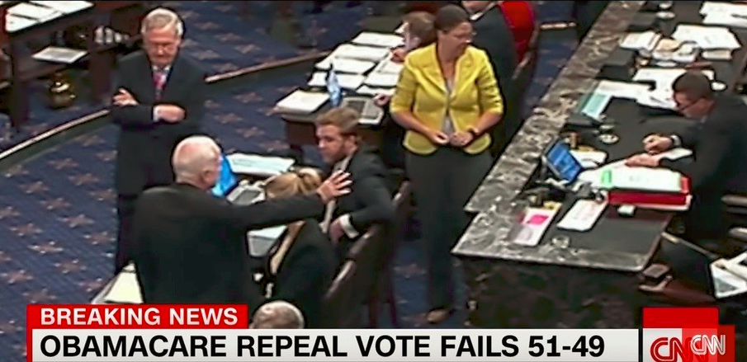
The Summer of “No Health Care Policy Love”
March 12, 2017
CBO projects 32 million Americans
would lose their insurance
July 13, 2017
Cruz Amendment Introduced
May 4, 2017
House passes AHCA
March 24, 2017
AHCA is pulled from House vote
July 13, 2017
Vote for BCRA is postponed
July 26-27, 2017
Senate vote for BCRA and skinny repeal (ORRA) fail
March 7, 2017
AHCA Introduced in House of Representatives
June 19, 2017
Senate bill BCRA announced
July 19, 2017
ORRA announced
April 20, 2017
Revised AHCA leaked
July 19, 2017
Sen. McCain announces brain cancer diagnosis
March 7, 2017
President Trump announces his support for AHCA
June 26, 2017
CBO projects 22 million Americans would lose their insurance
April 24, 2017
MacArthur Amendment Introduced
July 19, 2017
CBO projects 32 million Americans would lose their insurance
March 8, 2017
AHCA approved in committee
May 3, 2017
Upton Amendment Introduced
Notes:
American Health Care Act- decreased subsidies, get rids of individual and employer mandates, reducing funding for Medicaid expansion
MacArthur- allows plans with fewer benefits
WHICH
Led to a lot of concern about people with pre-existing conditions not being able to get coverage
WHICH
Led to the Upton amendment which providing some funding for high-risk pools for states to cover people with high medical costs/pre-existing conditions
This was enough to get the House republicans on board.
Better Care Reconciliation Act
Cruz amendment- similar to MacArthur but if insurers had compliant plans, they could also sell non-compliant plans
Obamacare Repeal Reconciliation Act- skinny repeal, basically just get rids of mandates

Slide 10
Key Takeaways
The public’s health care priorities are VERY DIFFERENT than politicians’ health care priorities
The public is still divided in their attitudes of the Affordable Care Act (ACA)
Health care policy is complicated and on most issues some attitudes can be shifted after hearing counter-arguments
The Republican replacement plans for the ACA were even less popular
Increase in support for a national health plan is driven by independents and attitudes are malleable
We are ready for a vacation ☺

Slide 11
Half of the Public Holds Favorable View of the ACA
As you may know a health reform bill was signed into law in 2010, known commonly as the Affordable Care Act or Obamacare. Given what you know about the health reform law, do you have a generally favorable or generally unfavorable opinion of it?
ACA signed into law on March 23, 2010
Trump Elected President
Nov
50%
SOURCE: Kaiser Family Foundation Health Tracking Polls

Slide 12
ACA Favorability in 2017 By Party Identification
Percent who say they have a favorable opinion of the health reform law:
SOURCE: Kaiser Family Foundation Health Tracking Polls

Slide 13
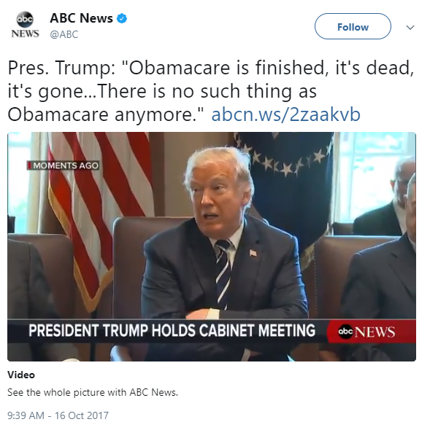
Notes:
Here’s a quote from last month – president Trump said that Obamacare is dead, it doesn’t exist anymore. Well that’s not the case

Slide 14
More Say President Trump’s Administration Should Make the ACA Work than Say They Should Make the ACA Fail
Moving forward, do you think President Trump and his administration should do what they can to make the current health care law work or should they do what they can to make the law fail so they can replace it later?
Total
By Political Party ID
Democrats
Independents
Republicans
NOTE: Don’t know/Refused responses not shown.
SOURCE: Kaiser Family Foundation Health Tracking Poll (conducted October 5-10, 2017)
Notes:
The Trump administration has taken a lot of actions aimed at destabilizing the ACA and discourage enrollment, speaking of today is the last day of ACA open enrollment in most states.
Despite the lack of overwhelming popularity towards the ACA, when we ask the public what they think the administration should do, 7/10 say they should do what they can to make the law work, while just 2/10 say they should try and make the law fail so they can replace it later.

Slide 15
More Democrats, Independents, and Republicans Say President Trump and Republicans Are Responsible for ACA Moving Forward
Which comes closer to your view?
Total
By Political Party ID
Democrats
Independents
Republicans
NOTE: Neither of these/someone else is responsible (vol.), Both are equally responsible (vol.), and Don’t know/Refused responses not shown. SOURCE: Kaiser Family Foundation Health Tracking Poll (conducted November 8-13, 2017)
Notes:
ADD BACKGROUND, SLOW DOWN

Slide 16
Health Care is Complicated, Public Knowledge about What the ACA Actually Does is Spotty
Share of nonelderly population uninsured:
Since the 2010 health care law was passed, has the share of people who are uninsured…
Note: 2016 data is for Q1-3 only.
Source: CDC/NCHS, National Health Interview Survey; Kaiser Family Foundation Health Tracking Poll (March 6-12, 2017)
Notes:
While the ACA wasn’t a perfect law by any means and policymakers can debate the impact it has had on cost and consumer choice, one pretty indisputable fact as I know you’re all aware is that it has lowered the uninsured rate. Yet when we asked Americans in March if the number of people who are uninsured has increased or decreased under the law, only 4/10 know it has decreased, and almost as many think it has actually increased.
Other examples, Half incorrectly think the law allows undocumented immigrants to get government financial help to buy insurance, many think it allows a govt panel…
I don’t point out this confusion to disparage the intelligence of the American public. We know health policy is COMPLICATED

Slide 17
Key Takeaways
The public’s health care priorities are VERY DIFFERENT than politicians’ health care priorities
The public is still divided in their attitudes of the Affordable Care Act (ACA)
Health care policy is complicated and on most issues some attitudes can be shifted after hearing counter-arguments
The Republican replacement plans for the ACA were even less popular
Increase in support for a national health plan is driven by independents and attitudes are malleable
We are ready for a vacation ☺

Slide 18
Majorities Oppose Eliminating Individual Mandate Upon Hearing Counter-Messages
Support
Oppose
Do you support or oppose eliminating the requirement for nearly all Americans to have health insurance or else pay a fine?
ASKED OF THE 55% WHO FAVOR ELIMINATING THE REQUIREMENT:
Now OPPOSE eliminating the requirement
What if you heard that…
NET OPPOSE
…most Americans still get coverage through their employers or a public insurance program so they automatically satisfy the requirement?
62%
…this would increase the cost of premiums for individuals who buy their own insurance by 10 percent?
60%
…people would not be held to this requirement if the cost of coverage would take up too much of their income?
59%
…this would increase the number of people without insurance by 13 million over the next ten years?
59%
NOTE: Question wording abbreviated. See topline for full question wording. Don’t know/Refused responses not shown.
SOURCE: Kaiser Family Foundation Health Tracking Poll (conducted November 8-13, 2017)
Notes:
AS I previously mentioned health care policy is complicated and so even if we take a look at one component of the ACA repeal that seemed to popular- repealing the individual mandate. When people hear counter messages to this argument, we find that a majority now OPPOSE eliminating the mandate.
People are busy and while my summer was dominated with health care policy, I am not sure this experience was universal so it is our job to help identify where knowledge gaps exist, to help journalists understand what they could do a better job explaining to the public, and help policymakers understand where leadership is necessary to bring the public along.

Slide 19
Medicare, Medicaid Remain Most Popular Health Care Policies
In general, do you have a favorable or an unfavorable opinion of …?
NOTE: Don’t know/Refused responses not shown. Question wording for national health plan was strongly favor, somewhat favor, somewhat oppose, strongly oppose.
SOURCE: Kaiser Family Foundation Health Tracking Polls

Slide 20
Key Takeaways
The public’s health care priorities are VERY DIFFERENT than politicians’ health care priorities
The public is still divided in their attitudes of the Affordable Care Act (ACA)
Health care policy is complicated and on most issues some attitudes can be shifted after hearing counter-arguments
The Republican replacement plans for the ACA were even less popular
Increase in support for a national health plan is driven by independents and attitudes are malleable
We are ready for a vacation ☺

Slide 21
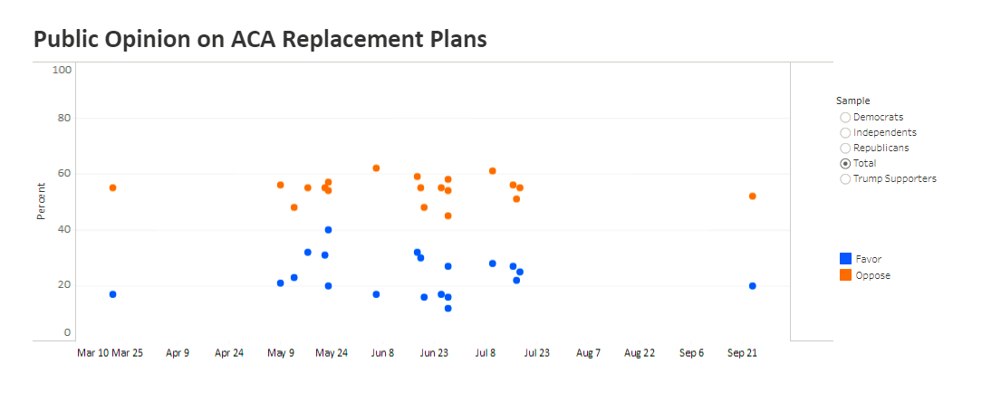
Polling on the ACA Replacement Plans
Notes:
At KFF, we pooled all of the polling on the various ACA replacement plans and never did favorability get above 40 percent.

Slide 22
Few Changes Included in ACA Replacement Plans Were Popular Among the Public
SOURCE: Kaiser Health Tracking Polls

Slide 23
What’s Behind Public Dislike of Repeal/Replace Plan?
AMONG THE 61% WHO HAVE A UNFAVORABLE VIEW OF THE REPLACEMENT PLAN:
Could you tell me in your own words what is the main reasons you have an UNFAVORABLE opinion?
“The whole thing is hurting those who are the least able to defend themselves.”
“It won’t be good for the older people.”
“Transfer of wealth to the rich.”
“A lot of people are not going to be able to afford insurance.”
“Don’t feel it fixes the original problems with Obamacare.”
“A lot of people with extreme conditions will not be able to get healthcare.”
“Because a lot of people won't get any health care at all.”
SOURCE: Kaiser Family Foundation Health Tracking Poll (conducted July 5-10, 2017)
Notes:
In our own polling, when we dug deeper to find out why people were opposed, we found that most opposition centered around the negative impact on people, increased insurance costs, and decreased access to care. You can see a small share – 15% here – were more concerned that the plan didn’t go far enough to repeal the ACA or fix the problems associated with the law.
Among Republicans, it was really the fact that they didn’t think the replacement plans went far enough in getting rid of the ACA regulations

Slide 24
Key Takeaways
The public’s health care priorities are VERY DIFFERENT than politicians’ health care priorities
The Affordable Care Act (ACA) is still not very popular
The Republican replacement plans for the ACA were even less popular
Increase in support for a national health plan is driven by independents and attitudes are malleable
In fact, on most complex health care policies issues some attitudes can be shifted after hearing counter-arguments
We are ready for a vacation ☺

Slide 25
Key Takeaways
The public’s health care priorities are VERY DIFFERENT than politicians’ health care priorities
The public is still divided in their attitudes of the Affordable Care Act (ACA)
Health care policy is complicated and on most issues some attitudes can be shifted after hearing counter-arguments
The Republican replacement plans for the ACA were even less popular
Increase in support for a national health plan is driven by independents and attitudes are malleable
We are ready for a vacation ☺

Slide 26
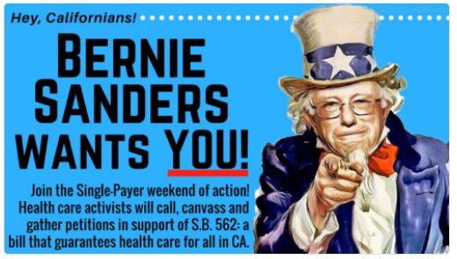
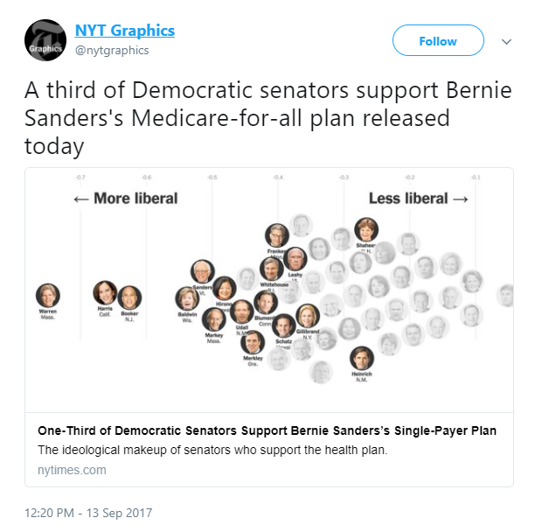
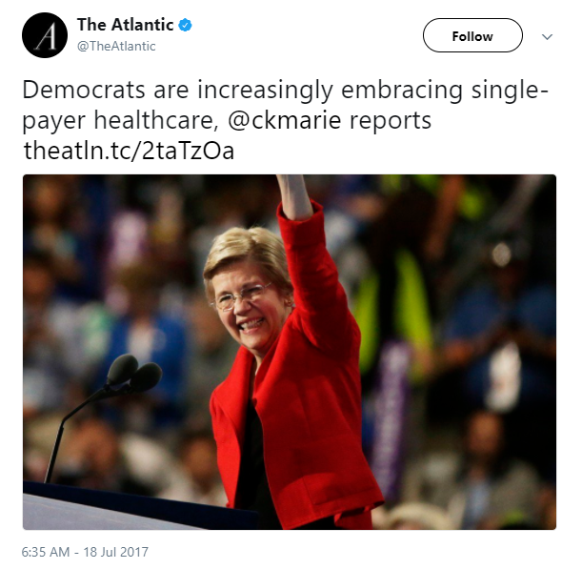
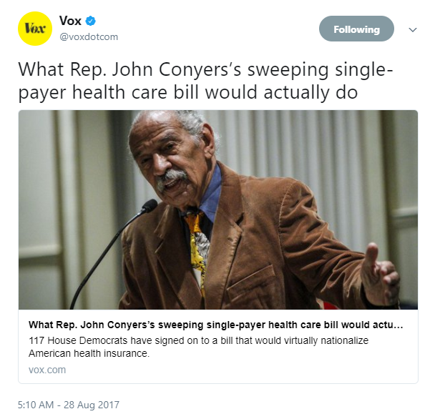
Is the U.S. Ready for Single-Payer?
Notes:
What was happening on the other side of the aisle during this…
And there’s been action at the federal level too, with many Senate Democrats saying they would support Bernie Sanders’ Medicare-for-all plan, and a similar proposal introduced in the House by Rep John Conyers.
Some have suggested that there has been a groundswell of public support for single payer amid frustration over the politics of the ACA

Slide 27
Modest Increase in Support for Single Payer Health Care in 2017
Percent who favor or oppose a national health plan in which all Americans would get their insurance from a single government plan
NOTE: Question wording varied slightly over time. See topline for full question wording.
SOURCE: Kaiser Family Foundation Polls

Slide 28
Perceptions of Impact of a National Health Plan Differ Somewhat by Party Identification
Percent who think that, if a national health plan was put into place, they and their family would…
Be able to access the health care they need
Be able to keep their current health insurance
By Political Party ID
SOURCE: Kaiser Family Foundation Health Tracking Poll (conducted October 5-10, 2017)

Slide 29
Democrats and Independents Favor Medicare “Buy-In,” Republicans Are Divided in their Views
As you may know, people become eligible for health insurance through Medicare when they turn 65. Do you favor or oppose letting some people under the age of 65 buy insurance through the Medicare program?
Total
By Political Party ID
Democrats
Independents
Republicans
NOTE: Don’t know/Refused responses not shown
SOURCE: Kaiser Family Foundation Health Tracking Poll (conducted September 13-18, 2017)
Notes:
There are some more gradual expansions of coverage being discussed that could gain more traction than a fully universal plan, so it’s worth touching on how the public feels about these. One such plan would allow people under age 65 buy into Medicare – some Democratic senators introduced a proposal like this earlier this year. And you see a familiar pattern – almost 2/3 are in favor, 1/3 oppose, with Dems and inds largely supportive and Reps more divided, leaning in opposition

Slide 30
Majority of Democrats and Independents Favor Medicaid “Buy-In,” Half of Republicans Oppose
As you may know, under the Affordable Care Act, people who don’t get health insurance at work can buy private insurance and then get government subsidies to help pay their premiums depending on their income. Do you favor or oppose letting people use those subsidies to buy health insurance through state Medicaid programs instead of purchasing a private insurance plan?
Total
By Political Party ID
Democrats
Independents
Republicans
NOTE: Don’t know/Refused responses not shown
SOURCE: Kaiser Family Foundation Health Tracking Poll (conducted September 13-18, 2017)
Notes:
Similarly, some have suggested letting people use subsidies under the ACA to buy coverage from MediCAID rather than purchasing coverage through the exchanges. A bill like this was passed in Nevada but vetoed by the governor, and a national plan was proposed by Democratic Senator Brian Schatz from Hawaii. Again, this proposal is popular with Democrats and independents, but less so with Republicans, suggesting it would be difficult to pass in a Republican-controlled Congress.

Slide 31
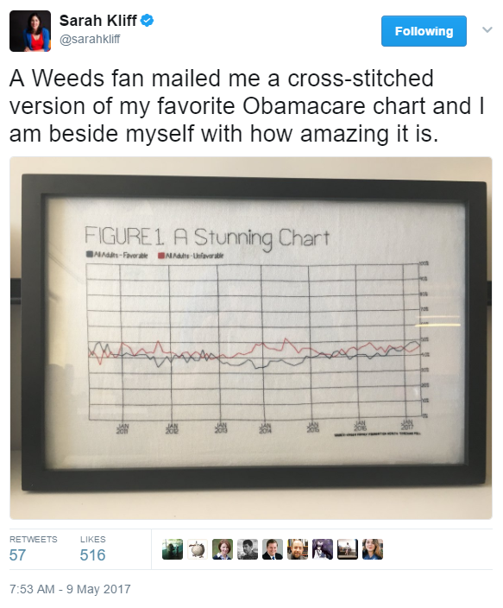
Notes:
Been tracking public opinion on the ACA monthly since it was passed
Since the ACA was passed, we've conducted 79 polls and interviewed roughly 100,000 respondents!!!
Despite ups and downs, mostly divided and stable picture
One time we saw a sustained shift was after the marketplace rollout in 2013, but by 2015 back to divided
News about Ocare becoming more popular after election –

Slide 32
Key Takeaways
The public’s health care priorities are VERY DIFFERENT than politicians’ health care priorities
The Affordable Care Act (ACA) is still not very popular
The Republican replacement plans for the ACA were even less popular
Increase in support for a national health plan is driven by independents and attitudes are malleable
In fact, on most complex health care policies issues some attitudes can be shifted after hearing counter-arguments
We are ready for a vacation ☺

