Slide 1


Targeted ABS: Methodology and Implementation
2017 PAPOR Conference, San Francisco
Ashley Hyon - Marketing Systems Group
Thursday December 14, 2017

Slide 2


Acknowledgement
Co-Authors:
Kelly Lin, MSG
Nathan Bordy, MSG
David Malarek, MSG

Slide 3
Overview
Address Based Sampling (ABS) Frame
  Frame Details
  Frame Enhancements
Targeted ABS:
  Methodology
  Implementation

Slide 4
Address Based Sampling Frame Details
  Based on USPS CDS File of 143 million active residential addresses
  Complimented with USPS NoStat File (inactive)
  Address-frame covers about 99% of all households
  Simplified addresses and drop units are augmented – where possible
  Every address geo-coded by (Lat/Long) to Census Geography
  Highest level of geographic precision down to the Zip+4 level
  Reconstructed monthly
Notes:
USPS Computerized Delivery Sequence File which is a snapshot of the USPS master address delivery file.
Every address on the CDS is Delivery Point Verified (DPV) and CASS certified. It requires no further address hygiene.

Slide 5
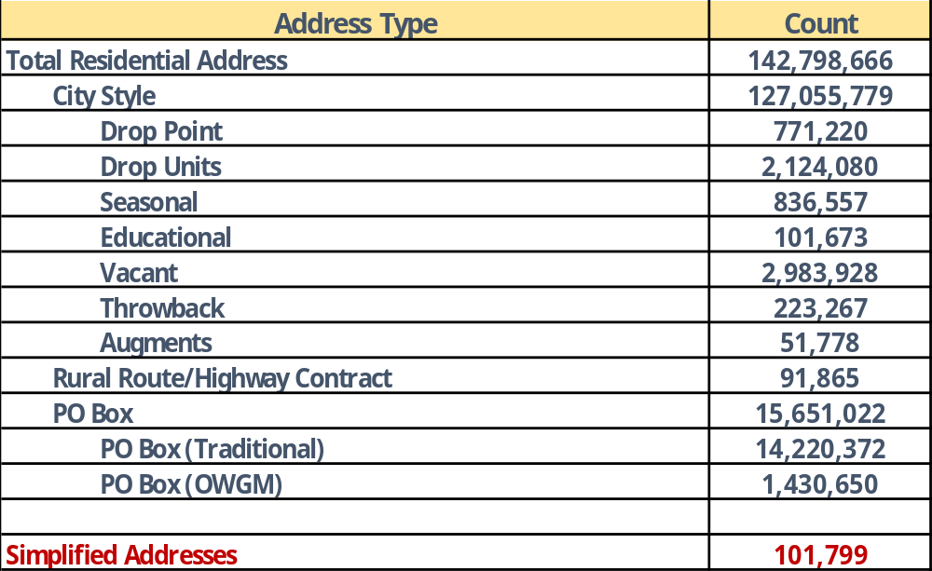
Address Based Sampling Frame Details
Notes:
Counts by address type
Before the 911 Conversion Campaign there was about 10 million simplified addresses but now there are only about 100K
Vacant – is long term 90 days
Do away with duality by excluding traditional PO Boxes

Slide 6

Address Based Sampling Frame Enhancements
Appending of ancillary information:
  Head of Household name for over 90%
  Telephone number for about 50%-65%
  Direct and modeled demographic indicators
    Age/Gender of Head of Household
    Age information for additional HH Members
    Income
    Ethnicity
    Education
    Own/Rent
    Presence of Children
Notes:
For the phone matches you can maximize the cell phone number appends by making them priority over the land line phone if both are available.
Nationally:
47% LL number match
59% cell number match
HH with both cell and ll numbers – 21%
Net match for one number per hh – 64%
Being able to append phone numbers allows for a multi-mode approach to help increase RR by calling some of the non-responders from the mailing.

Slide 7
Address Based Sampling Frame Enhancements
Notes:
The match rate for education or ethnicity can be maximized to about 65% by making the source with these variables first in line for matching. However, this source has the lowest phone match rate at roughly 22%. Since these demographics tend to cluster going with a density approach using public data sources may be a better option. I will run through an example in later slides.

Slide 8

Targeted ABS Methodology (T-ABS)
T-ABS is a disproportionate stratified sampling design that employs a cost effective optimal allocation plan that reduces screening costs
Calculated design effects can be used for quality control by keeping them within the acceptable range of 1-2
It’s a single frame approach that assigns the entire population into one of the mutually exclusive strata
Ensures the coverage of hard-to-reach population within each stratum.
Notes:
Provides more control for balancing efficiency (cost) vs. coverage (statistical validity).
Simplifies back end weighting to account for the over and under sampling of the various strata because they are mutually exclusive.

Slide 9
Targeted ABS Methodology
Utilizing Commercial Data Sources
Over Generate a file of addresses from the ABS Frame (dependent on the estimated match rate of the demographic variable)
Match the addresses against the commercial databases to flag households that meet the demographic criteria of interest
Stratify into mutually exclusive strata: Targeted vs. Remainder
Disproportionately sample from each by over sampling the targeted stratum and under sampling the remainder stratum
Notes:
There can be multiple targeted and remainder strata depending on the population groups that need to be reached.
It’s very important that all records must be included in one of the strata in order to have a chance of being selected.

Slide 10


Targeted ABS Implementation
Hypothetical Example 1
Aiming to achieve 1000 homeowner Completes in San Francisco
Excluded Vacant, Seasonal, Educational and Traditional PO Boxes
Pulled all available addresses (370,894) and ran them against all and the commercial sources to flag for homeowners
Stratified into two strata:
  S1 - Households flagged as homeowners = 91,950
  S2 - All remaining households = 278,944
Notes:
Since all projects employing these methods are client specific I won’t be able to run through an actual study with field outcomes.
However, I have created hypothetical examples to illustrate how T-ABS methods can be applied to reduce screening costs when compared to SRS.
For the sake of time we will just look at the possible cost savings on mailing out the survey packets. We will estimate the cost at $3 per printed survey along with a $2 incentive.
Total cost of mail packet = $5 (not including postage).

Slide 11
Targeted ABS Implementation
Sample Allocation Plans: SRS vs. T-ABS
Table 1
Simple Random Sample - Number of Contacts (35% Owners Overall)
Stratum | Contacts
San Francisco County | 2,824
Total sample | 2,824
Design effect | 1.00
Table 2
Targeted ABS - Number of Contacts
Stratum | Optimal Allocation 1 | Optimal Allocation 2
Owner | 861 | 900
Remainder | 982 | 707
Total sample | 1,843 | 1,607
Design effect | 1.19 | 1.40
Notes:
Overall percent of owners in San Francisco is about 35%.
Just by the nature of the commercial sources demographically being more older and established it contained a large proportion of the owners. Thus there was not much variation in the optimal allocations so we limited to two.
Optimal Allocation 1: Most conservative with the least amount of oversampling from the high stratum. {86/14} Deff less than 1.5
Optimal Allocation 2: Taking the least from the low stratum but keeping the floor at 10%. {90/10} Deff still under 1.5.
Most efficient is optimal 2

Slide 12
Targeted ABS Implementation
Sample Size Calculation: SRS vs. T-ABS
Table 1: SRS
Without Stratification: Owners
Record Type | Completes | Response Rate | Eligibility Rate | Bad Sample | Yield Rate | Needed Sample (completes/yield rate)
Has phone | 400 | 40% | 35% | 10% | 13% | 3,175
No phone | 600 | 10% | 35% | 10% | 3% | 19,048
Total | 1000 | 22% | 35% | 10% | 7% | 22,222
Total Sample = 22,222
Table 2: T-ABS
Stratum 1: Owners
Record Type | Completes | Response Rate | Eligibility Rate | Bad Sample | Yield Rate | Needed Sample (completes/yield rate)
Has phone | 360 | 40% | 70% | 10% | 25% | 1,429
No phone | 540 | 10% | 70% | 10% | 6% | 8,571
Total | 900 | 22% | 70% | 10% | 14% | 10,000
Stratum 2: Remainder
Record Type | Completes | Response Rate | Eligibility Rate | Bad Sample | Yield Rate | Needed Sample (completes/yield rate)
Has phone | 40 | 40% | 14% | 10% | 5% | 794
No phone | 60 | 10% | 14% | 10% | 1% | 4,762
Total | 100 | 22% | 14% | 10% | 3% | 5,556
Total Sample = 15,556
Notes:
Even though these were flagged as owners the commercial sources used are not 100% accurate so we applied a list accuracy of 70%.
List accuracy levels can vary depending on the variable being targeted.
Since we backed out the known owners into S1 the overall incidence of owners in these stratum is estimated at about 14% rather than 35%.

Slide 13
Targeted ABS Implementation
Possible Cost Savings: SRS vs. T-ABS
SRS
T-ABS
Assuming each
mailer costs of $5
Notes:
Possible savings = $33,330 by reducing the number of mailings by about 6,666 mailings compared SRS – about 30%.

Slide 14
Targeted ABS Methodology
Utilizing Public Data Sources
Run a Density Report based on census geography for the desired demographic
Impute the cut-of points for the incidence and coverage for the desired demographic
Stratify into mutually exclusive strata: Targeted vs. Remainder
Disproportionately sample from each by over sampling the targeted stratum and under sampling the remainder stratum
Notes:
Only the first two steps differ compared to the first example. For this approach we public data sources.
The stratification here is done at the geographic level prior to pulling the ABS file.
Since we are going to the census block group we have to use population figures as a proxy since the race information is not available at the household level below state or large metro areas.

Slide 15
Targeted ABS Implementation
Hypothetical Example 2
Aiming to achieve 1000 Hispanic Completes in San Francisco
Ran a density report for percent Hispanic based on Census Block Groups and stratified into three strata based on percent Hispanic:
Total Pop | Hispanic | Incidence | Coverage | Density Level
236,461 | 76,974 | 33% | 56% | High
224,170 | 31,513 | 14% | 23% | Medium
424,317 | 28,078 | 7% | 21% | Low
884,948 | 136,565 |  | 100%
Notes:
Cuts made at:
20%+ for high
10%<20% for medium
<10% for remainder

Slide 16
Targeted ABS Implementation
Sample Allocation Plans SRS vs. T-ABS
Table 1
Simple Random Sampling - Number of Contacts (16% Hispanic Overall)
Stratum | Contacts
San Francisco County | 6,250
Total sample | 6,250
Design effect | 1.00
Table 2
Targeted ABS - Number of Contacts
Stratum | Optimal Allocation 1 | Optimal Allocation 2 | Optimal Allocation 3
Hispanic - High (33%) | 2,148 | 2,305 | 2,305
Hispanic - Medium (14%) | 1,335 | 1,067 | 1,425
Hispanic - Low (7%) | 1,734 | 1,511 | 756
Total sample | 5,217 | 4,883 | 4,486
Design effect | 1.12 | 1.19 | 1.71
Notes:
16% overall incidence of Hispanics in San Francisco – meaning a ton of screening will need to be done to reach them.
Optimal Allocation 1: Most conservative with the least amount of oversampling from the high stratum. {70/19/11} Deff less than 1.5
Optimal Allocation 2: Taking more completes from the high stratum while taking at least 10% of the completes from the low stratum. {75/15/10} Deff controlled to be less than 2.
Optimal Allocation 3: Taking the least from the low stratum but keeping the floor at 5%. {75/20/5} Deff still under 2.
Most efficient Optimal 3

Slide 17
Targeted ABS Implementation
Sample Size Calculation: SRS vs. T-ABS
Table 1: SRS
Without Stratification: Hispanics
Record Type | Completes | Response Rate | Eligibility Rate | Bad Sample | Yield Rate | Needed Sample (completes/yield rate)
Has phone | 400 | 40% | 16% | 10% | 6% | 6,944
No phone | 600 | 10% | 16% | 10% | 1% | 41,667
Total | 1000 | 22% | 16% | 10% | 3% | 48,611
Total Sample = 48,611
Table 2: T-ABS
Stratum 1: High Hispanic
Record Type | Completes | Response Rate | Eligibility Rate | Bad Sample | Yield Rate | Needed Sample (completes/yield rate)
Has phone | 300 | 40% | 33% | 10% | 12% | 2,560
No phone | 450 | 10% | 33% | 10% | 3% | 15,361
Total | 750 | 22% | 33% | 10% | 6% | 17,921
Stratum 2: Medium Hispanic
Record Type | Completes | Response Rate | Eligibility Rate | Bad Sample | Yield Rate | Needed Sample (completes/yield rate)
Has phone | 80 | 40% | 14% | 10% | 5% | 1,581
No phone | 120 | 10% | 14% | 10% | 1% | 9,524
Total | 200 | 22% | 14% | 10% | 3% | 11,104
Stratum 3: Low Hispanic
Record Type | Completes | Response Rate | Eligibility Rate | Bad Sample | Yield Rate | Needed Sample (completes/yield rate)
Has phone | 20 | 40% | 7% | 10% | 2% | 839
No phone | 30 | 10% | 7% | 10% | 1% | 4,762
Total | 50 | 22% | 7% | 10% | 1% | 5,601
Total Sample = 34,627
Notes:
Yield rate = RR x eligibility x bad sample

Slide 18
Targeted ABS Implementation
Possible Cost Savings: SRS vs. T-ABS
SRS
T-ABS
Assuming each
mailer costs of $5
Notes:
Possible savings = $69,920 (13,984 less mailings) – 29% reduction

Slide 19

Summary
ABS is a viable sampling alternative that provides almost near complete coverage of all households.
The auxiliary variables that can be appended allows for more efficient sampling designs and allocations.
Targeted ABS can reduce the required level of screening for reaching the eligible households by sampling more heavily in the least cost strata.
This single frame approach simplifies weighting calculations on the back end since all strata are mutually exclusive.

Slide 20




THANK YOU
Ahyon@m-s-g.com
610-994-8321

