Slide 1


Fielding Section 508 Compliant Web Surveys for Respondents with Disabilities
Best Practices and Lessons Learned
Bob Davis
bob@davisresearch.com

Slide 2

Today’s Goals
My goals for today are:
Increase awareness of need for accessibility consideration when designing web surveys
Prepare you for what is involved in 508 compliance.
Provide lessons learned and some quick hit suggestions

Slide 3

Presentation Backdrop
These experiences came from several multi-modal (phone + web) studies conducted by Davis Research on behalf of the Department of Veterans Affairs.

Slide 4

Disabilities to consider
Visual including total, partial and color blindness
Auditory
Speech
Neurological
  E.g., ADHD, dyslexia, seizures
Multiple combinations
Changing abilities – limitations may be experienced over time

Slide 5

Why this is important
Participation in survey research from important population. 7MM in US have some visual impairment. (nfb.org)
Required through Section 508 of Rehabilitation Act of 1973 for certain Federal government systems

Slide 6

Challenges
508 Compliance is an Art and a Science. No clear set of ‘rules’.
Most examples of 508 compliance are overly simplistic. Research fundamentals like randomization complicate the accessibility process.
Survey platforms may claim 508 compliance in theory but have not tested this in practice.
Multiple browsers on multiple platforms need to be considered.
You can’t design 2 paths, one for accessibility and one for the general population. Some accessibility features may impact the look for general population.
Each round of certification testing can take weeks or months. Automated testing is followed by hands on testing.

Slide 7
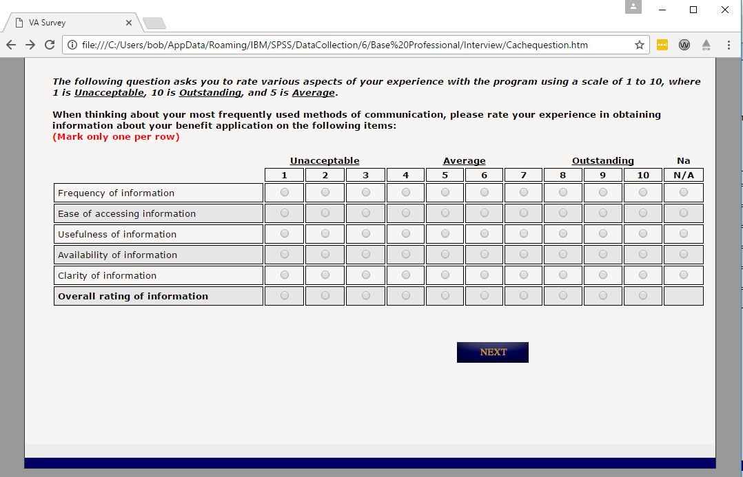

Before
Notes:
No labels, grid, use color, next button doesn’t have alt text, no skip link, no page title, no headings, multi-level grids

Slide 8
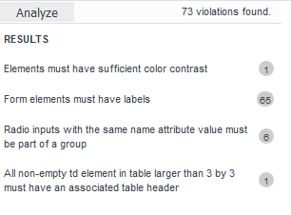
Before – Automated Check
Notes:
No labels, grid, use color, next button doesn’t have alt text, no skip link, no page title, no headings, multi-level grids

Slide 9
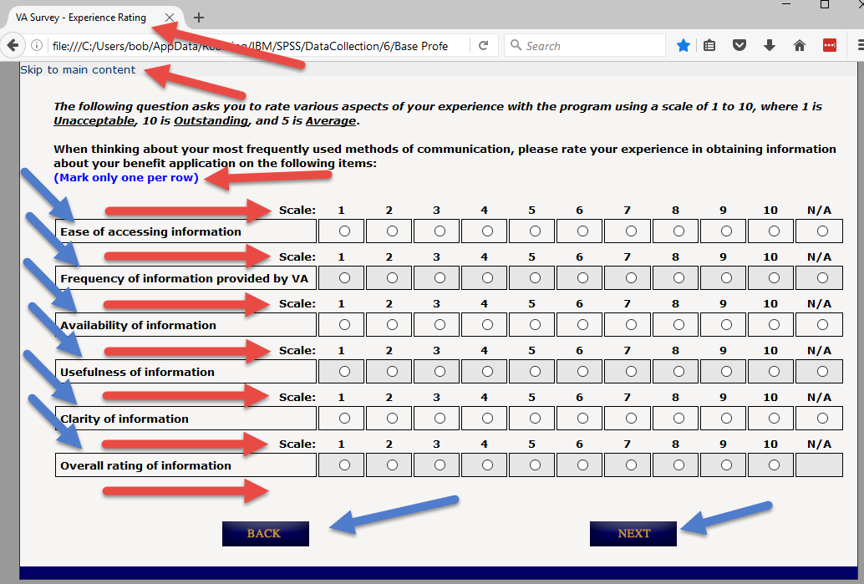
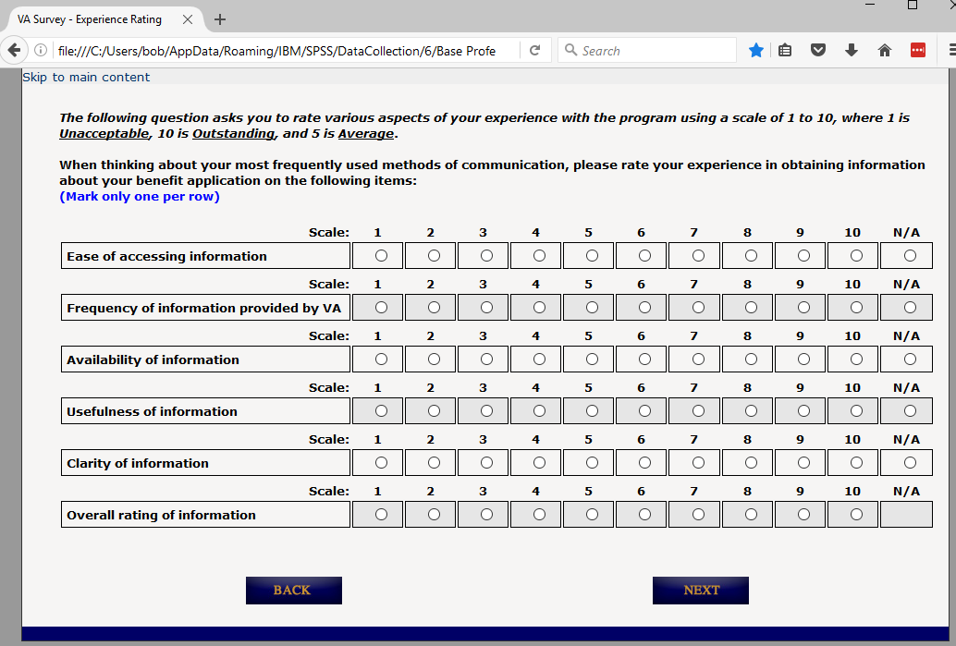
After
Notes:
Page Title, captions, no floating header, Column and Row Headers, Alternate text for buttons, color contrast.

Slide 10

Guidelines & Best Practices – Be Prepared
Prepare a great toolkit
  Screen reader such as NVDA (freeware) or JAWS (evaluation)
  Usability tools aXe (from Deque) AND WAVE (from WebAIM)
  Multiple broswers (and their Developer Tools)
  Consider a professional 508 testing firm
Budget enough time for formal certification
  Manage expectations that very little passes on the first round.
  Each round can take between 3-6 weeks.
  Feedback between rounds may seem contradictory.
Although formal process is long, there are many quick hit improvements that are easy to incorporate.
Work in partnership with the certification team and be understanding of their workload.

Slide 11
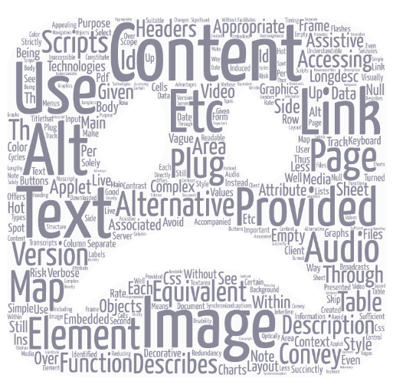
Data Analytics on Programming Guidelines
http://webaim.org/standards/508/checklist

Slide 12
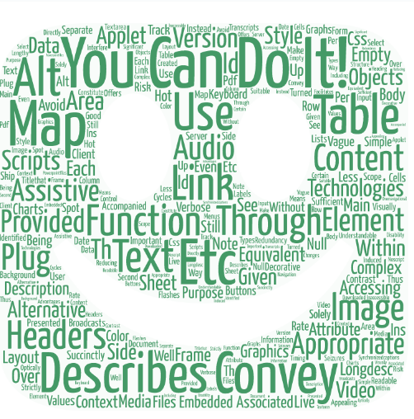
Guidelines & Best Practices – Quick Hits
Is additional screen decoration necessary?
Use the underlying structure to help explain the survey layout.
  Meaningful titles, header tags to separate sections, “Skip to Main Content Link”, captions, labels
Focus attention on grid questions and pages with multiple questions.
Provide text alternatives to non-text attributes.
  Images, Image Maps, Audio, Video
Don’t use color as the sole way to express meaning. Watch your color contrast.
  Don’t have anything flashing.
Make sure that your page can be navigated using a keyboard in a meaningful order.

Slide 13
Other Lessons Learned
Stick to it and have empathy for those who this is their daily experience with the web.
Projects with the government often require GSA contracts.
  Formal position is that this takes 90-120 days. My experience was 17 months.
When interviewing Veterans be prepared for frustrated and potentially depressed respondents.
  Take complaints very seriously and treat with respect. Don’t be surprised at long interview lengths.
  Review data for signs of trouble, compare against privacy agreement, & prepare for worst case scenarios.
Review underlying security of survey eco-system for potential security exposures.
  Data is encrypted at rest and in transit, personnel have underlying privacy and security training,

Slide 14
Thank You
Thank you very much. I’ll be happy to answer questions later.
Notes:
Click Audio

Slide 15
Fielding Section 508 Compliant Web Surveys for Respondents with Disabilities
Best Practices and Lessons Learned
Bob Davis
bob@davisresearch.com

