Slide 1
“BEHIND THE WALLS”
A Case Study in
Accessing Hard-to-Reach Populations

Slide 2
STATE OF CALIFORNIA
Government Operations Agency
CalHR
“First-Ever Employee Engagement Survey”

Slide 3

JD Franz Research, Inc.

Slide 4
OBJECTIVES
Assess levels of engagement among State employees
Ascertain where enhancements are most needed
Determine where those working on Civil Service Reform might be most effective in enhancing employees’ sense of connectedness to their jobs

Slide 5
QUESTIONNAIRE DESIGN
Steering Committee from GovOps, CalHR, and CalSTRS
Liberal use of plagiarism (Sudman & Bradburn)
Design by JD Franz Research
Multiple rounds of review and revision
Reading level testing
Cognitive pretesting in three focus groups
ADA compliance review

Slide 6
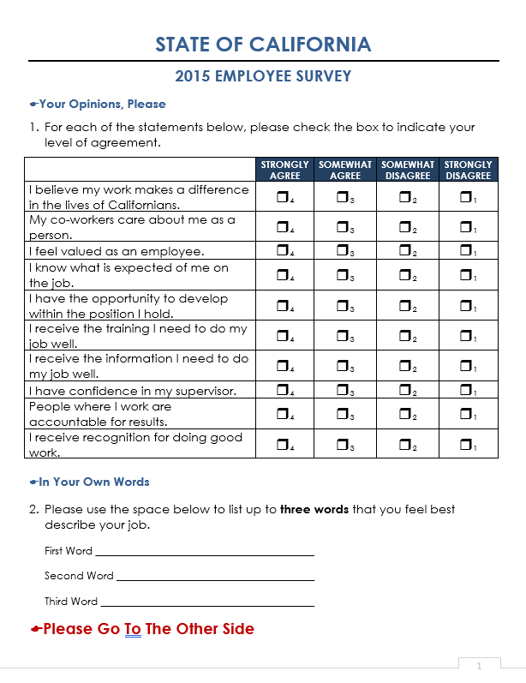
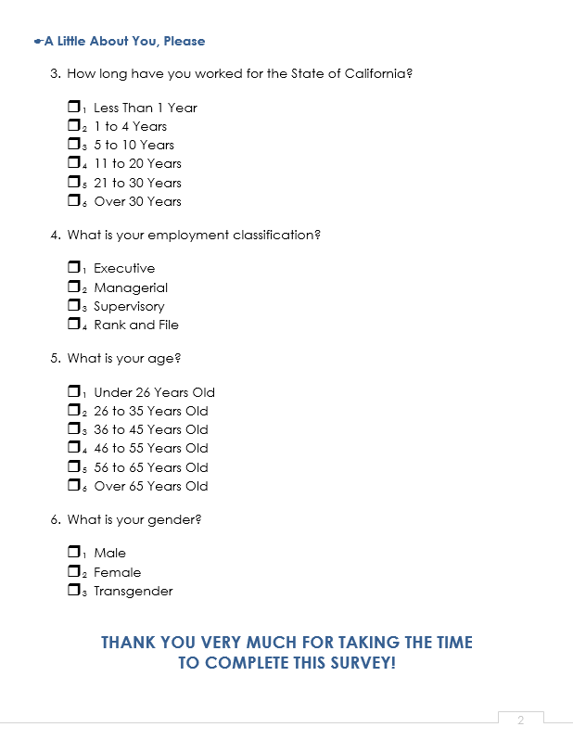

Slide 7
SAMPLE SELECTION
Sample selected by CalHR from comprehensive employee database
Database stratified by age and gender
Random selection in proportion to population
Employees with access to email: 4,464
Employees without access to email: 527
Total sample size 4,991 – not 5,000

Slide 8
SURVEY ADMINISTRATION
Notification with questionnaire attachment to all collective bargaining units 30 days prior to launch
Advance letters to all agency and department heads asking them to encourage participation
Survey link emailed to those with email access
Questionnaire mailed to those without email access with a cover letter and postage-paid return envelope

Slide 9
SURVEY ADMINISTRATION
Survey launched June 9, 2015
First reminder sent June 16
Email reminder: Variation of the original invitation
Mailed reminder: Postcard adapted from the original cover letter
And the results are …

Slide 10
BEWARE OF THOSE WITHOUT EMAIL!
Online: Initial surge, bump following the reminder
Mail: A few responses a day on a good day
Online Response Rate: 39 Percent after two weeks
Mail Response Rate: 2 Percent after two weeks

Slide 11
LEARNING BY DOING
All of the mailed questionnaires went to employees of the California Department of Corrections and Rehabilitation – new news!
Most are correctional officers – prison guards – who work “behind the walls”
For security reasons, most do not have email access at their work locations
But … What happened to the mailings?

Slide 12
IT HELPS TO HAVE LEARNED
IN A PREVIOUS LIFE
Time to figure out where the mailings went
A couple of team members had experience in California correctional institutions
Hope we would have been smart enough to seek some out if we didn’t
High level of concern about contraband
Things often just disappear
Further study – mailings never got there

Slide 13
IT HELPS TO GO (ALMOST) TO THE TOP
Consultation with the Agency Undersecretary
Third mailing sent in batches to the wardens at all 37 sampled institutions
Cover letter from the Agency Undersecretary
List of sampled employees
Questionnaires and business reply envelopes
In-person distribution to officers by clerical staff, not wardens
Recipients required to sign for receipt

Slide 14
THE FINAL PUSH
Institutional packages hand-delivered to CDCR on July 23
Second email reminder sent August 4 to coincide with anticipated distribution at the institutions

Slide 15
DID IT WORK?
Sort of
No, sorry, we don’t know why it wasn’t the perfect solution we thought we had hit upon
Institutional issues? We have the signatures …
Correctional officers who called the GovOps survey number mentioned job complexity, frustration, other challenges
And the results are …

Slide 16
FINAL RESPONSE RATES
Overall: 52 Percent
Online: 54 Percent
Mail: 33 Percent
Late Batches of Mail: 44 Percent
Overall: 53 Percent

Slide 17
So, do you have any data?

Slide 18
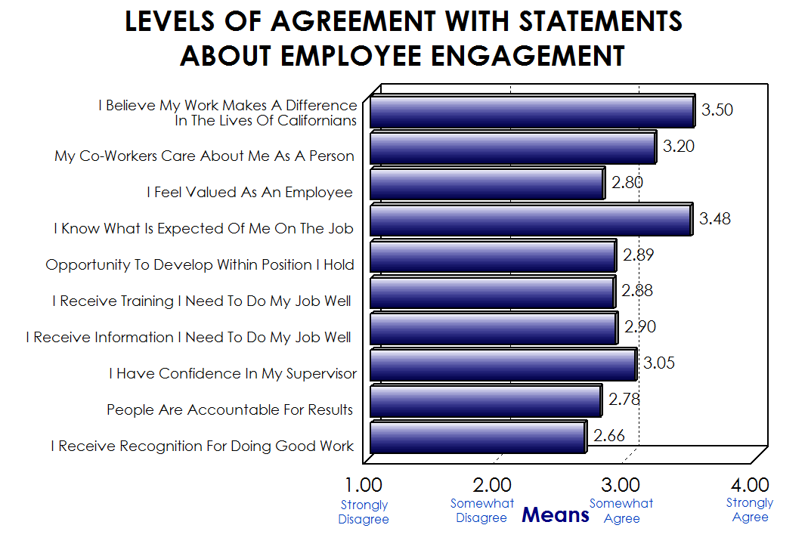

Slide 19
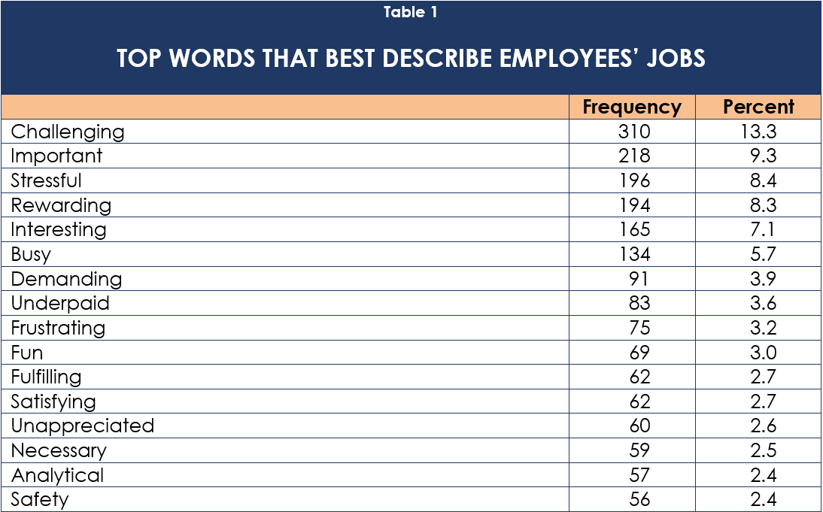

Slide 20
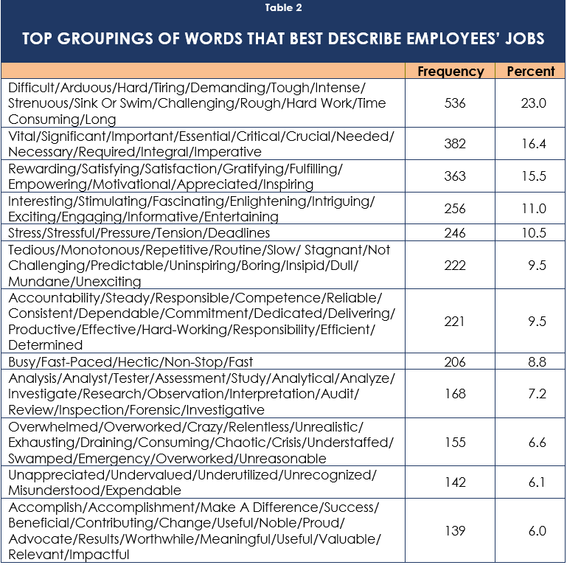

Slide 21
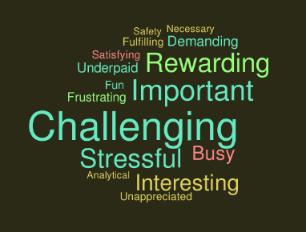

Slide 22
THE MORALS OF THE STORY
Determination to be inclusive can be a powerful motivator
It pays to be persistent beyond the standard literature
Insider knowledge is useful
Creativity counts

