Slide 1
Managing Surveys from Start to Finish
Gary Langer
Langer Research Associates
glanger@langerresearch.com
@LangerResearch
PAPOR annual conference
Dec. 15, 2017

Slide 2


Let’s not.

Slide 3
What we all think about (rightfully)
The research lifecycle
  Establishing the research question
  Learning from prior work (e.g., reviewing the literature)
  Selecting the appropriate methodology
  Designing and testing the instrument (e.g., questionnaire or qual guides)
  Spec’ing the project, managing/overseeing field work
  Data processing, weighting, dataset review
  QA (process oriented); QC (product oriented); adaptive design
  Data analysis
  Report and presentation

Slide 4
With the aim of
Delivering insights
Serving our clients
Advancing our profession
Not to mention…
Improving our skills and advancing our careers

Slide 5
What we think less about (sadly)
The research infrastructure
  Organization
  Consistency
  Efficiency
  Materials management
  Knowledge management
  Accuracy management
  Insight management

Slide 6

It’s a lot harder to hit the ball
…If you haven’t teed it up

Slide 7
The wisdom of the sages
For every minute spent organizing, an hour is earned.
  – Benjamin Franklin
Good order is the foundation of all things.
  – Edmund Burke
Fail to plan, plan to fail.
  – Winston Churchill
How many things are there, which I do not want.
  – Socrates

Slide 8
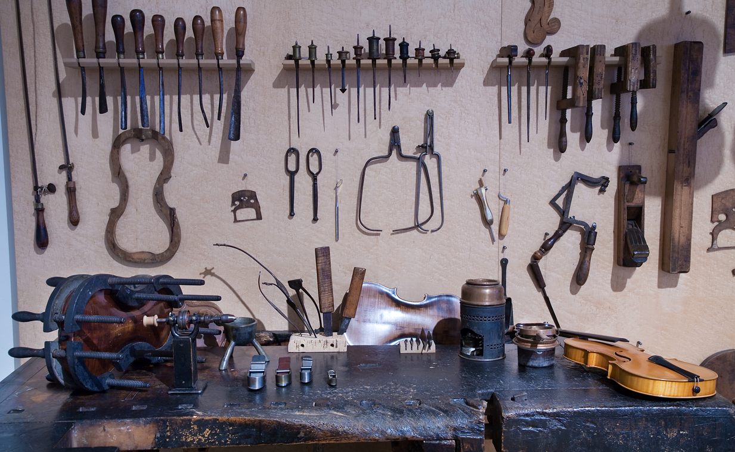
The tools of our trade…

Slide 9
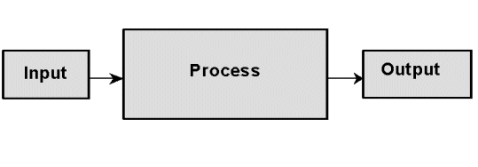
Or, more precisely
…a system

Slide 10
In our shop
Langer Research Associates Operations Manual
45 glorious pages, with things like…
Trend document formatting
Banner book formatting
Reference/citation style
Analysis and style guide
Regression guide
And the heavy hitter:
  File name, folder name and record-keeping protocols

Slide 11
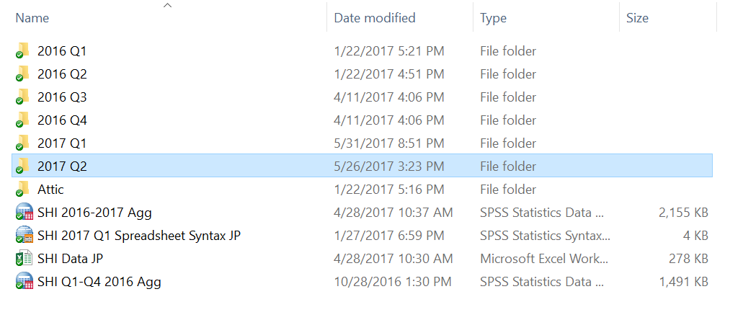
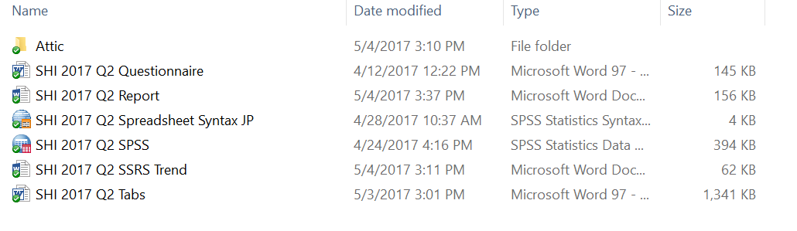
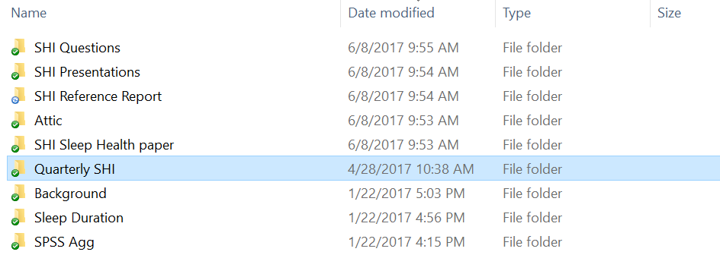
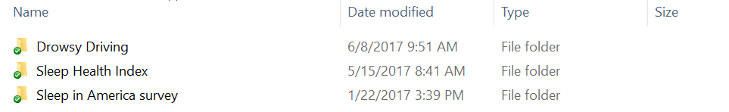
Example…

Slide 12
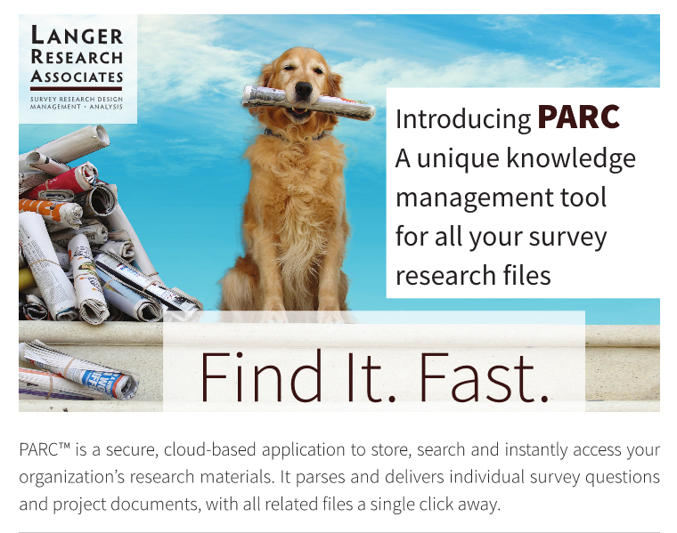
…and PARC
…let’s go to the web

Slide 13
Thank you!
Gary Langer
Langer Research Associates
glanger@langerresearch.com

