Slide 1
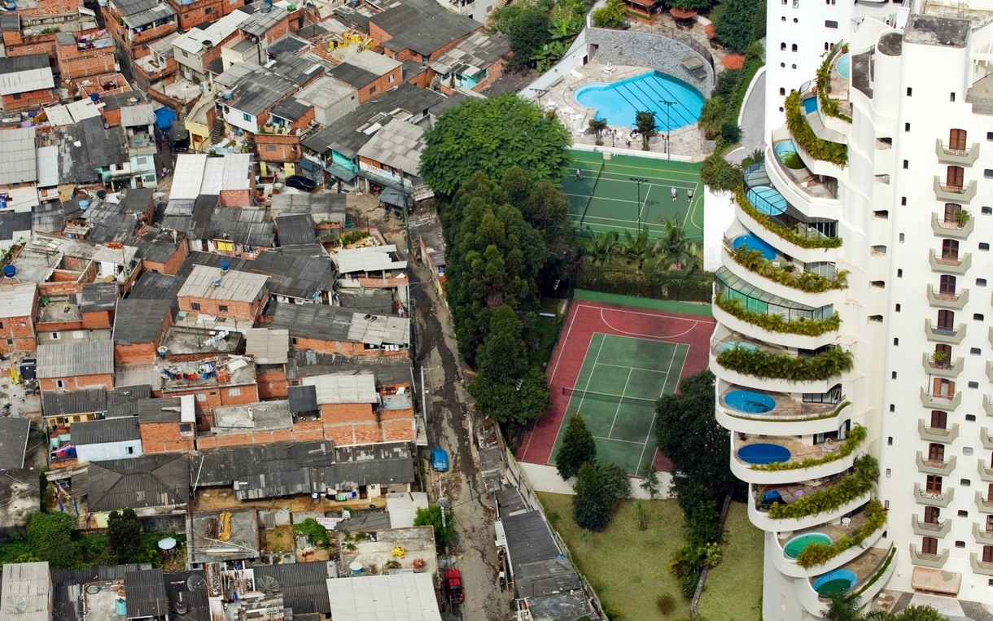
Does income inequality reduce the quality of life in the post great-recession era?
Eric Lin
University of Nevada, Reno
Notes:
Good morning everyone. My name is Eric Lin and I’m a graduate student at UNR. Thank you for joining me this morning so that I may share my current research with you.
With media and political discourse stressing and responding to the disparity in income across the globe, income inequality is once again a hot topic. While early prior research supported the conventionally held view that income inequality results in many negative effects, more recent research has found a null or positive relationship by including an essential control, GDP PPP per capita, and utilizing multilevel modeling. Note the disparity in this background image of this community outside of SP, with a favela right next to an upperclass residential area.

Slide 2
Theoretical framework
Kuznets’ Inverted U
Social Comparison Theory
  Status-Anxiety Hypothesis
Hope Factor
Notes:
U: Development increases inequality:
-poor w/ few elite, equality is universal, equality of poverty.
-then development begins, with a few gaining the opportunity, skills, and capital to move into modern agriculture/trade,
-farming mechanizes: More skills
-increases poor income (social programs)/higher return for edu
Social Comparison Theory:
-objective standards are used in stable, well-defined settings….(education, occupation, standard of living)
-Reference groups play larger role in self-evaluations in rapidly changing , unstable conditions (Festinger)
-Status anxiety theory: (greater inequality=lower happy) people usually make upward comparisons=status anxiety=stress=unhappy
-HF: success of rich=opportunity
-legitimate v illegitimate sources of inequality

Slide 3
Data
World Values Study-Wave 6: 2010-2014
European Values Study-Wave 4: 2008-2010
86 countries & about 150,000 individuals
Gini & GDP PPP per capita
  World Bank, UNHDR, and CIA Factbook
Income, not wealth
Notes:
-integrated dataset
-representative samples: stratified multistage random sampling/quota
-developed v undeveloped (illiterate/inaccessible areas) undersampled
-Sample size varies by model

Slide 4
Methods
Multilevel Regression
  2 levels
  Models estimated using GLS
  Control variables at both the national and individual levels
Notes:
-More precise standard errors due to considering that people in a country are more similar to each other
General least squares

Slide 5
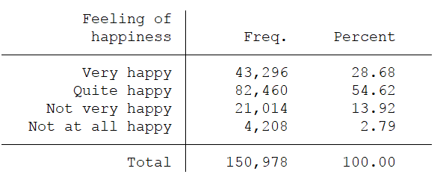
Taking all things together, would you say you are:
Notes:
Mean 73.11
Reverse coded

Slide 6
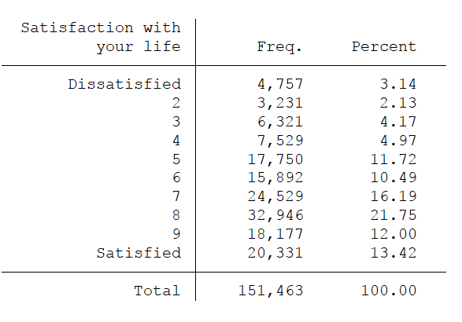
All things considered, how satisfied are you with your life as a whole these days?
Notes:
Mean=65.7

Slide 7
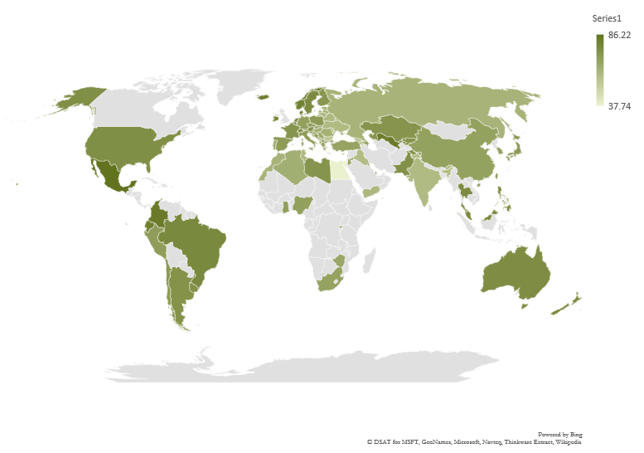
Subjective Well-Being
Notes:
Mean 69.3
Cor: .4996

Slide 8
CAUSES…
NATIONAL LEVEL
Inequality (Gini)
Income Return to Education & Skills
GDP PPP Per Capita
MODERATORS & CONTROLS…
CONTROLS…
Economic Management Trust
Well-being
Age
Sex
Married
Education
Income
Formerly Married
Religious Attendance
INDIVIDUAL LEVEL
Notes:
Conceptual model

Slide 9
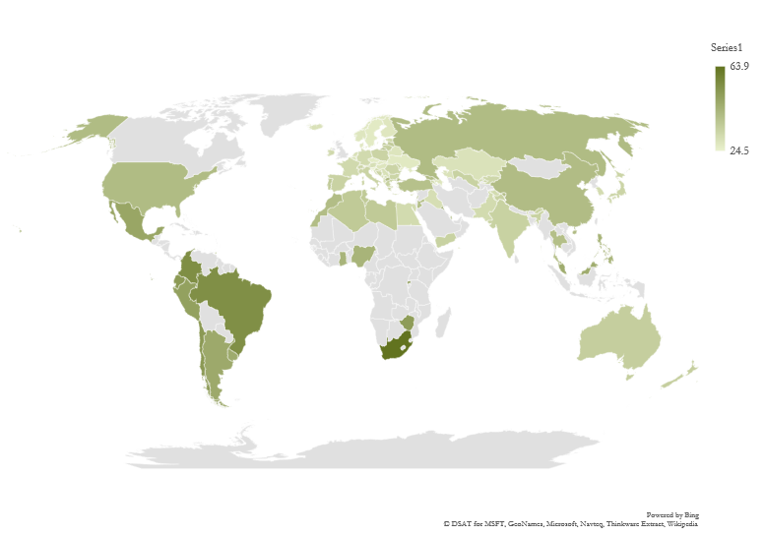
Gini
Notes:
Low .3s
US .4 , mid/upper 20s Scandinavian,
2005-2010 AVG

Slide 10
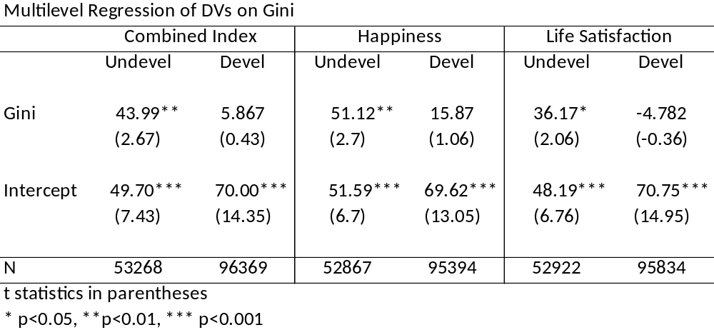
Model 1 + Dvs
Notes:
.30 GDP USA
.4996 correlation

Slide 11
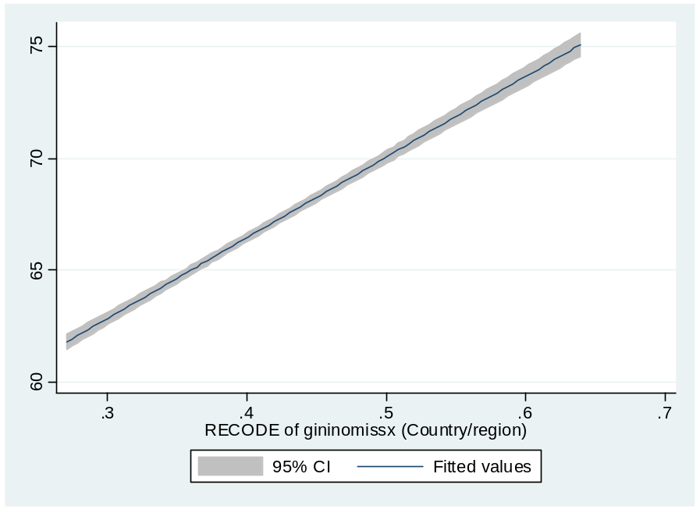
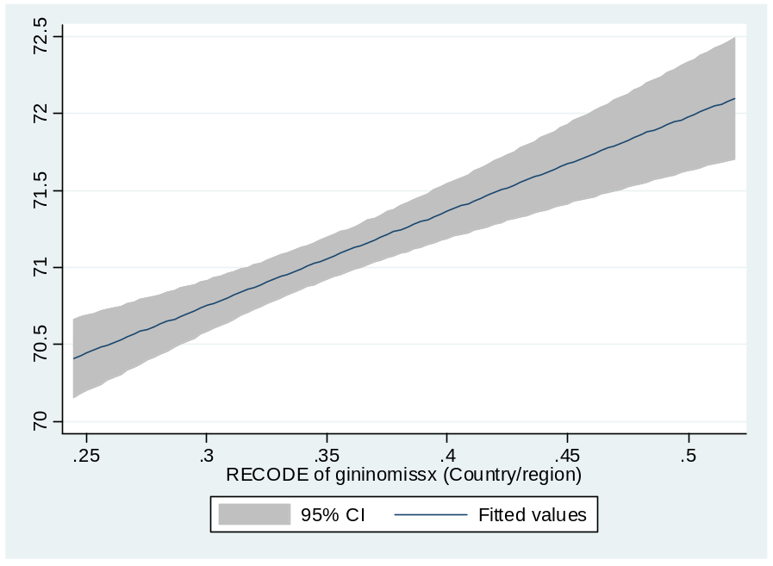
Bivariate SWB & Gini fit
Developing
Developed

Slide 12
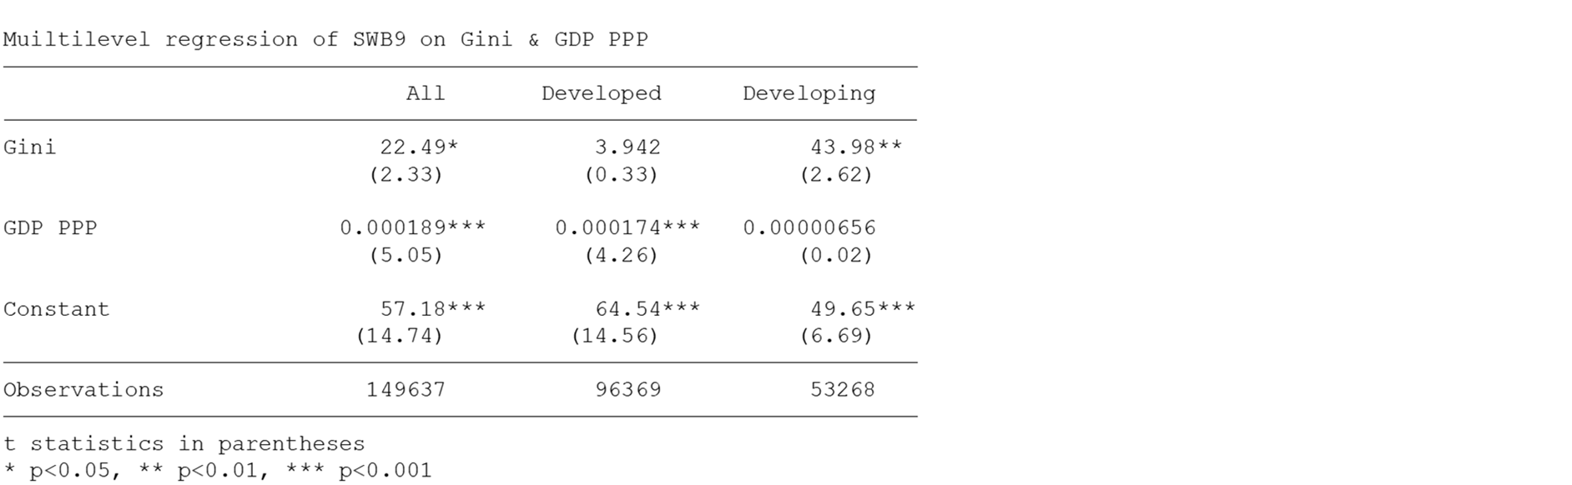
Model 2: Gini & GDp
Notes:
-Development may be easier to notice in developed countries

Slide 13
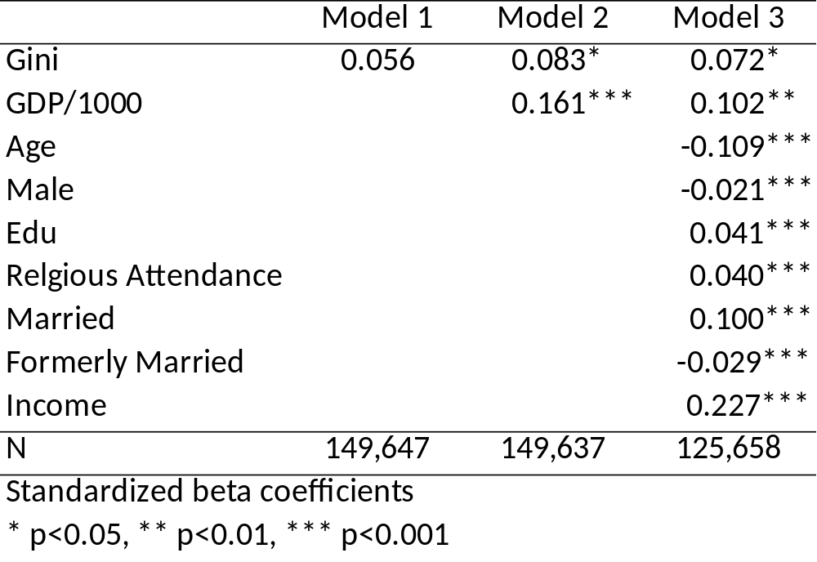
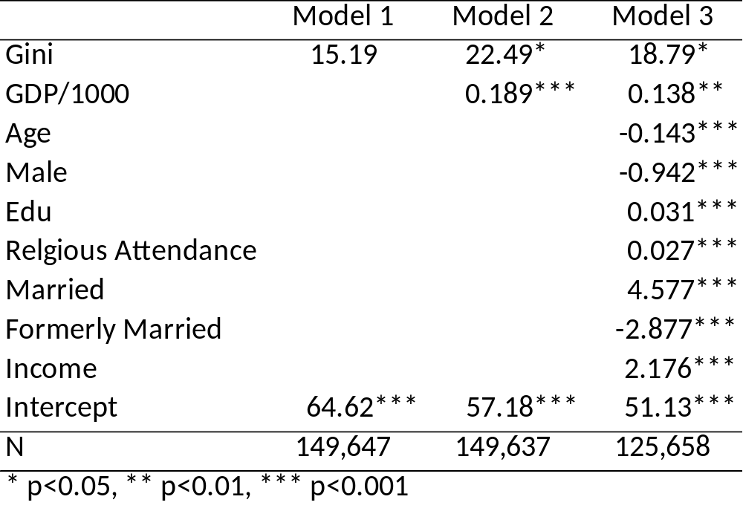
Metric & standardized

Slide 14
summary
Significant positive relationship across all nations combined, when proper controls are introduced
Significant positive relationship for developing nations only, using multiple DV models

Slide 15
discussion
Negative relationship is not observed
Most recent literature is supported
Individualistic v Collectivistic?
  Social Anxiety?
Health Control
Feeling of Closeness

Slide 16
i
Thank you!
Eric Lin
elin237@nevada.unr.edu

