Slide 1
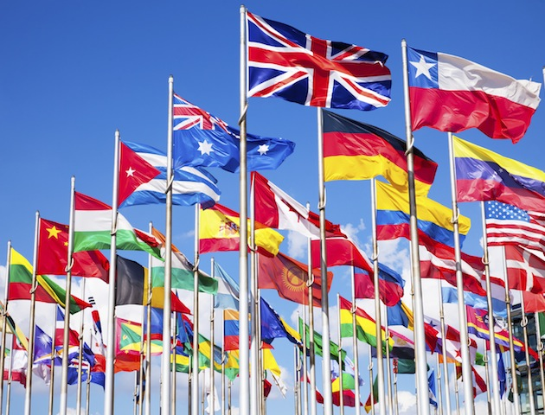
National Pride:
An International Perspective
Ian Scot Nesbitt
University of Nevada
Notes:
Hello and thank you all for being here.
My name is Ian Nesbitt, I’m a masters student at the U of Nevada
And today I’ll be presenting my project, national pride: an international perspective.

Slide 2
Overview
Background
Data
Descriptive Statistics
Methods
Results
Highlights
Notes:
Before beginning, here’s a quick over view of the presentation.
Ill give you a little bit of background on the topic,
I’ll talk about the data,
We’ll look at some descriptive statistics,
I’ll explain my methods,
And then we’ll take a look at the results before finishing with a quick recap of highlights.

Slide 3
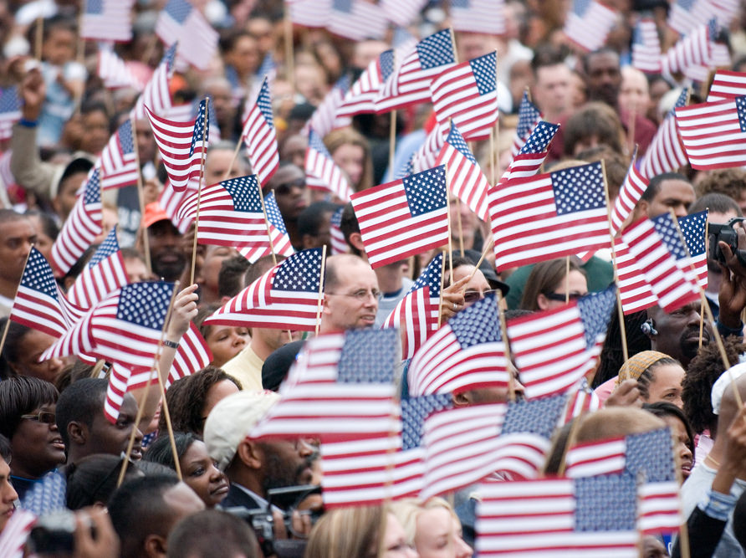
Notes:
There is new urgency to studying national pride given recent political events such as Donald Trump’s unexpected rise to the presidency…

Slide 4
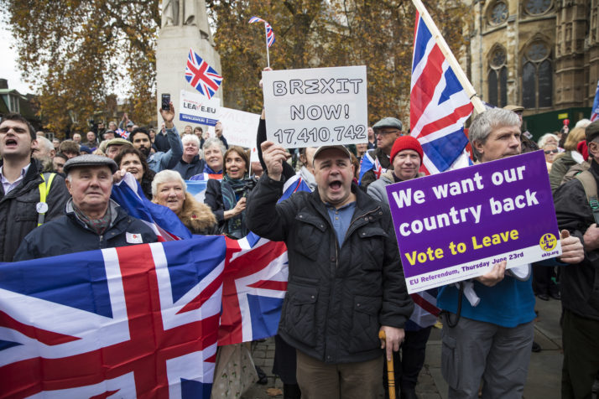
Notes:
…EU departures like Brexit (with others suggested like Frexit)…

Slide 5
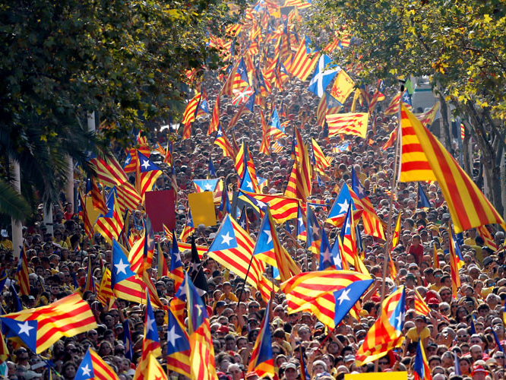
Notes:
…and cries for independence in Catalonia.

Slide 6
Theory
Notes:
These current events contrast a great deal of classical and contemporary modernization theory that suggest that national sentiment and indeed nations themselves should basically disappear over time.
Reference 1: Urry (2000) Mobile Sociology

Slide 7
Central Question
What predicts pride in the nation?
    Individual-level effects?
    Country-level effects?
Notes:
Given that national boundaries still appear to be salient in the era of globalization, I propose the following question: Which individual-level and country-level characteristics predict national pride?

Slide 8
Data
International Social Survey Program
  http://www.issp.org
Representative samples from 34 countries
Total sample size is 45,297 people
Notes:
To address this question, I have used the 2013 wave of the national identity survey from the International social survey program, an international consortium of mostly academic survey research organizations.
The data includes a representative sample of 34 countries, across 4 continents.
The total sample size is 45,297 people, average of 1,332 per country

Slide 9
Dependent Variable
Single item with four answer choices
“How proud are you of being [Country Nationality]?
Answer Choice | Score | %
Very proud | 100 | 43%
Somewhat proud | 67 | 39%
Not very proud | 33 | 9%
Not proud at all | 0 | 2%
I am not [Country Nationality] | --- | 2.41%
Can't choose | --- | 2.86%
No answer | --- | 0.67%
Notes:
My primary dependent variable in this study is a survey response to the question, “how proud are you of being American?”, for example.
Respondents selected one of four choices from not proud at all to very proud. These scores were recoded from 1-4 to a scale from 0 to 100. This makes interpreting the metric regression coefficients much easier.
This study uses “Complete case analysis,” but further analyses might include an imputational approach to missing data.

Slide 10
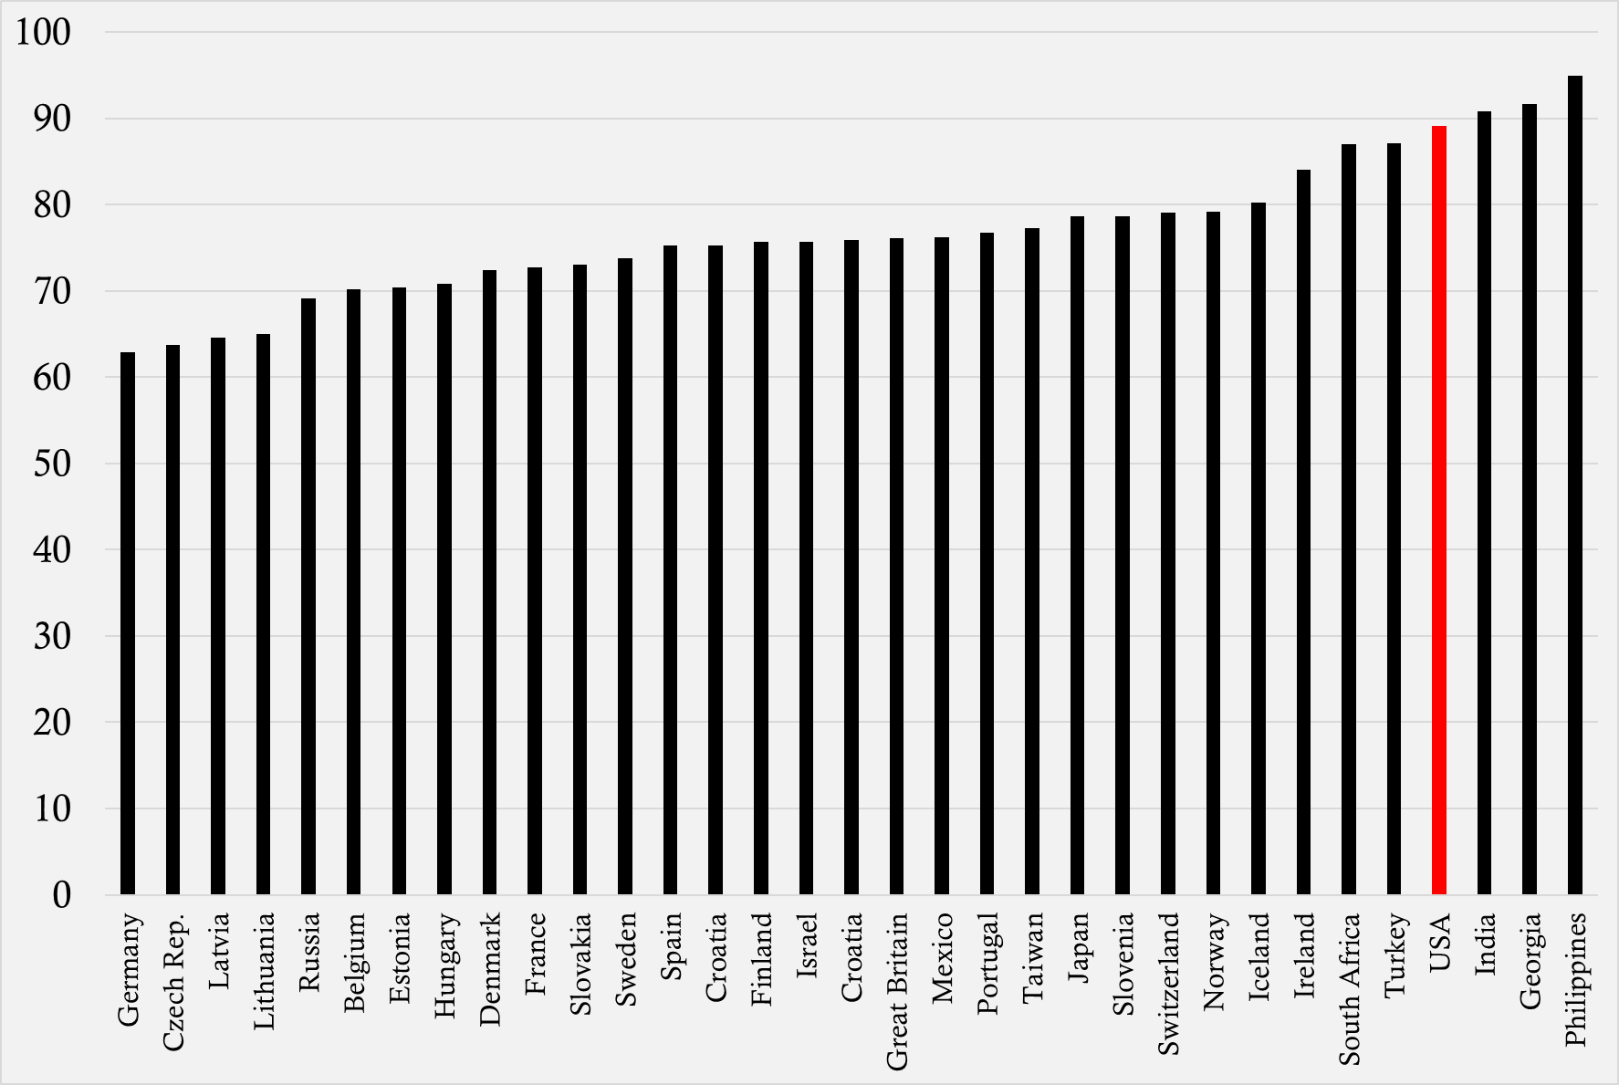
Bar Chart of Pride Means
Notes:
Before any formal analyses were performed, means of national pride were examined.
This graph shows that means range from ~63 to ~95 with Germany occupying the lowest spot and the Philippines occupying the top spot.
The USA is highlighted in red. There is a lot of national pride, but Americans are not the most proud.

Slide 11
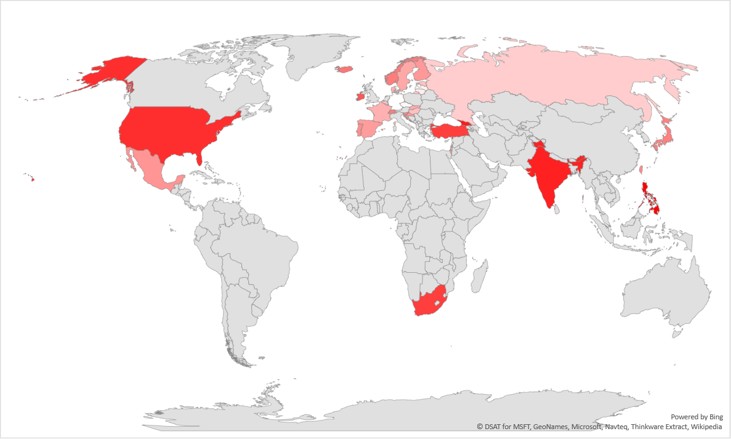
Map of Pride Means
Notes:
Here is a gradient map of national pride means. As you can see, a number of countries are bright red due to their high scores

Slide 12
Methods
Multilevel regression modeling
  Two levels
“xtreg” procedure in STATA 14
Notes:
To analyze this data, I used a standard 2-level multilevel model based on General least squares regression.
The levels in my study are people and countries.
This technique provides more accurate estimates of SEs because it accounts for non-independence of observations caused by participants being from different countries.
I used the xtreg function in STATA 14 for these analyses.

Slide 13
Results
Notes:
So, lets take a look at the results!

Slide 14
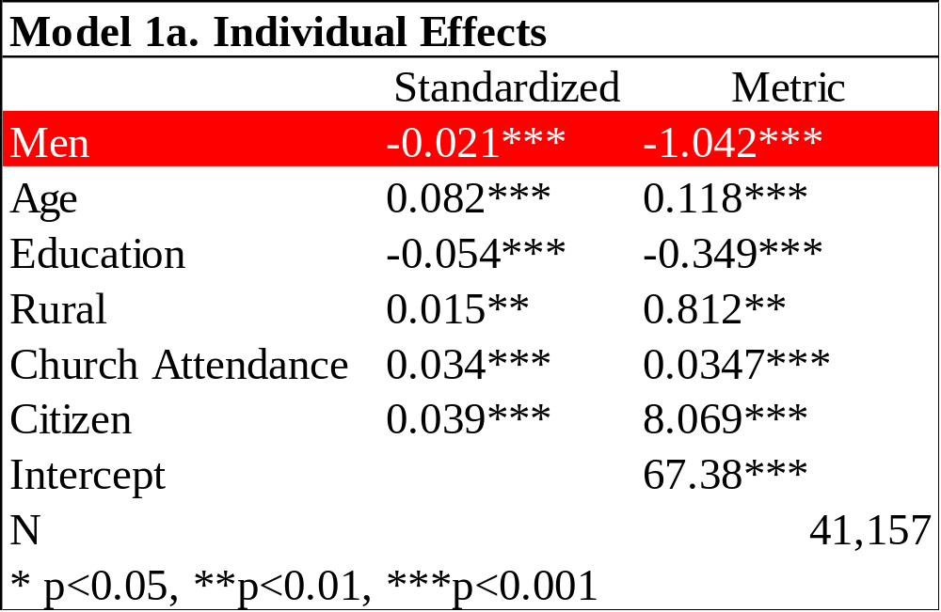
Notes:
Here is my first model, that includes only individual level characteristics.
Past research has argued that gender effects on national pride should be weak, but also that patriotism is a masculine construct. For these reasons I hypothesized that men would be more proud of their nation, but results do not support this. Women are marginally more proud, though effects are very small.
References:
Nagel (1998)
Moghadam (1995)
Massad (1995)

Slide 15
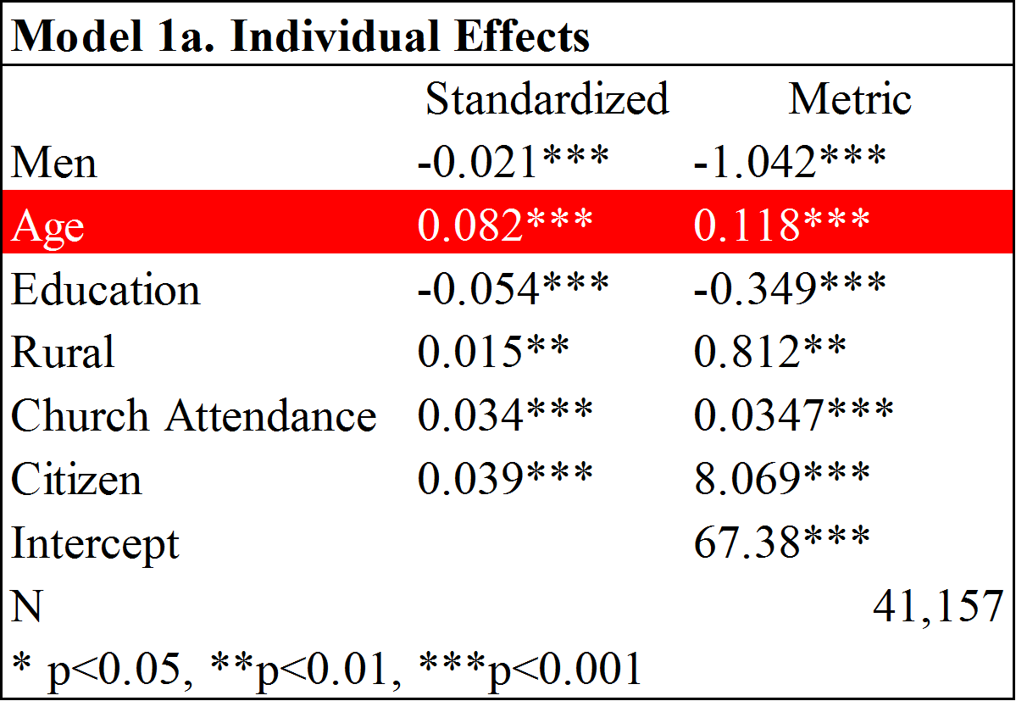
Notes:
I hypothesized that older people who were born in less globalized times would be more proud of their nation, and results support this hypothesis.
References:
Abramson and Inglehart (1992)
Pew Research (2013)

Slide 16
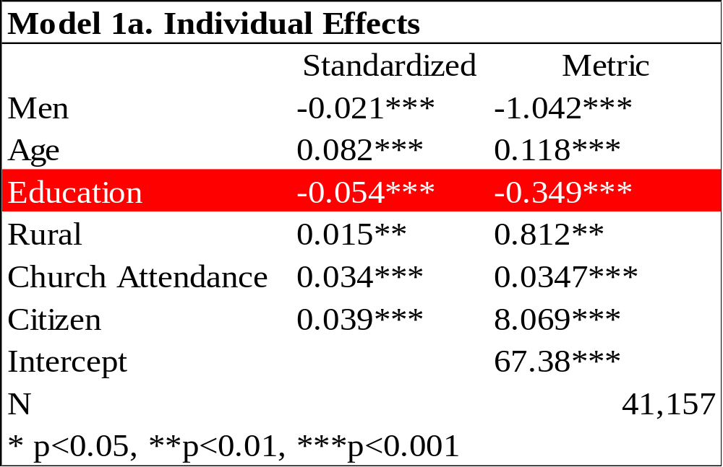
Notes:
Education has been shown to attenuate a number of attitudes including ethnic-exclusion, xenophobia and nationalism, and my results are consistent with past findings. It appears that highly educated people have less pride in their nation.
Smith and Kim (2006)
Coenders and Sheepers (2003)

Slide 17
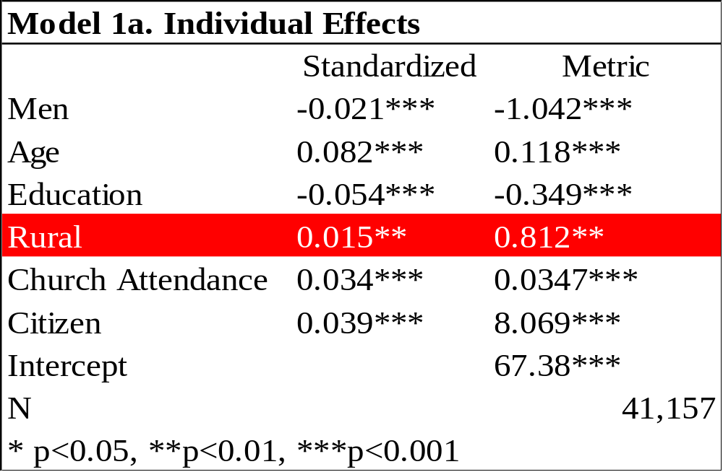
Notes:
Living rurally has been demonstrated to influence a number of values. It’s links to tradition and conservatism lead me think that it would predict higher national pride, but results are only correct in terms of direction given the effect size.
England, Gibbons and Johnson (1979)
Bell Lloyd and Vatovec (2010) (READ IT)

Slide 18
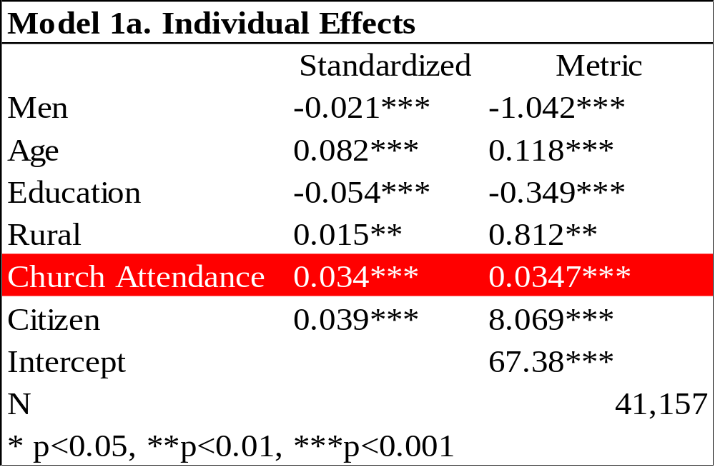
Notes:
Religion pervades many aspects of life, and has been shown to associate positively with national sentiment. I hypothesized that church attendance, a proxy for religiosity, would predict national pride and this was the case.
References:
Brubaker (2011)
Backhouse (2017)

Slide 19
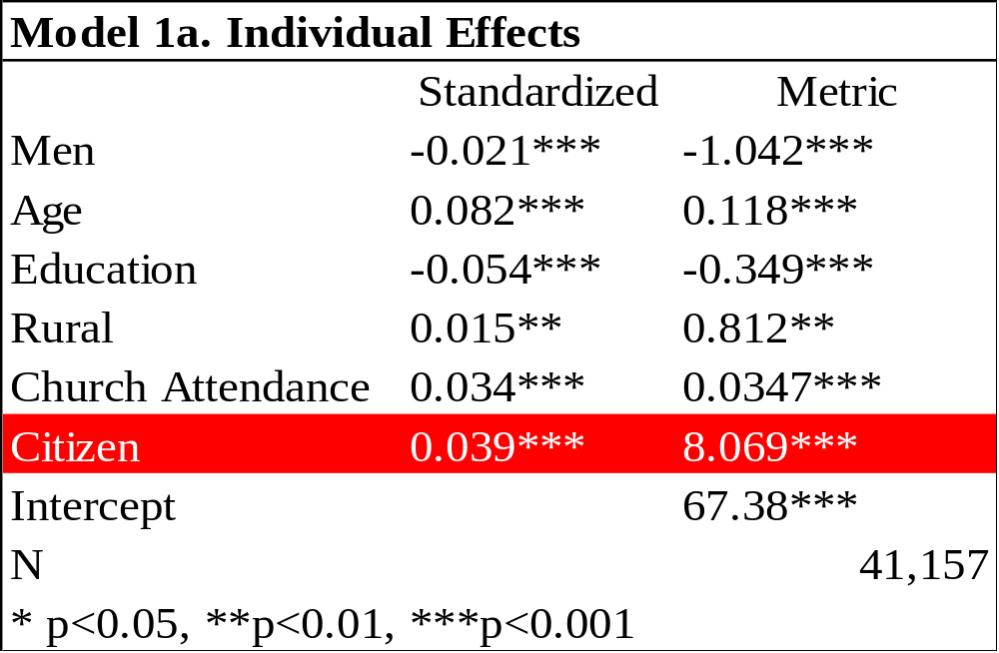
Notes:
Researchers have connected feelings toward one’s country with a number of in-group statuses. Because of this I hypothesized that formal recognition as a member of the nation via citizenship would predict greater national pride and results show that this was the case.
References:
Druckman (1994)

Slide 20
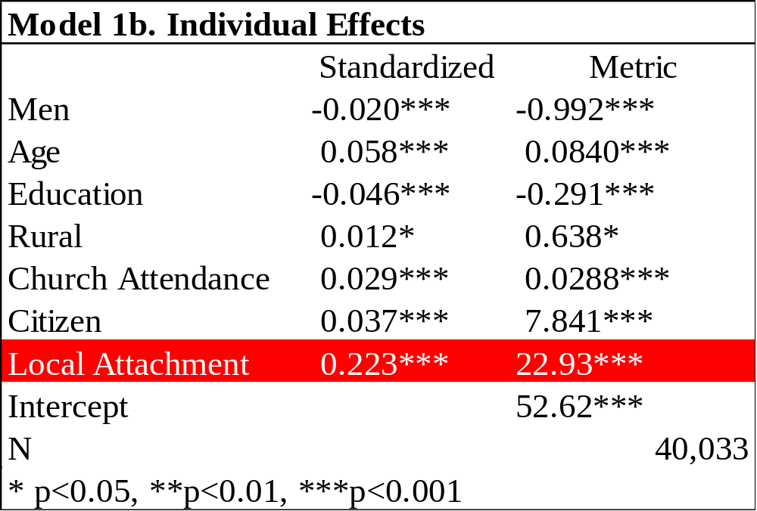
Notes:
Here I adjust model 1a to include another variable, “local attachment.”
During my research, I encountered a paper that talked all about the understudied idea of pride in one’s city. I decided to play around with the idea and create a scale based on it because the data included a number of place attachment items, two of which were locally oriented. They read:
How close do you feel to your: “city/town”, “county”
And the Cronbach’s alpha for the scales was .76, which is acceptable for two item scales,
As you can see the variable is a very strong predictor of national pride. I am not sure why, but there could be an underlying construct regarding positive feelings to one’s “territories,” if you will. Because I have yet to distinguish this idea from pride in one’s nation, this variable is not included in further models.
References:
Morrison, P.S. (2016)

Slide 21
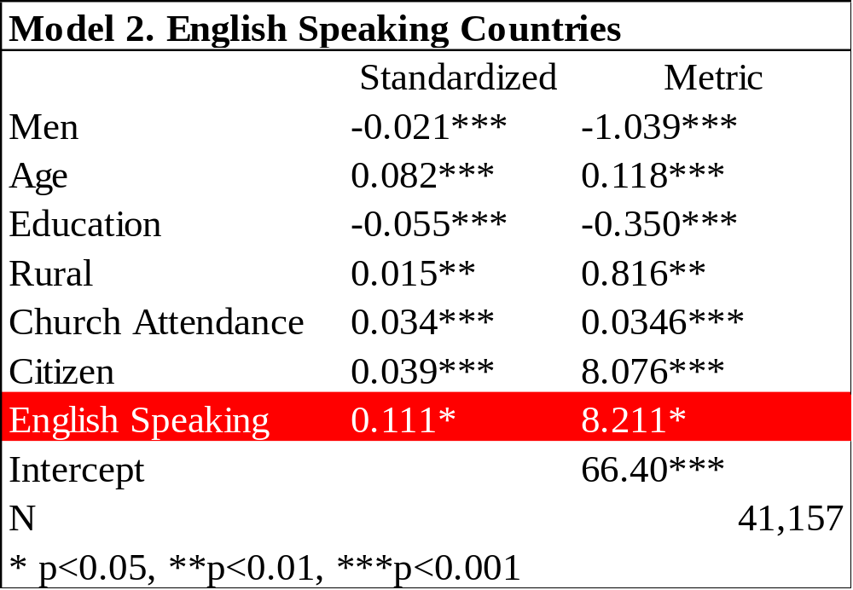
Notes:
Moving into the models with country-level effects, I first examine English speaking countries which are known for their long traditions of individualism and national exceptionalism.
I hypothesized that this group would be higher in national pride than non-English speaking countries, and model 2 shows that this is the case.
USA, Britain, Ireland, South Africa.

Slide 22
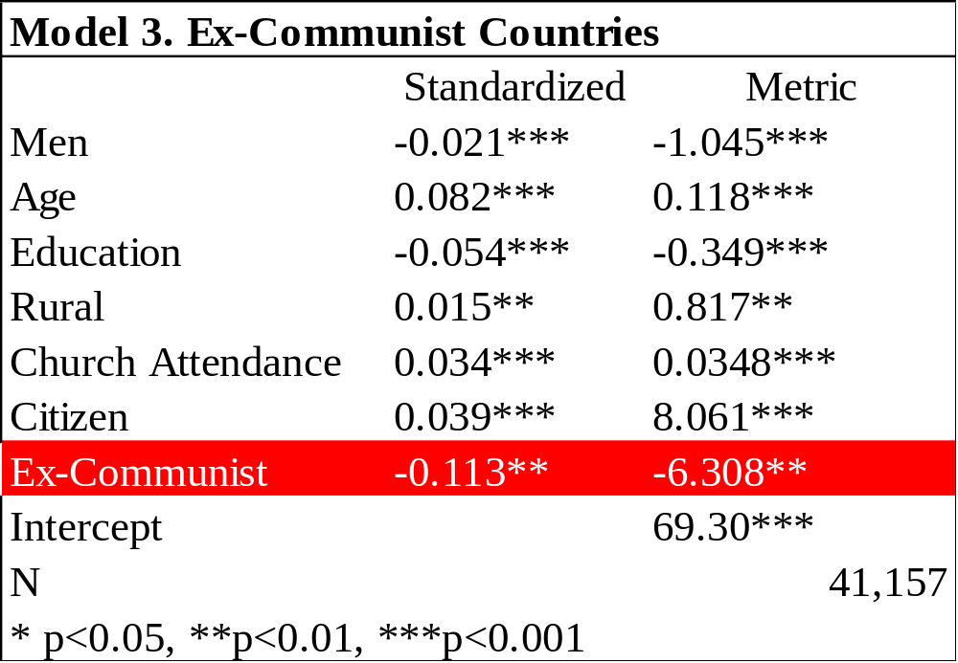
Notes:
In model three I examine the contextual effect of a communist history.
Ex-Communist countries were expected to be less proud of their country because of their histories of political corruption and poor economic performance through the cold war, and based on my analyses, this could be the case.
Indeed, people in ex-communist countries are LESS proud than other people.

Slide 23
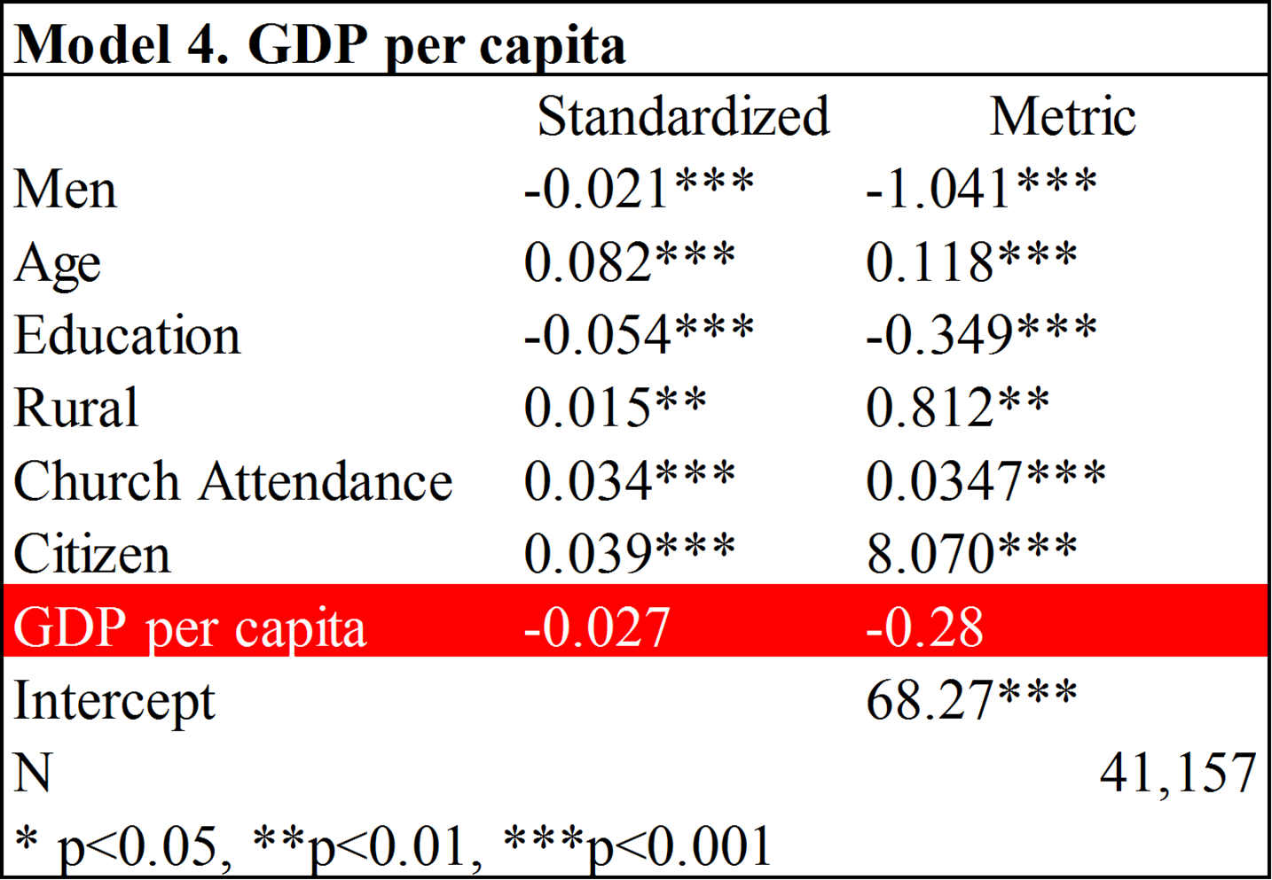
Notes:
A large body of scholarship argues that as economic development increases, values become less materialistic. Given that nations are often regarded for their role in economic activity, I hypothesized that GDP per capita would predict lower national pride, but model 4 shows that it is not a significant predictor! This null effect means that people in poor countries are no less proud than people in rich ones.
This finding is especially interesting given that so much of the discourse about a national success relates to its level of wealth and economic performance.
Inglehart, R., (1977)

Slide 24
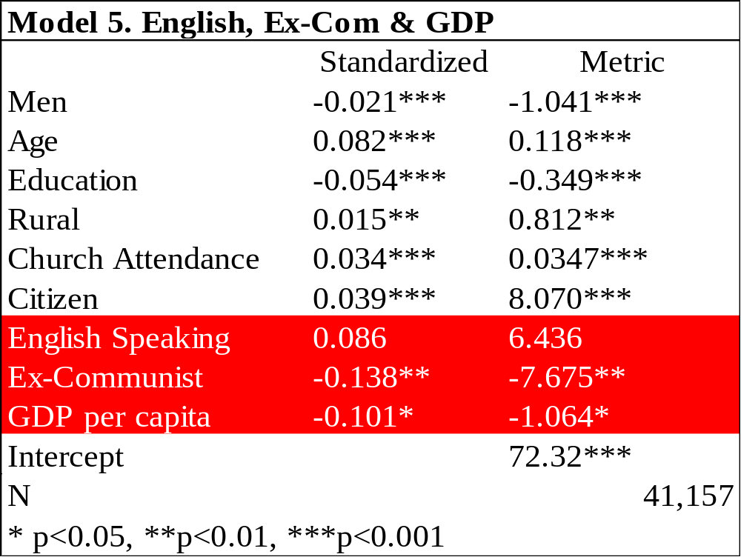
Notes:
In my final model, I incorporate all three contextual effects. Results show that English-speaking status is no longer a significant predictor, but GDP emerges significant and ex-communist status remains so. This result suggests that Ex-communists are not less proud because of their current economic conditions, but that English speaking countries might be more proud because of it.

Slide 25
Highlights of Results
Gender
Ex-Communist
GDP per capita
Place Closeness
Notes:
A number of interesting findings emerged from this study.
I thought men would be more proud of their country, but it is actually the women of the world who are slightly more inclined to rally around their nation.
It is also clear that ex-communist countries are less proud than other countries. Perhaps the poor economic and political legacy of communism is the reason why, But the second most proud nation in the sample, Georgia, is a mystery!
GDP is not a significant predictor in some models and isn’t a terribly strong predictor in others. Money might not be everything after all.
Finally, Local attachment emerged as a very strong predictor, but I am still trying to explain why attachment to one’s city and county predicts pride in the nation.

Slide 26
Discussion
Notes:
In summary, I have tried to answer the question: what predicts national pride? I have shown that there are a number of individual level effects and country level effects. I have also shown that there MIGHT be a relationship between local attachment and national pride.
My work will soon be expanding to include several dimensions of pride. These variables will be important for better evaluation of why, for example, Ex-communist countries are less proud…is it economics? Maybe it’s democracy. I can’t wait to share my findings with you this May in Denver, Colorado, so stay tuned and…
NEXT SLIDE

Slide 27
Thank You!
Ian Scot Nesbitt
inesbitt@nevada.unr.edu
Notes:
..thank you for listening. Feel free to contact me via email anytime.

