Slide 1

If Populism is the Rage, Is Polling in Trouble?
Description of 2016 Election Night perfect storm and the damage done to the credibility of polling. What are the long-term consequences as American and Western politics turn toward populism?
Annual Conference
Pacific Chapter of American Association
for Public Opinion Research
Professor Floyd Ciruli
Crossley Center for Public Opinion Research
Josef Korbel School of International Studies
University of Denver
December 2016
Floyd Ciruli 777 Grant St., Ste 303, Denver, CO 80203 PH (303) 399-3173 FAX (303) 399-3147 www.ciruli.com

Slide 2
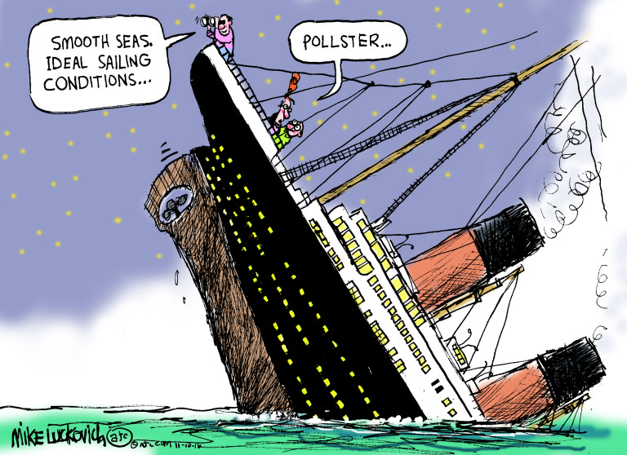
Close Election: Massive Change
Topics
Populism
Election night
Polls, forecasts and commentary
Colorado swing state
Observations, recommendations
Mike Luckovich, Atlanta Journal Constitution, 11-9-16

Slide 3
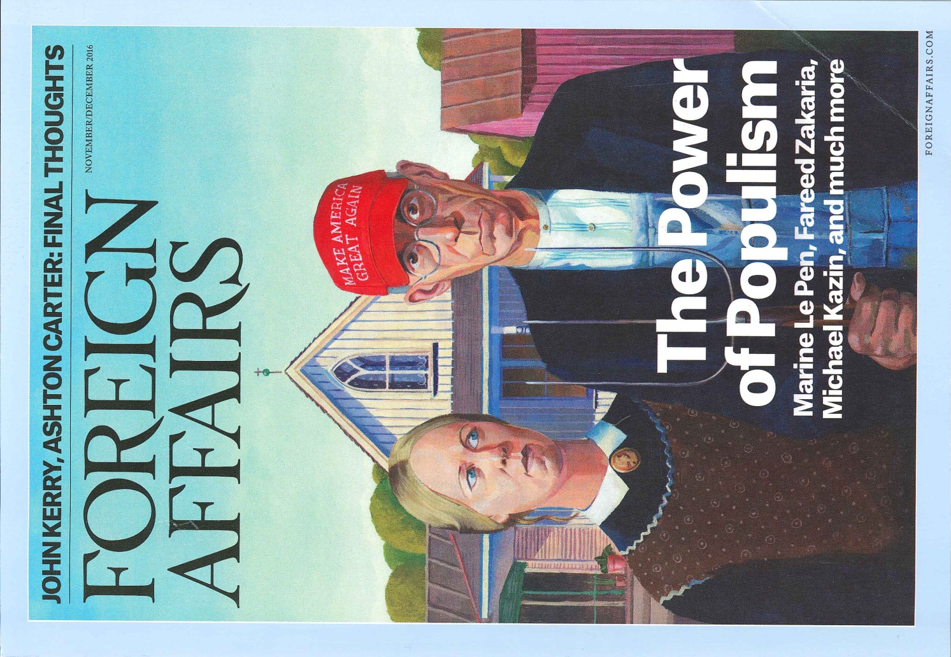
Populism – Ordinary citizens’ interests harmed by elites and their politics and institutions. Popular will represented by a strong leader.
Europe and U.S.: fall of USSR, 2008-09 economic crisis, massive migration, demographic change, tensions among religious, race, ethnic groups, terrorism

Slide 4
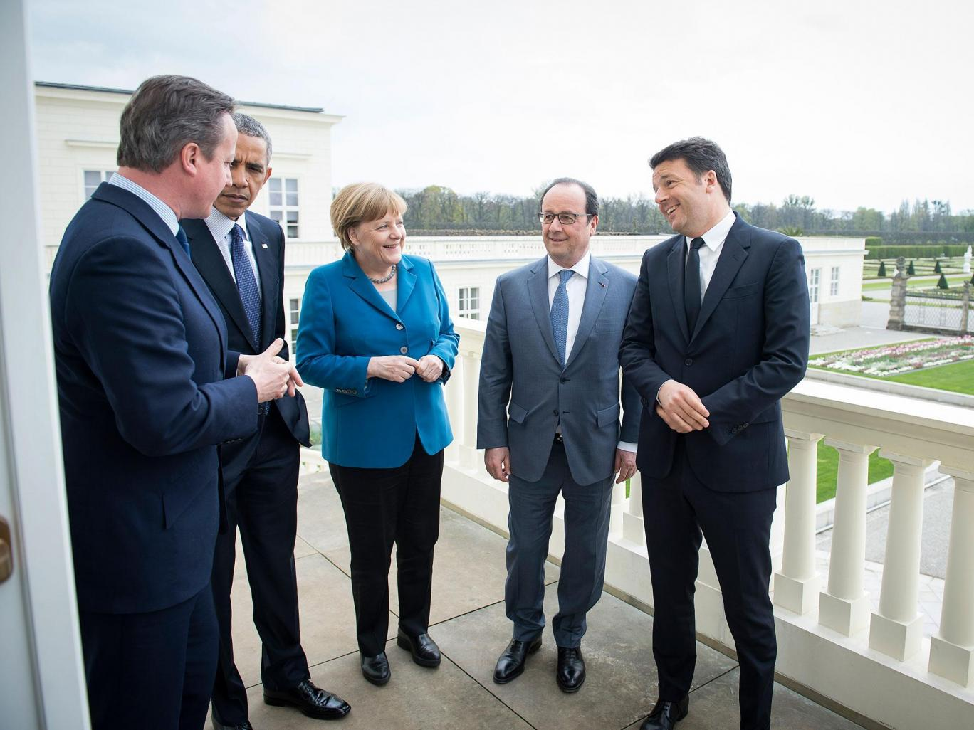
Populism in Europe
Brexit – 52%
Austrian Freedom Party – 35%
Italy 5 Star – 30%
France National Front – 23%
Alternative for Germany – 16%
World leaders (L to R) former British Prime Minister David Cameron, outgoing President Barack Obama, German Chancellor Angela Merkel, French President Francois Hollande, and Italy’s newly resigned Prime Minister Matteo Renzi, at the G5 summit in Hanover, April 2016
Photo: Getty Images

Slide 5
Illiberal Democracy
Illiberal Democracy: Election takes place, but lack of independent information and competition. Other elements missing or threatened. Rule of law, pluralism, separation of powers, freedom of speech, assembly, religion, property, transfer of power, independent judiciary, free press
— Fareed Zakaria, 1997
Illiberal Democracy (human rights)
Sisi, Egypt
Erdoğan, Turkey
Putin, Russia
Moduro, Venezuela
Duterte, Philippines
Xi, Hong Kong
ESOMAR and WAPOR call on Russian Justice Minister to rescind decision declaring Yuri Levada Center a foreign agent, Oct. 3, 2016

Slide 6
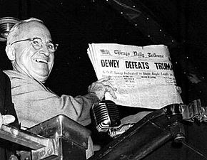
Spectacular Start, Huge Miss
1936 | George Gallup, Elmo Roper and Archibald Crossley each conducted media-sponsored newspaper polling in the 1936 presidential election. Crossley worked with Hearst Newspapers; Roper with Fortune. They correctly predicted Roosevelt would win the 1936 presidential election. The most famous poll of the time (Literary Digest poll) had Alfred Landon the winner.
1947 | Crossley with colleagues starts American Association of Public Opinion Research (AAPOR) to examine survey methodology and develop professional standards for published polls. Crossley chairs a committee on practice for minimum disclosure of public polls. The beginnings of including size of sample, dates conducted and other relevant information.
1948 | Dewey’s “victory.” Gallup, Crossley and Roper polls missed the 1948 presidential winner, Harry Truman. Professional issues of methodology, ethics and disclosure become more salient.
President Truman holds the infamous Chicago Tribune issue telling the press: “That ain’t the way I heard it!”
Brexit 2016
Colombia 2016
British General Election 2015
Greek Referendum 2015
Israel General Election 2015
Crossley Center 2016
Ciruli Associates 2013

Slide 7
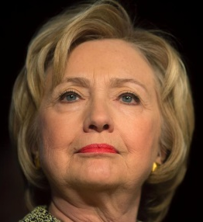
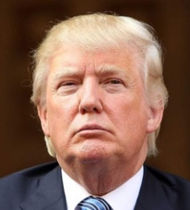
“Donald Trump wins the presidency. The business tycoon and TV personality, capping his improbably political journey with an astounding upset victory,” Blitzer said. “Donald J. Trump will become the 45th President of the United States, defeating Hillary Clinton in a campaign unlike anything we’ve seen in our lifetime.”
— CNN, Call the Race, Wolf Blitzer, 3:12 am, 11-9-16
Aggregators - November 7, 2016
 | 538 | Huffington Post | RealClearPolitics
Clinton | 49% | 48% | 47%
Trump | 45 | 42 | 44
Difference | 4 | 6 | 3
Results – December 10, 2016
 | Electoral Vote | Popular Vote
Trump | 306 | 46%
Clinton | 232 | 48%
Forecasts - November 7, 2016
 | NYT Upshot | 538 | Princeton | Cook | Sabato
National | Clinton 84% | Clinton 72% | Clinton 99% | Lean Dem | Likely Dem
Colorado | 88% Dem | 78% Dem | 99% Dem | Lean Dem | Likely Dem

Slide 8
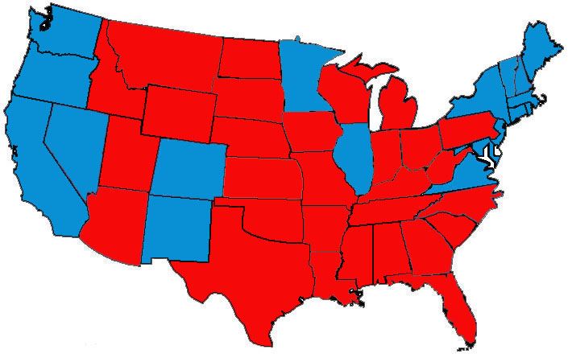
Battleground States
Clinton vs. Trump Final Polls and Results
November 7 & 27, 2016
Iowa
Trump
+3 (9)
Wisconsin
Clinton
+6 (T .7)
538 – 302
RCP – 272
No toss-up
Michigan
Clinton
+3 (T .2)
Ohio
Trump
+3 (8)
Nevada
Trump
+1 (2)
New Hampshire
Trump
+1 (.4)
Pennsylvania
Clinton
+2 (T .7)
Colorado
Clinton
+3 (5)
Virginia
Clinton
+5 (5)
Arizona
Trump
+4 (4)
North Carolina
Trump
+1 (4)
Georgia
Trump
+5 (5)
Florida
Trump
+1 (1)
Red = Republican
Blue = Democrat
Gray = Not called yet

Slide 9
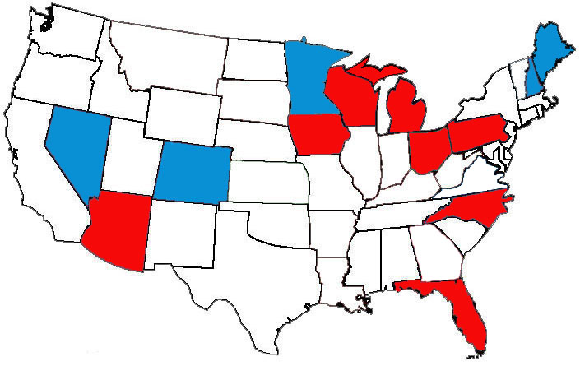
Final Result
Two Elections – 13 Swing States and the Rest
December 10, 2016
 | Clinton | Trump | Other
13 swing | 21.4 M | 22.2 M | 2.3 M
Non-swing | 44.3 M | 40.7 M | 5.3 M
Total | 65.7 M | 62.9 M | 7.6 M
Pennsylvania | Wisconsin | Michigan | Total
45,000 | 23,000 | 11,000 | 79,000
Cook Report 2016

Slide 10
2016 Presidential Election
Final Results and Polls
Results
 | Clinton | Trump | Percent Margin | Poll Margins | Difference Results/Polls
Arizona | 45.1 | 48.7 | Trump 3.5 | Trump 4.0 | 0.5
Colorado | 48.2 | 43.3 | Clinton 4.9 | Clinton 3.0 | 1.9
Florida | 47.8% | 49.0% | Trump 1.2 | Trump 0.2 | 1.0
Iowa | 41.7 | 51.1 | Trump 9.4 | Trump 3.0 | 6.4
Michigan | 47.3 | 47.5 | Trump 0.2 | Clinton 3.6 | 3.4
Nevada | 47.9 | 45.5 | Clinton 2.4 | Trump 0.8 | 1.6
New Hampshire | 46.8 | 46.5 | Clinton 0.4 | Trump 0.2 | 0.2
North Carolina | 46.2 | 49.8 | Trump 3.7 | Trump 2.7 | 1.0
Ohio | 43.6 | 51.7 | Trump 8.1 | Trump 3.5 | 4.6
Pennsylvania | 47.9 | 48.6 | Trump 0.7 | Clinton 2.1 | 1.4
Wisconsin | 46.4 | 47.2 | Trump 0.7 | Clinton 6.5 | 5.8
 |  |  | 1.6 | 2.7 | 2.5

Slide 11
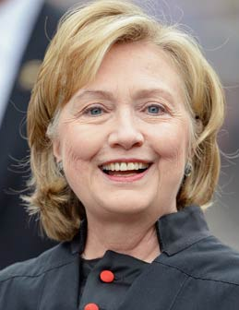
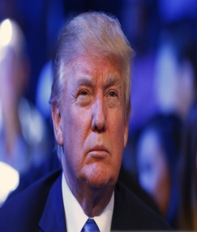
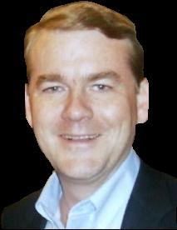
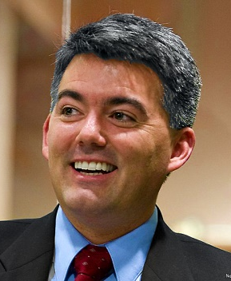
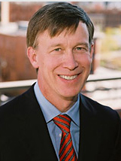
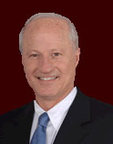
Is Colorado a Swing State?
Closer the National Race, More Important is Colorado
Margin of Victory
Democratic Win
Republican Win
+10 +5 +5 +10
Dole
1996
2%
Hillary Clinton
Bush
2000
8%
Donald Trump
Obama
2008
9%
Bush
2004
5%
Michael Bennet
Obama
2012
5%
Cory Gardner
Clinton
2016
3%
John Hickenlooper
Mike Coffman

Slide 12
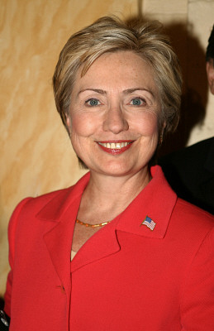
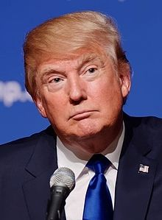
Change Election
Highly Volatile, Very Negative
Favorability/Trust Ratings of Hillary Clinton and Donald Trump
Hillary Clinton
Donald Trump
Exit Poll 2016
Exit Poll: 4 in 10 desire change. Favored Trump 83%. More than half cast ballots for both candidates with reservations.

Slide 13
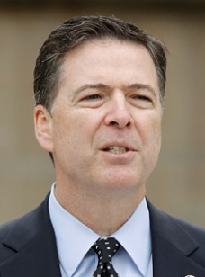
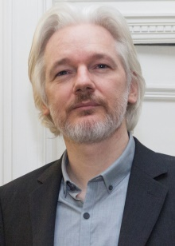
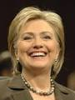
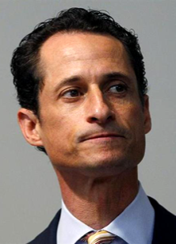
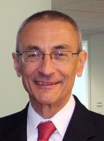
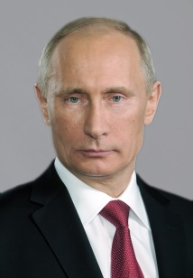
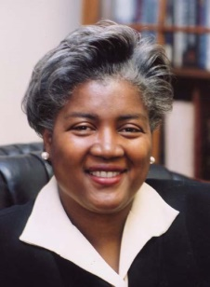
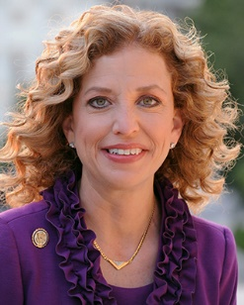
Comey and the E-mails
Toss in WikiLeaks
October/November Surprise
July 5 – Announces “extremely careless”
Oct. 28 – Announces further investigation
Nov. 6 – Announces end of review, no further action
Exit Poll: – 63% bothered a lot, some; 70% voted for Trump; late decision: 60% Trump, 35% Clinton
FBI Director
James Comey
WikiLeaks
Founder
Julian Assange
Oct. 8 – FSB/KGB – Administration accuses Russia of hacking
Nov. 2 – 25 – Release of e-mail from John Podesta, Clinton campaign chair (42,000)
Hillary Clinton
Anthony Weiner
John Podesta
Vladimir Putin
Donna Brazile
Debbie Wasserman Schultz

Slide 14
Democrats’ Challenge With White Working Class
He’s for Jobs, Not Really a Republican, An Outsider
U.S. Colorado
Pueblo, Colorado:
Trump – 45.9%
Clinton – 45.8%
“This goes directly to the Democratic Party’s problem and Hillary Clinton’s problem,” said Floyd Ciruli, a prominent Colorado political consultant. “They are losing the white working class and Pueblo is the cutting edge of it.”
— John Frank, Denver Post,
11-12-16
Gardner lost by 309 votes
Tipton won by 12 points
Bennet won by 10 points

Slide 15
Ad-Hoc Committee on 2016 Election Polling
AAPOR’s Council met today and it strongly reaffirms its commitment to examine the performance of the polls in the 2016 election through its Ad‐Hoc Committee on 2016 Election Polling. The committee draws together prominent academics, election pollsters as well as authorities on public opinion who are not directly involved in political polling.
Chair: Courtney Kennedy (Pew Research Center)
Chris Wlezien (University of Texas)
Kristen Olson (University of Nebraska-Lincoln)
Scott Clement (Washington Post)
Claire Durand (University of Montreal)
Lee Miringoff (Marist College)
Doug Rivers (Stanford, YouGov)
Mark Blumenthal (SurveyMonkey)
Kyley McGeeney (PSB)
Josh Clinton (Vanderbilt)
Evans Witt (PSRAI)
Charles Franklin (Marquette University)
Lydia Saad (Gallup)

Slide 16
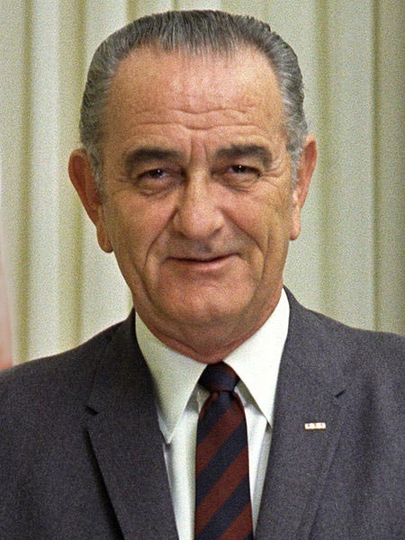

Crossley Takes on President Johnson in 1967
President Lyndon Johnson tried to take the offensive when his poll ratings began to decline. To convince key elites that he was still strong, Johnson attacked the public polls, selectively leaked private polls, and tried to influence poll results and poll reporting by cultivating the acquaintance of the pollsters.
— Herbert Asher 2012
President
Lyndon B. Johnson
Archibald Crossley

Slide 17
Partisan and Manipulative Use of Polls
“One of the rare occasions for which we have a rather full picture of how a poll is leaked to the press took place in the fall of 1967. At that time many of the published polls, most notably Gallup and Harris, were reporting that President Lyndon Johnson’s public support was weakening considerably. For example, in October the Gallup Poll reported Romney ahead of Johnson nationwide 48 percent to 45 percent, Rockefeller ahead 54 to 40, and Nixon ahead 49 to 45. Then, on October 27 it was reported in the press that private polls were showing Johnson in the lead.
In this case, the attempt to leak polls to achieve a specific political purpose backfired for two reasons. First, a number of alert reporters refused to accept at face value the leaked results and the slanted way in which they were interpreted. Second, the pollster himself adhered to high professional standards and put the public interest ahead of personal profit.”
— Harold Mendelsohn and Irving Crespi, 1970
Section II. Principles of Professional Practice
We will not knowingly make interpretations of research results that are inconsistent with the data available, nor will we tacitly permit such interpretations. We will ensure that any findings we report, either privately or for public release, are a balanced and accurate portrayal of research results.
— AAPOR Code of Professional Ethics (2015)
It is up to the profession to protect the Freedom of Inquiry and the publication of its results.

Slide 18
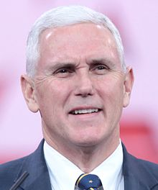
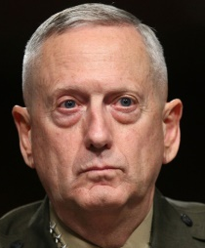
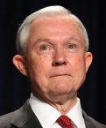
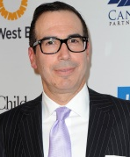
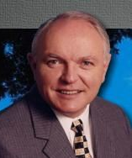
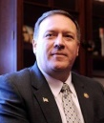
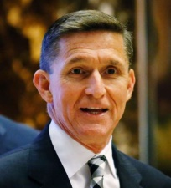
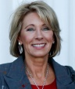
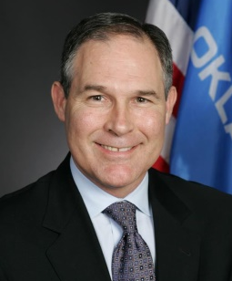
Close Election/Massive Change
Cabinet Picks and Trump Agenda
Obamacare – repeal and replace
Immigration – build a wall, speed deportation
Energy independence – coal, oil, gas, pipelines, question climate change
Trade – treaties (NAFTA), tariffs
Taxes – cut corporate, middle class, revise Dodd/Frank
Supreme Court – social issues, environment, labor
Foreign policy – alliances, Syria, Russia, China
Mike Pence
Gen. Jim Mattis
Sen. Jeff Sessions
Steven Mnuchin
Rep. Tom Price
Mike Pompeo
Michael Flynn
Betsy DeVos
Scott Pruitt

