Slide 1

Election 2016:
Commercialization of Marijuana is Not the Same as Legalization – Time to Change the Question?
Annual Conference
Pacific Chapter of American Association
for Public Opinion Research
Professor Floyd Ciruli
Crossley Center for Public Opinion Research
Josef Korbel School of International Studies
University of Denver
December 2016
Floyd Ciruli 777 Grant St., Ste 303, Denver, CO 80203 PH (303) 399-3173 FAX (303) 399-3147 www.ciruli.com

Slide 2
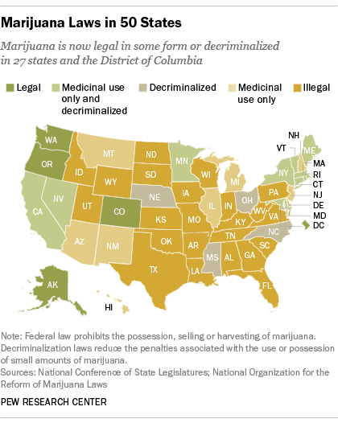
Marijuana in the U.S.: Pew Map 2015
Notes:
Beginning course details and/or books/materials needed for a class/project.

Slide 3
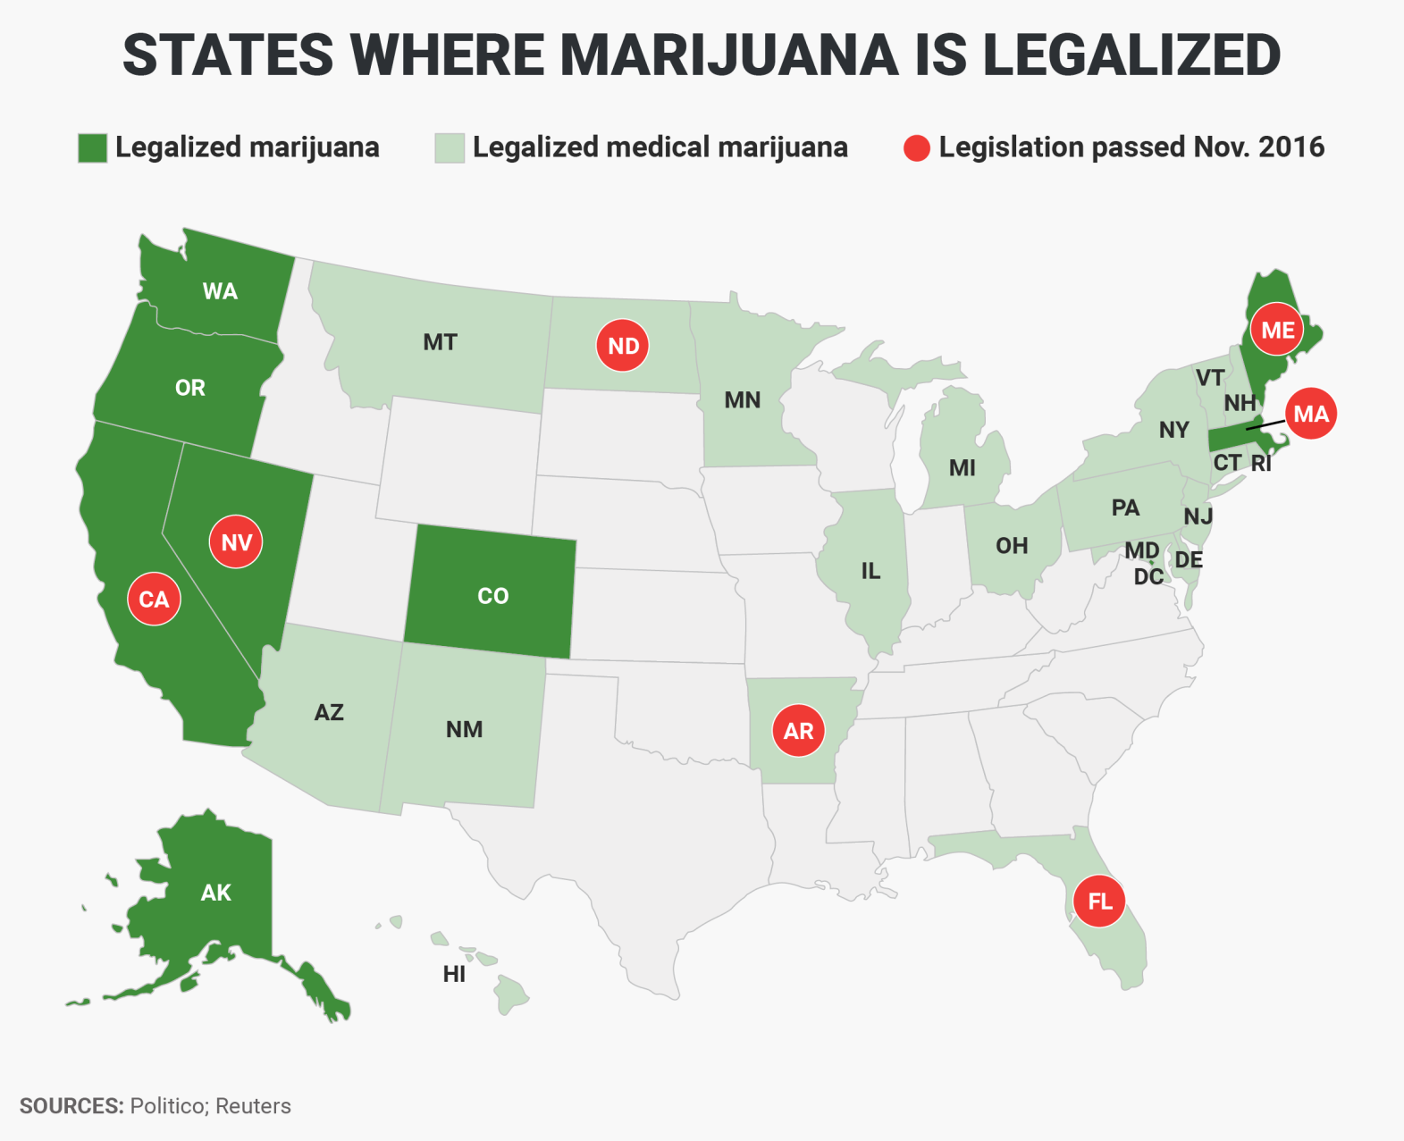
Marijuana in the U.S.:
Politico/Reuters Map 2016
Notes:
Beginning course details and/or books/materials needed for a class/project.

Slide 4
Legalization of Marijuana on Ballot or Statute
States and Legalization - 2016
State | Win/Lose | Type
California | Win – 56% | Recreational
Maine | Win – 50.3% | Recreational
Massachusetts | Win – 53.5% | Recreational
Nevada | Win – 54.5% | Recreational
Arizona | Lose – 52.2% | Recreational
Arkansas | Win – 53.2% | Medical
Florida | Win – 71.3% | Medical
Montana | Win – 56.3% | Medical
North Dakota | Win – 63.8% | Medical
NORML 2016

Slide 5
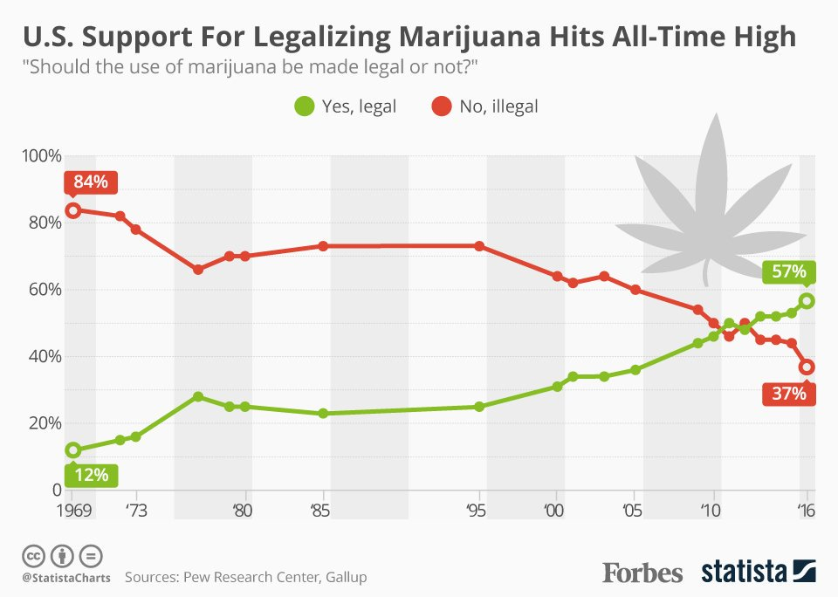
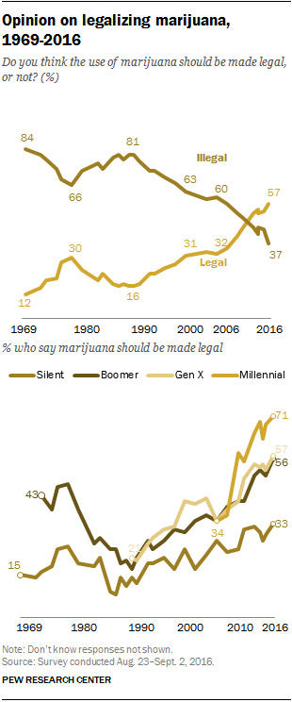
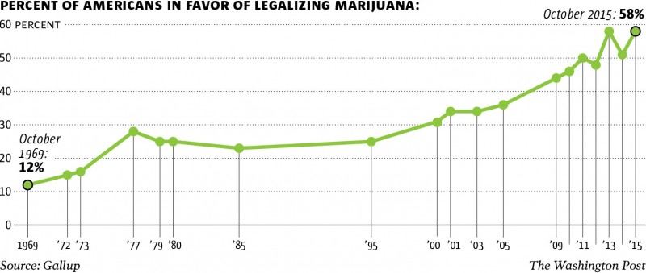
U.S. Public Opinion on Marijuana:
1960s to 2016
Notes:
Beginning course details and/or books/materials needed for a class/project.

Slide 6
Recreational Marijuana in Colorado
2016 Election
Pueblo – Napa Valley of Cannabis
Delegalize in county
Yes | 42%
No | 58
Allow in city
Yes | 51%
No | 49
Denver – Expansion of Use in Public Places
Use in bars
Favor | 54%
Oppose | 46
H. Clinton | 74

Slide 7
Statement that Teens are Less Likely to Graduate
From High School by Demographic Group
As I read the following statements, please tell me if you believe it is a very strong argument to limit the commercial spread of marijuana, a somewhat strong argument to limit it or not a very strong argument to limit the commercial spread of marijuana. Q: Did you know that teens under age 17 who use marijuana daily are 60 percent less likely to graduate from high school…
Very Strong Argument
+65
+49
+52
+41
+55
+38
+43
+38
+39
Ciruli Associates, N516, Feb. 21, 2016

Slide 8
Residents Strongly Agree
With Concerns About Marijuana
Substantial portions of Pueblo residents believe that there are significant problems with marijuana sales. Q: As I read the following statements, please tell me if you strongly agree, somewhat agree, somewhat disagree or strongly disagree with the statement…
Strongly Agree
 | All | White | Hispanic
Driving under the influence of marijuana is as dangerous as alcohol and harder for police to detect | 62% | 64% | 56%
There is considerable scientific evidence that regular marijuana use has bad health effects, especially on young people | 59 | 62 | 55
Recreational marijuana is becoming big business. Its advertising and production of convenient, colorful edible products, such as cupcakes, attracts and encourages use by young adults. | 59 | 60 | 46
Ciruli Associates, N516, Feb. 21, 2016

Slide 9
Recreational Marijuana Sales Expansion in
Colorado Springs/El Paso County – 62% No
 | Yes | No | Don’t Know
Total | 32% | 62% | 7%
Party Self-Identified
Democrat | 48% | 41% | 11%
Unaffiliated | 40 | 51 | 9
Republican | 17 | 80 | 3
Ethnicity
White | 30% | 65% | 6%
Hispanic | 42 | 52 | 6
Black | 32 | 59 | 9
Age
18-34 | 56% | 39% | 5%
35-49 | 37 | 57 | 7
50-64 | 35 | 59 | 6
65+ | 16 | 78 | 6
Ciruli Associates, Colorado Springs Gazette, N600, Oct. 18, 2016
Q: Do you believe recreational marijuana sales should be expanded in Colorado Springs?

Slide 10
Recreational Marijuana
Sales Expansion in Colorado – 53% No
 | Yes | No | Don’t Know
Total | 35% | 53% | 12%
Ethnicity
White | 33% | 56% | 11%
Non-white | 44 | 44 | 12
Education
College Grad | 33% | 55% | 12%
Non-college grad | 37 | 51 | 12
Age
18-54 | 43% | 46% | 11%
55+ | 25 | 62 | 13
Ideology
Liberal | 51% | 35% | 14%
Middle | 37 | 53 | 10
Conservative | 19 | 72 | 8
Crossley Center, N550, Oct. 31, 2016
Q: Do you believe recreational marijuana sales should be expanded in Colorado?

Slide 11
Arguments for Marijuana Legalization
Pro
Regulate – Like alcohol, like medicine
Economic – Tax revenue, jobs
Crime – Redirects resources to better use, reduces drug crimes
Freedom – Libertarian, individualistic sentiment
Anti
Don’t know health risk, addictive
Especially dangerous for children and their development
Don’t need more intoxication/driving
Economic costs, health care, homelessness
Drug lawbreaking will continue
Commercialization, use will expand, advertise, lobby, campaigns

Slide 12
Expansion of Commercialization of Recreational Marijuana
Like sentiment, don’t like proximity, element, smell
Commercialization, normalization expands
Revenue, jobs vs. social costs, homelessness
Experience, research
Resistance with conservative parts of states and country
Organized resistance
Polling: Expansion is different than legalization, create a baseline for comparison
Expansion, but slowly and with narrow margins. Some active resistance.

