Slide 1

Consistency is Key: Replication across Online Non-probability Sample Sources
Nicole R. Buttermore, Frances M. Barlas, & Randall K. Thomas
GfK Custom Research

Slide 2
Introduction
With the growing interest in online non-probability samples, one emerging concern in survey science is the ability to replicate effects across different sample sources.
Research Question: Does what you find with one non-probability sample source replicate with other sample sources?

Slide 3
Introduction
In the social sciences, a number of studies have had difficulties replicating both the direction and degree of experimental effects across convenience samples (Nozek et al, 2015; Heinrich, Heine, & Norenzayan, 2010).
However, other researchers have found that experimental results obtained in convenience, non-probability samples are roughly equivalent in their accuracy across samples (Yeager et al., 2011).

Slide 4
Introduction
Our interest in this study was to examine experimental replications across a wide range of non-probability sample providers.
The Foundations of Quality 2 (FoQ2) was a major study investigating survey quality conducted in 2013 by the Advertising Research Foundation.
The study collected data from 17 different non-probability sample providers with each providing three separate samples averaging about 1,100 respondents.

Slide 5
Introduction
The FoQ2 dataset has been used extensively for other purposes:
  Research with the FoQ2 dataset compared results across non-probability sample providers for 24 national benchmarks (Gittelman, Thomas, Lavrakas, & Lange, 2015).
  The study found significant variance across providers in their average proximity to the benchmarks.
  Further, the use of respondent quotas and use of demographic weighting did not consistently reduce the divergences.

Slide 6
Method

Slide 7
Method
The ARF FOQ2 dataset had 57,104 completes from 17 different opt-in sample sources (with 3 samples each = 51 different samples).
The study fielded in January 2013. The study’s primary intent was to examine how using different sample quota methods might impact the quality of research results.

Slide 8
Method
In this study, there were four major content areas we could examine for replicability of findings included:
  An experiment on response formats for past six month purchase,
  An experiment on 4 different new product concepts,
  Evaluations of 27 different brands, and
  Rated order of political spending priorities.

Slide 9
Method
To assess replicability, there were two major measures for each content area:
  Average absolute divergence from the overall mean across samples
  Relative ordering of results (i.e., high ratings for the same brand across samples compared to low ratings for another brand).
We used demographically weighted data for comparisons to eliminate confounding factors due to demographic differences across sample providers.

Slide 10
Results

Slide 11
Test 1 Summary
Respondents were asked about their past 6 month purchase of a series of 6 items (randomly selected from 10 items).
  Men’s clothing
  Women’s clothing
  Children’s clothing
  Home improvement items such as tools or paint
  Automotive accessories or parts
  Groceries
  Sporting goods
  Computer-related electronics
  Entertainment-related products (DVDs, stereos, TVs, etc.)
  A Segway transporter

Slide 12
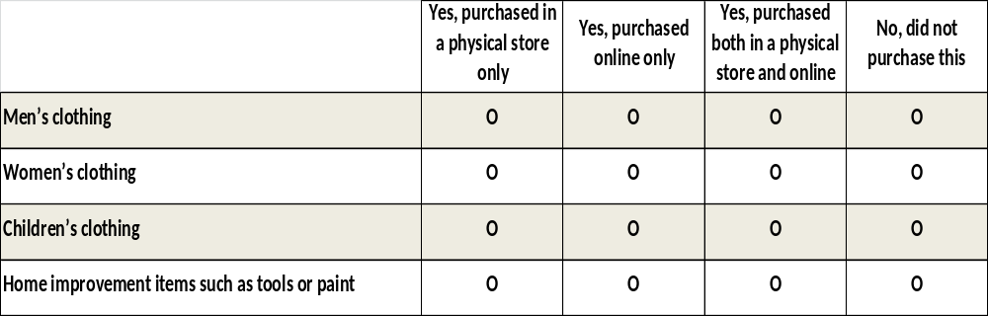
Test 1 Summary
Respondents were randomly assigned to use one of three response formats:
  Multiple response
  Yes-no grid
  Combination grid
Based on prior research, we have found that multiple response format (‘Select all’) yields significantly lower endorsement levels than yes-no grids, and yes-no grids have lower endorsement levels than combination grids.

Slide 13
Purchase Response Format
The experimental results were replicated in 50 of the 51 samples, and partially replicated in the 1 remaining sample. All showed the highest endorsement frequency in the combination grid.

Slide 14
Purchase Response Format
Average mean difference of endorsement between response format conditions.
Difference between means

Slide 15
Test 2 Summary
Respondents were randomly assigned 1 out of 4 possible new product concepts, they read a description of the new concept, and then rated their likelihood to purchase the product. The 4 concepts were:
  OneSurface Paint
  Soup-to-Go
  Energy-on-Demand
  Unbeatable Luggage

Slide 16
New Product Preferences
The experimental results were replicated in 45 of the 51 samples, and partially replicated in the remaining 6 samples. The concept with highest purchase interest was ‘OneSurface Paint’ with 51 rating it highest; 47 samples rated ‘Energy-on-Demand’ lowest.

Slide 17
Test 3 Summary
Respondents were randomly assigned 5 out of 27 brands to evaluate how much they liked each brand (with a ‘Not familiar’ response available).
Analyses excluded ‘Not familiar’ responses.

Slide 18
Brand Ratings
The ratings of brands remained fairly consistent across samples, with most samples having a correlation with the overall brand ratings (pooling total sample) of over .95.

Slide 19
Brand Ratings
The overall ordering of brands was fairly consistent across samples.
0 = Strongly Dislike; 100 = Strongly Like

Slide 20
Test 4 Summary
Respondents were presented with 6 programs that faced budget cuts in the U.S. and were asked which 1 they would reduce spending on the most.
  1 Military weapons programs
  2 Border patrol and prevention of illegal immigration
  3 Police and crime prevention
  4 Development of new technology
  5 Health care system
  Social welfare system for the poor

Slide 21
Political Priorities
The overall results were replicated in 28 of the 51 samples, but the top and bottom programs selected for a spending cuts were replicated in all 51 samples. The second and third top programs for program cuts alternated in a number of samples, whereas the fourth and fifth programs were more reliably replicated.

Slide 22
Conclusions and Discussion

Slide 23
Summary of Results
For the purchase response format experiment and new product evaluation experiment, the relative rates of endorsement and new product preferences remained fairly constant.
For the brand ratings, the overall ordering of brands was fairly consistent across samples, and we saw less absolute divergence among the highest rated brands.
Finally, for political priorities, the experimental results were replicated in only 28 of 51 samples, primarily due to the proximity of the second and third priorities for spending cuts, which crossed over for a number of the samples.

Slide 24
Conclusions and Discussion
Overall, we found most findings replicated across non-probability samples.
One issue is not just the relative differences among samples, but also the absolute values – this is something we did not study.
Another issue we are studying further – a subset of samples of the 51 were from river samples. Among these samples, replication of results seemed somewhat more problematic.

Slide 25
Thank you!
Contact: Nicole R. Buttermore
email: nicole.buttermore@gfk.com

