Slide 1

Populism and Prejudice in Europe:
Brexit and the European Union
Jonathan Kelley and M.D.R. Evans
University of Nevada
Presentation to the Pacific Association for Public Opinion Research’s
Annual Meeting, San Francisco, 2017, December 14th-15th
mariahev2@gmail.com International.survey@gmail.com

Slide 2

Introduction
&
Overview

Slide 3
Are populist attitudes undermining Europe?
Aversion to immigrants was a defining issue in political debates about Brexit and forms a recurrent theme in populist politics in many European Union nations.
  Indeed, if Britons are not uniquely hostile, then Britain's exit from the EU may be only the first symptom of enduring conflicts that will plague EU nations in future years.
A well-established indicator of prejudice – aversion to outgroups as a neighbours – shows that prejudice against immigrants, other races, Muslims, Hindus, Jews, and Gypsies are all low in Britain.
  This is as expected from the general decline of prejudice with socioeconomic development, leaving Britain similar to other prosperous EU and Anglophone nations.

Slide 4
Changes over time?
Detailed analysis of Britain, Germany, the Netherlands, and the USA shows that prejudice in the EU declined to a minimum in the mid-90s, perhaps lower than elsewhere,
But prejudice is now rising steadily, becoming higher than elsewhere.

Slide 5
Methodological note
Confirmatory factor analysis suggests a single latent ethno-religious prejudice generates all these specific prejudices.
Replication using other measures of prejudice and another cross-national dataset confirms these findings.

Slide 6
Prejudice and confidence in the EU
Contrary to common assumptions, prejudice in fact plays only a minor role in undermining confidence in the EU
  many other things are more important,
Especially important is confidence in one's own national government.

Slide 7
Data and methods

Slide 8
Data and Methods
Data: pooled World and European Values Surveys
  450,000+ individuals,
  >300+ surveys, and
  >100+ nations for this analysis
  replication from European Quality of Life surveys.
Analysis: descriptive, multi-level, and structural equation methods.

Slide 9
Prejudice questions

Slide 10
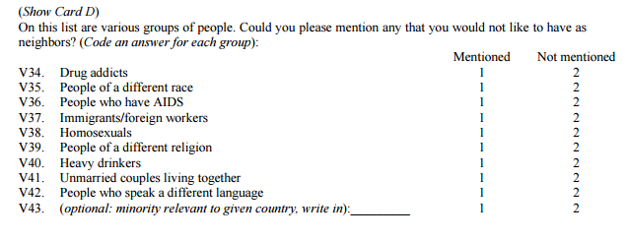
Questions:
Also, Gypsies, Hindus, Jews, and Muslims (from "add on" versions or other years)
Unfortunately, all these items are dichotomies so, as has long been known, measurement is crude and random measurement error is greater than if they had been measured on a 5-category or 7-category scale

Slide 11
Descriptive results: UK vs other nations
We will see that the UK is not unique

Slide 12
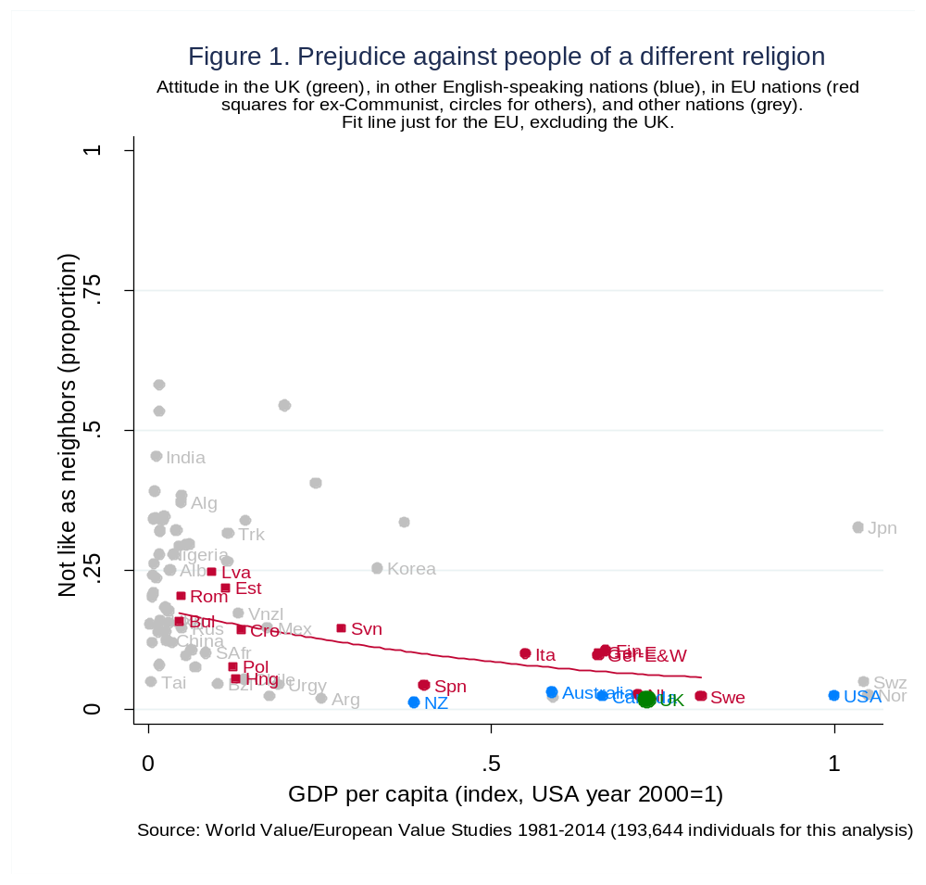

Slide 13
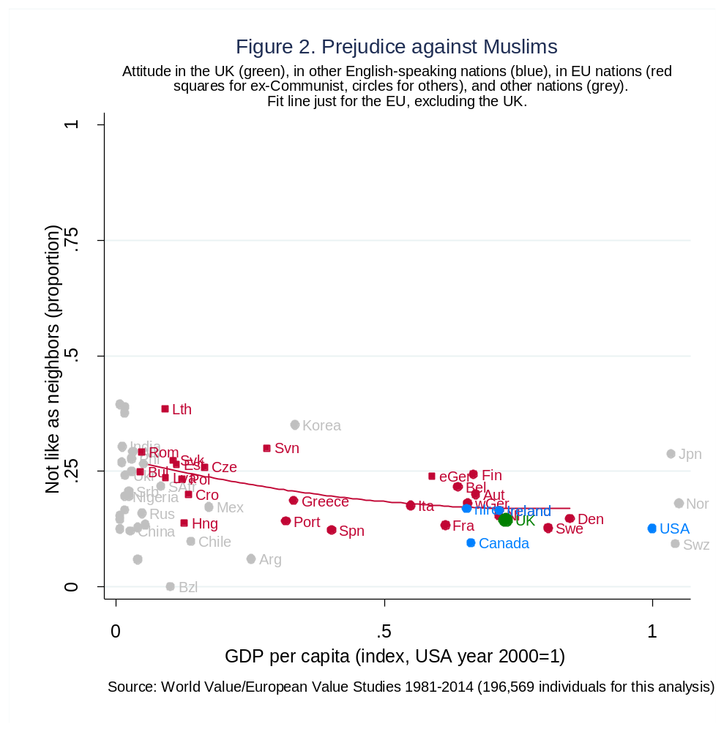

Slide 14
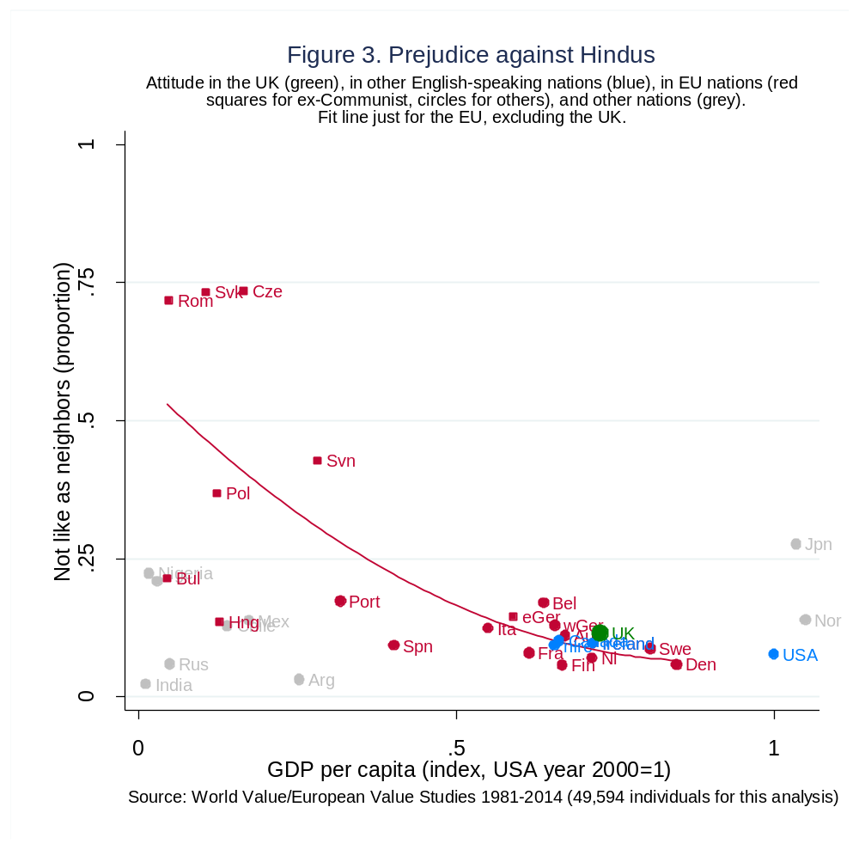

Slide 15
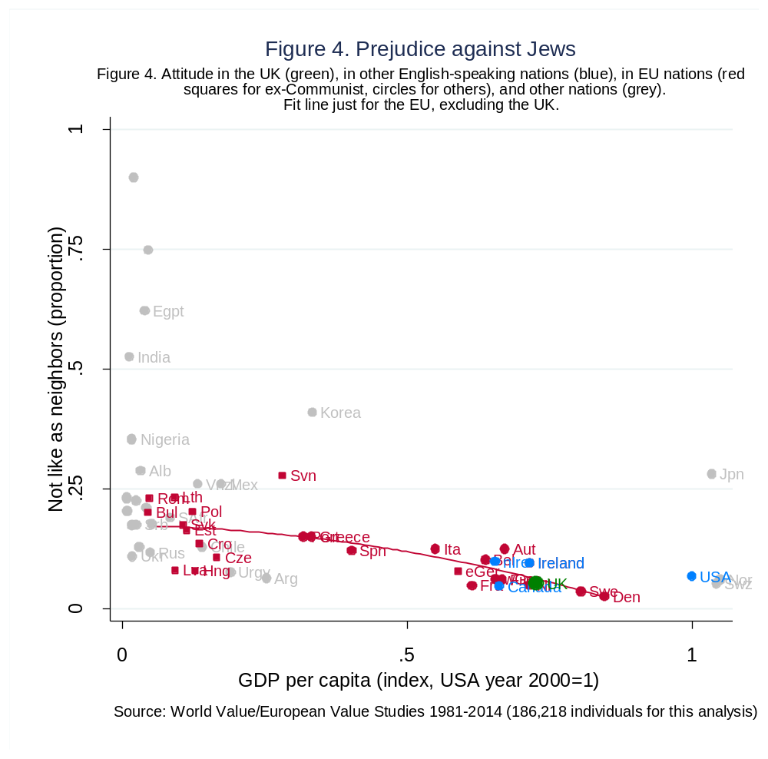

Slide 16
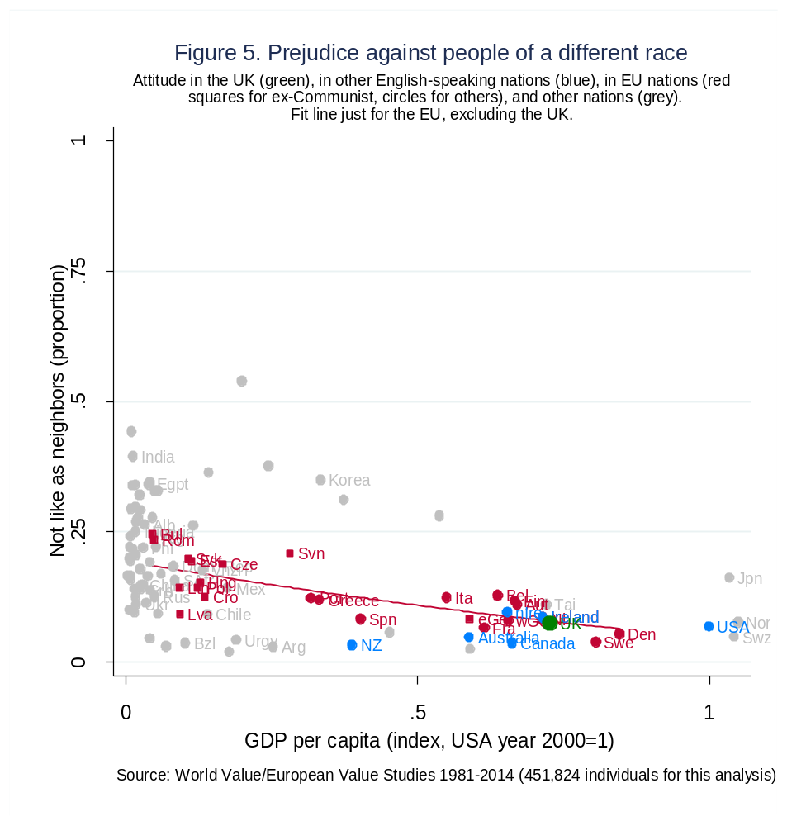

Slide 17
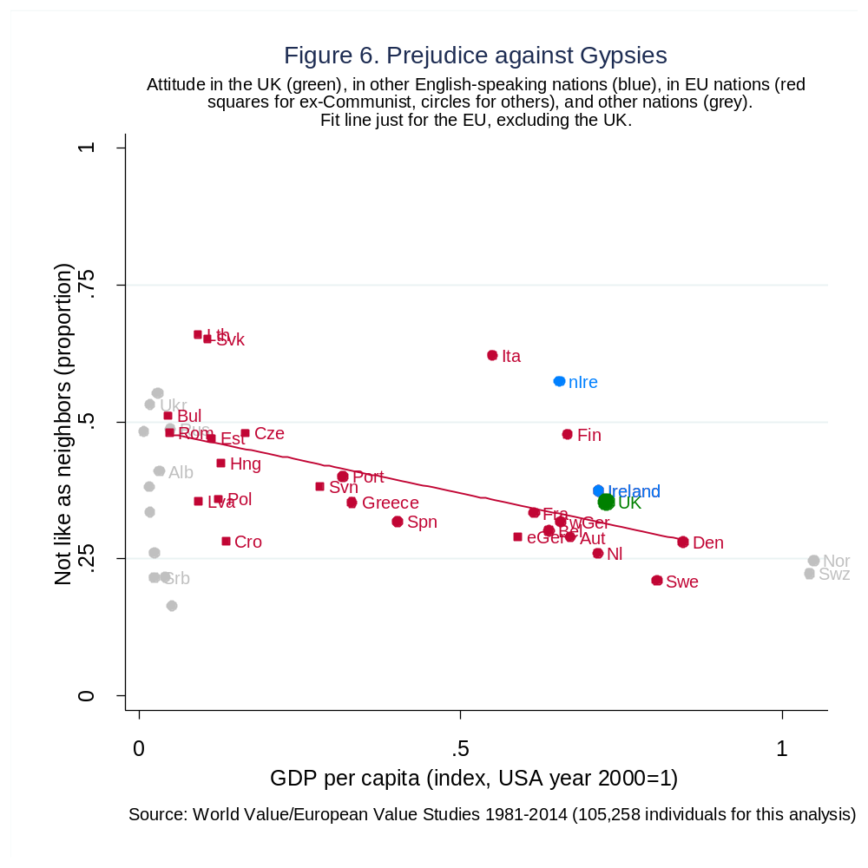

Slide 18
The key issue in the public discussion of Brexit…

Slide 19
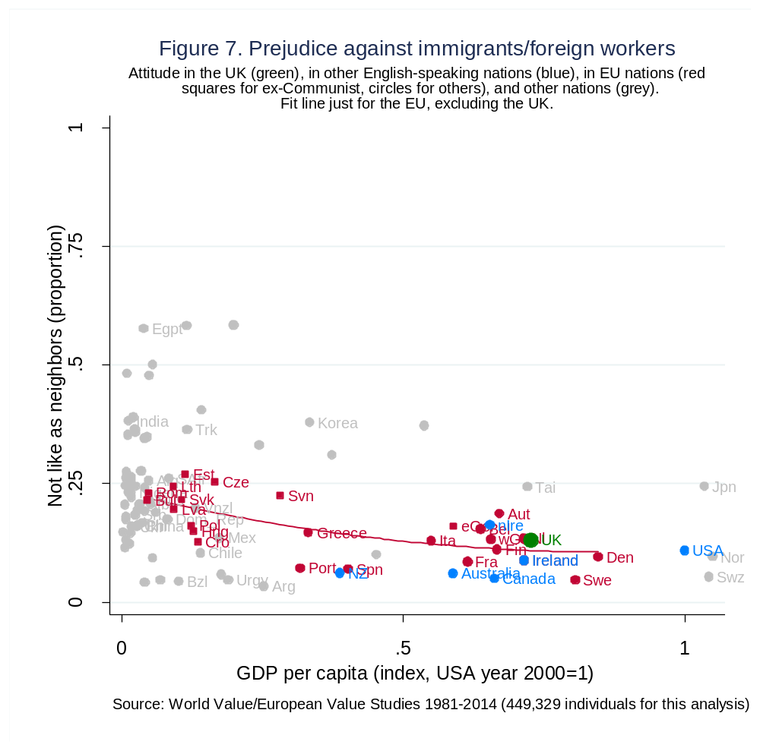

Slide 20
Note: Although few favor segregation, small preferences can have large consequences…
Small amounts of prejudice can be expected to create large amounts of residential segregation.
This famous result is due to Thomas C. Schelling
  (1969) "Models of segregation", American Economic Review, 1969, 59(2), 488–493.
  (1971). "Dynamic Models of Segregation," Journal of Mathematical Sociology, 1(2), pp. 143–186.
  (1978) Micromotives and Macrobehavior, Norton.

Slide 21
Replications

Slide 22
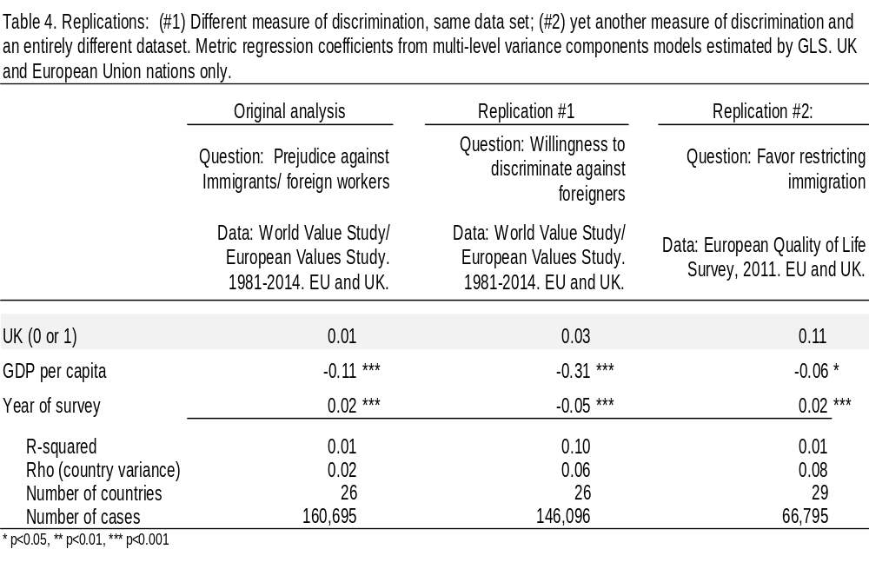

Slide 23
One prejudice or many?

Slide 24
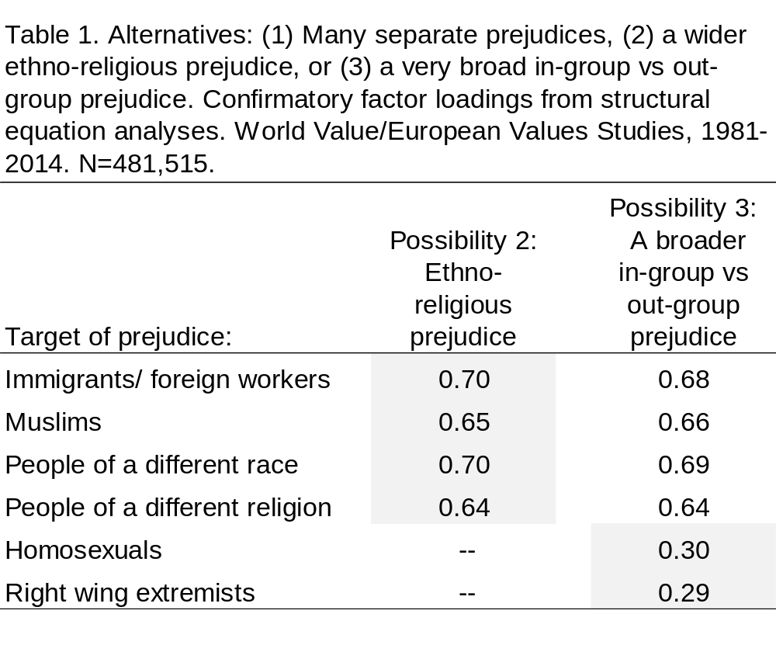

Slide 25
Prejudice may be on the upswing

Slide 26
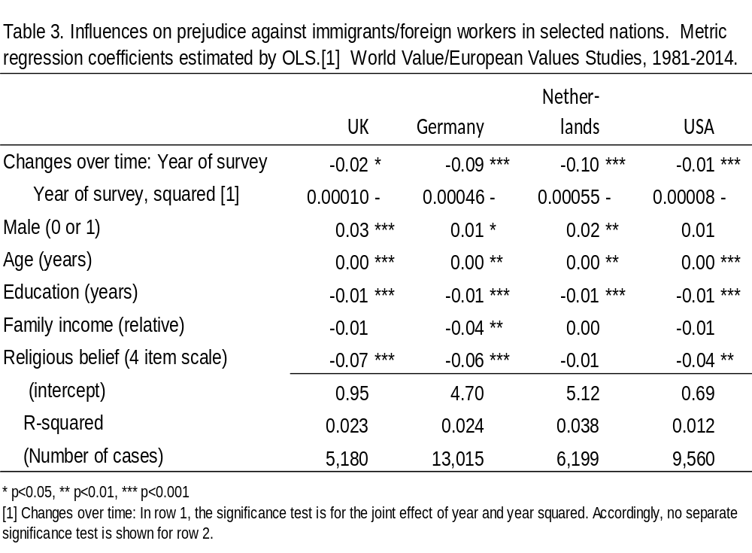

Slide 27
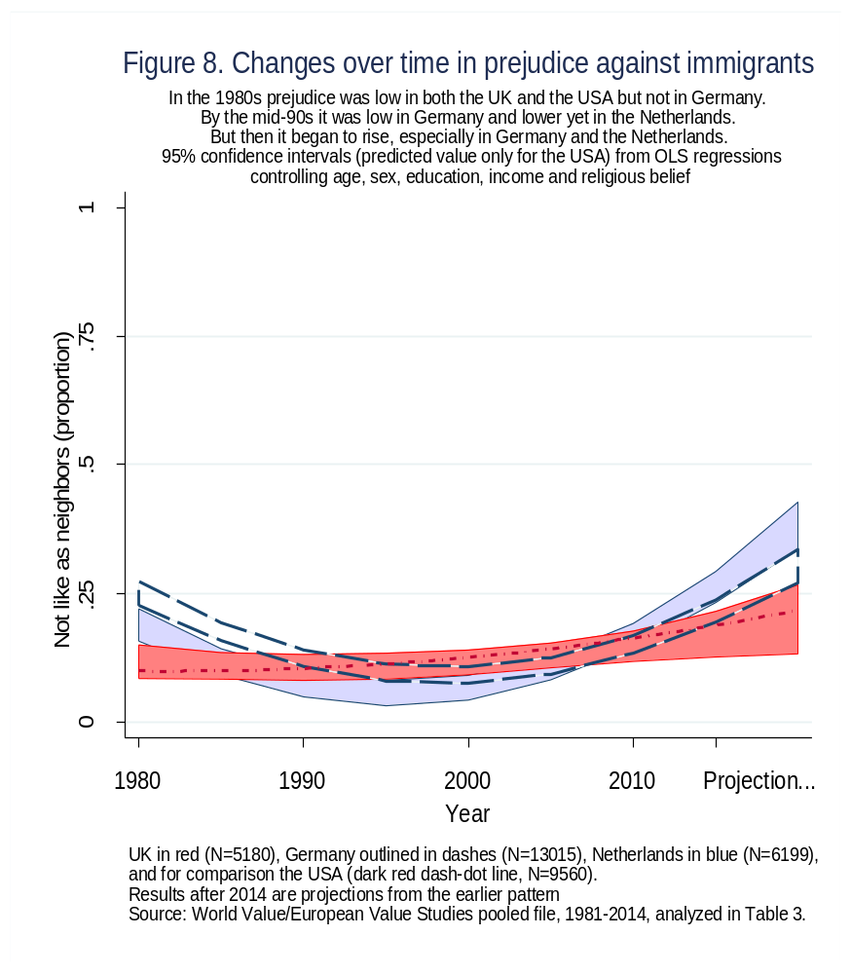

Slide 28
Sources of prejudice

Slide 29
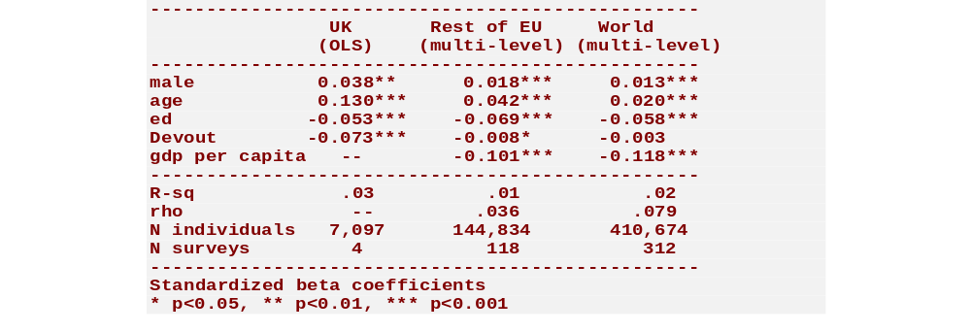
Sources of prejudice against immigrants:
Standardized effects
In the UK: Older are more prejudiced, devout less, educated less
EU and the world as a whole: Prosperous nations and more educated people are less prejudiced
Individual differences are small and national differences modest.

Slide 30
Prejudice and confidence in the EU

Slide 31
The confidence questions
... Tell me how much confidence you have in them…
The churches
  A great deal (scored 100)
  Quite a lot (67)
  Not very much (33)
  None at all (0)
…
The government in your nation’s capital
Parliament
The police
The courts
…
The European Union

Slide 32
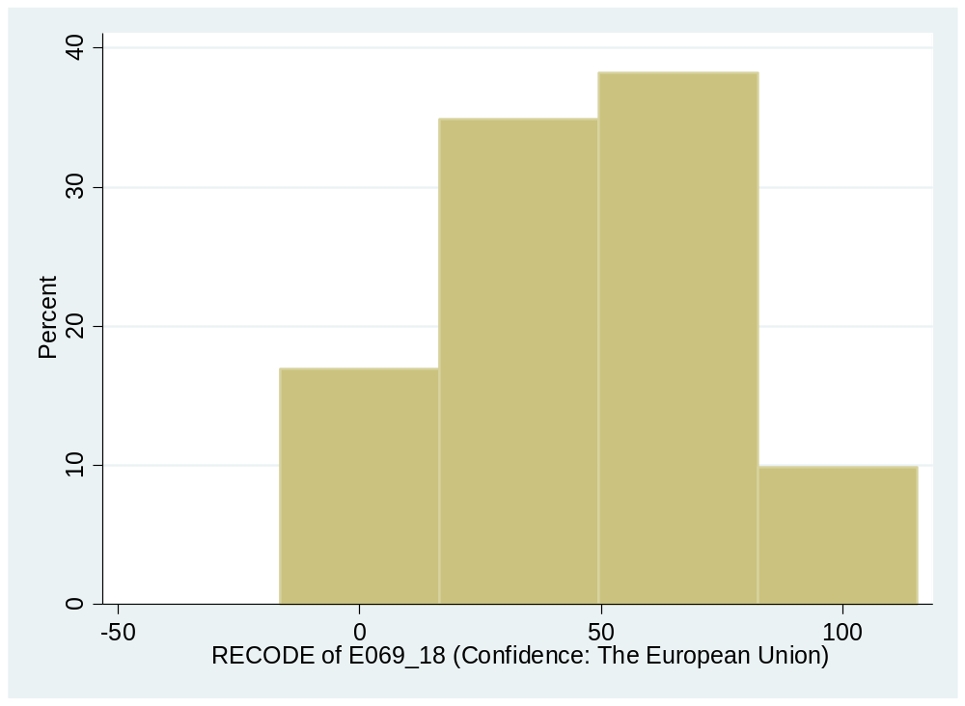
Confidence in the EU
(the outcome of interest)
Asked mainly in EU nations, 1990 through 2014.
Mean 40 points out of 100. Standard deviation 30 points.
  In the UK: mean 38, standard deviation 28.

Slide 33
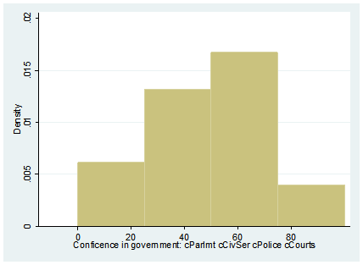
Confidence in government scale
(used in the analysis)
Major EU nations only (population over 1 million). 1981-2009.
Scale: Average of government, parliament, police, courts
  Good Alpha reliability, .77
Mean 47 points out of 100. Standard deviation 21 points.
  In the UK: mean 52, standard deviation 20.

Slide 34
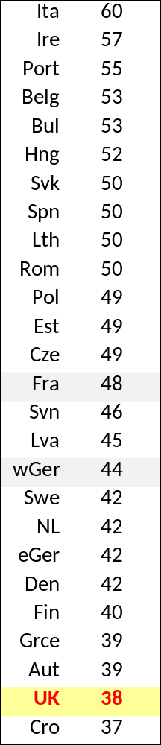
UK residents less confident about the EU
Average level of confidence in the EU:
  In the UK: 38 points out of 100 (n= 7,346)
  Elsewhere in the EU: 48 points out of 100 (n=158,374)
But many other EU nations are not much different.
Even Germany and France, the dominant forces in the EU, have only middling levels of confidence in it.

Slide 35
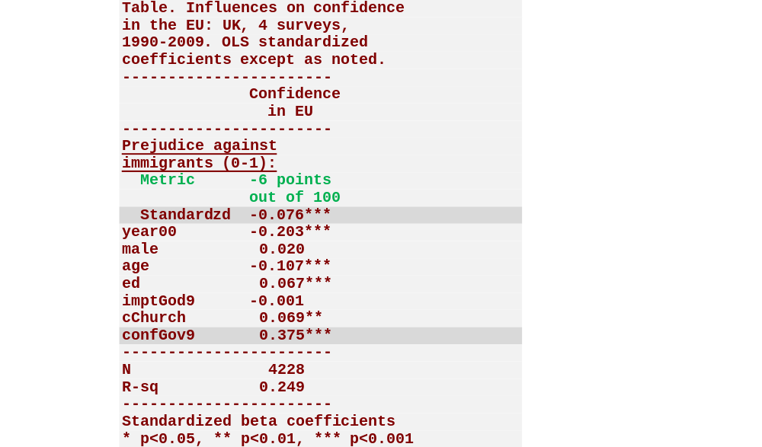
In the UK: Sources of confidence in the European Union
Prejudice against immigrants reduces confidence, but not by much
  Just 6 points out of 100.
Confidence in the UK’s own national government matters hugely more

Slide 36
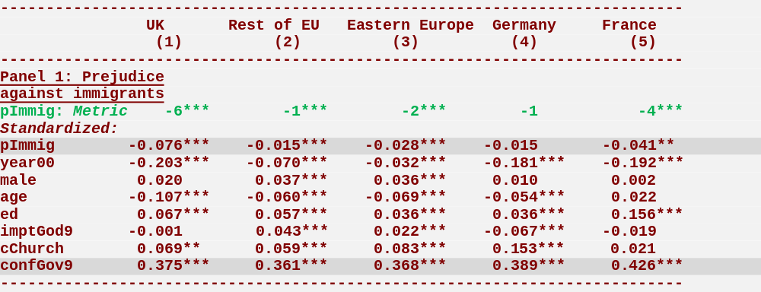
Confidence in the EU: UK vs other nations
Confidence in the EU (standardized coefficients) is:
  Slightly lower among those prejudiced against immigrants,
  A little lower in recent years,
  Lower among some demographic groups,
  Slightly higher among the religious, and
  vastly higher among those confident in their own national government.

Slide 37
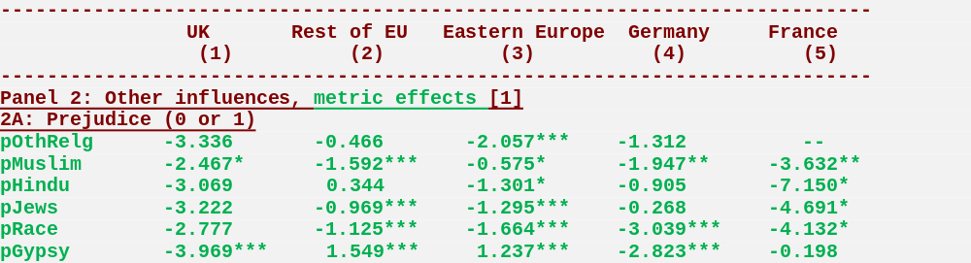
Prejudices matter little to confidence in the EU
Metric regression estimates using the same model as before. Caution: Some prejudice questions asked only rarely, so Ns can be small.
Prejudice against other religions: No statistically significant effect on confidence in the EU, save perhaps for a little drop in Eastern Europe
Prejudice against Muslims: Surprisingly, only slight reductions in confidence
Prejudice against Hindus: No significant effect, save perhaps for France
Prejudice against Jews: No effect in UK, tiny effect in EU, especially France
Racial prejudice: Irrelevant in UK, reduces confidence a little elsewhere
Prejudice against Gypsies: Modest reduction in confidence in UK & Germany
OVERALL: There is hardly any prejudice in the EU (as we saw earlier) and what there is barely matters to public confidence in the EU

Slide 38
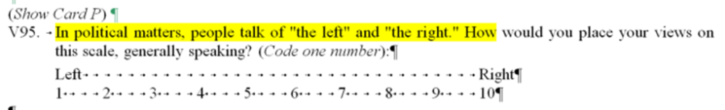
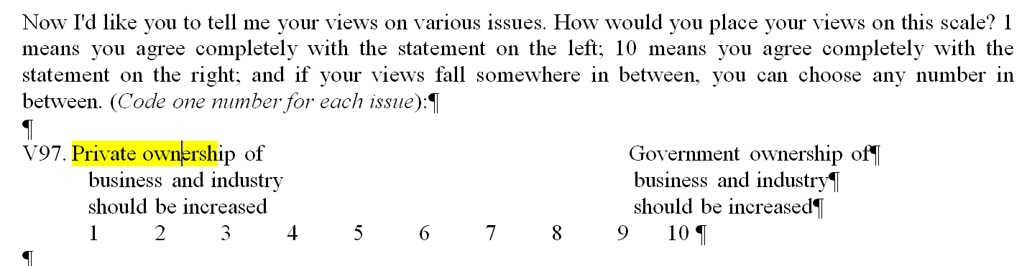
Politics: Some basic questions
For clarity, and without loss of generality, rescored into equal intervals between zero and one:
  (V95) Furthest to the left = 0, …etc…, furthest to right=1
  (V97 reversed) Strongest agreement with government ownership = 0, …etc…, strongest preference for private ownership=1

Slide 39
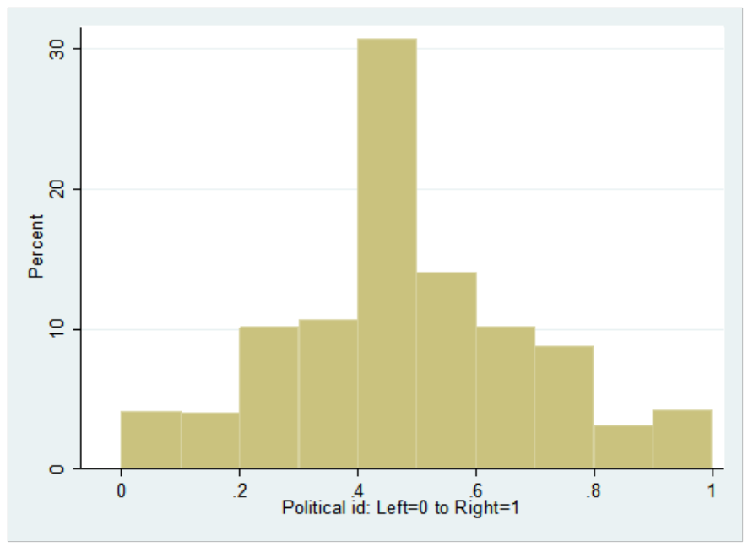
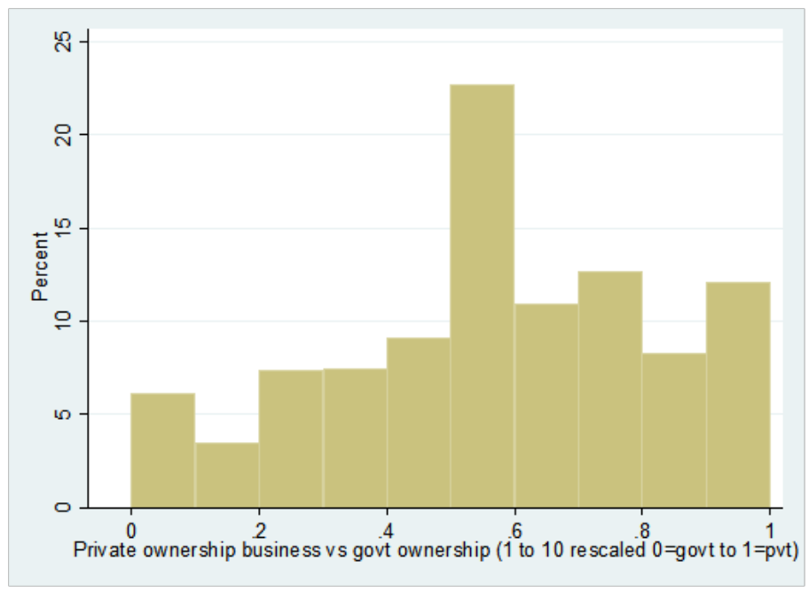
Politics: Description:
Left … Right Government … Private
Less than 5% on either the far left or the far right.
  Most in the middle
Around 6% very strongly for government ownership
  12% very strongly for private ownership
  Most spread throughout the middle

Slide 40
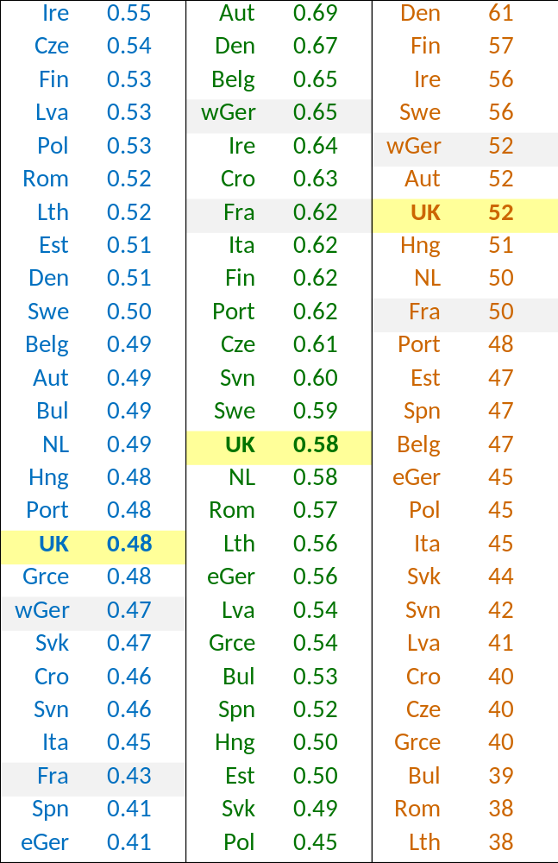
Politics: Country differences
Politically right (1st column, in blue)
  UK a bit to the left
Support private rather than government ownership (2nd column, in green)
  UK near the middle
Confidence in own nation’s government (3d column, in orange)
  UK more confident than most

Slide 41
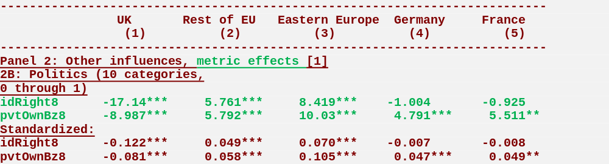
Confidence in the EU is somewhat politicized
In the UK the political right is noticeably less supportive of the EU
  A moderately strong effect in standardized terms (the metric effects compare the extreme right to the extreme left on this 10 category question, so tend to be larger than for the prejudice dichotomies)
  In Germany and France, left-right differences are negligible
  And elsewhere in the EU the right is a little more supportive
Economic conservatives (pro-private enterprise) in the UK are less supportive of the EU.
  But in other nations, by contrast, they are somewhat more supportive

Slide 42
Conclusion

Slide 43
For the world at large…
Prejudice against immigrants as neighbors varies hugely among countries
  Low in the UK
  And in most other developed nations
This prejudice is only one symptom of a latent ethno-religious prejudice that generates prejudice against many groups
Modernization matters: the higher the GDP, the lower the prejudice
UK is not exceptional
Results replicate across questions and surveys
Not over yet: Prejudice resurgent in some EU countries

Slide 44
Specifically about the European Union…
Confidence in the EU is (and has long been) unusually low in the UK
Prejudice reduces confidence in the EU,
  But only a little
Politics matters
  But only a little
Confidence in the EU is strongly linked to confidence in your own national government, so for change…
  Look to your own house

Slide 45
End

Slide 46
End

Slide 47
