Slide 1

Reflected Glory? National Pride and Subjective Well Being in International Perspective
M.D.R. Evans and Jonathan Kelley
University of Nevada
Presentation to the Pacific Association for Public Opinion Research’s
Annual Meeting, San Francisco, 2017, Decenmer 14th-15th
mariahev2@gmail.com International.survey@gmail.com

Slide 2

Abstract

Slide 3
Goal: Merge national pride & Subjective wellbeing traditions
This project merges two lively research traditions of research on individuals’ national pride and subjective well-being. Our primary goal is to assess whether, and how strongly, national pride influences subjective wellbeing, in the context of richly developed model of both.

Slide 4
Result preview 1: National pride
National pride varies widely among the countries of the world (as is also shown on an entirely independent dataset in this session)
It also varies among individuals in ways that largely replicate prior research.

Slide 5
Result preview 2: happiness
Happiness varies widely
Echoing recent research (including a paper in this session!) we replicate the findings that socioeconomic development boosts happiness, that inequality does not matter, and that the usual individual level effects hold.
What’s new: In addition to these, national pride gladdens people substantially

Slide 6
Data and methods

Slide 7
Data and Methods
Data: pooled World and European Values Surveys (> 500,000 individuals, 300 surveys, and 100 nations for this analysis) & replication from European Quality of Life surveys.
Analysis: descriptive and multilevel methods.

Slide 8
The questions

Slide 9
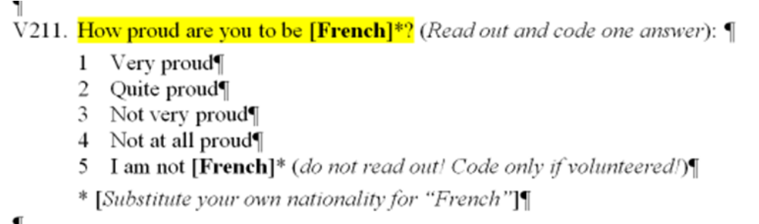
National pride
For clarity, and without loss of generality, rescored into equal intervals between zero and one:
  Very proud: scored 1.0
  Quite proud: 0.66
  Not very proud: 0.33
  Not at all proud: 0
  Other answers: Missing data

Slide 10
Almost everyone is proud of their nation
Analysis is restricted to nations with a population of one million or more
National pride:
55% Very proud
33% Quite proud
9% Not very proud
3% Not at all proud
100% (N= 457,892)

Slide 11
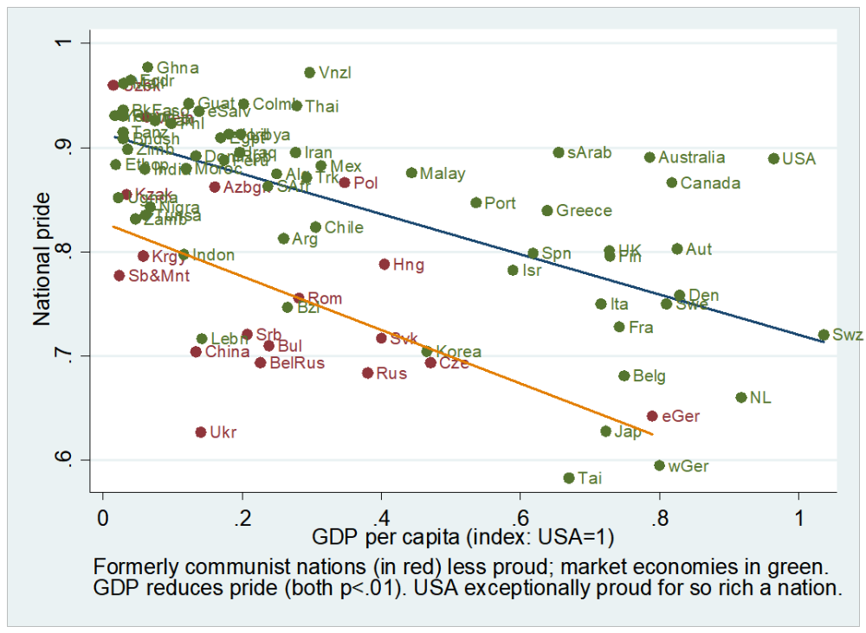

Slide 12
Well-being
(the dependent variable)

Slide 13

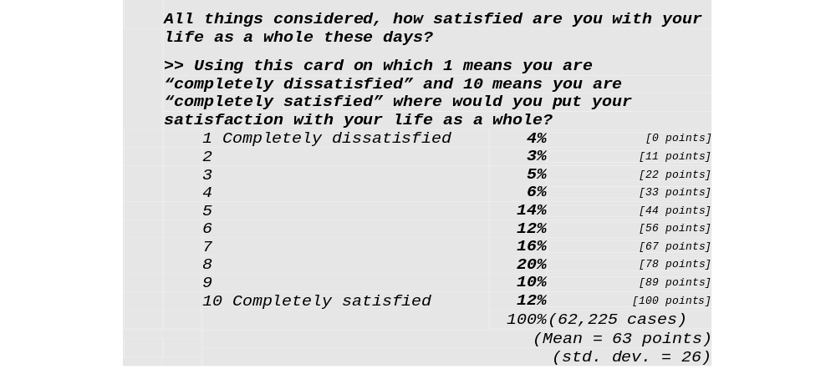
Questions: Well-being (dependent variable)

Slide 14
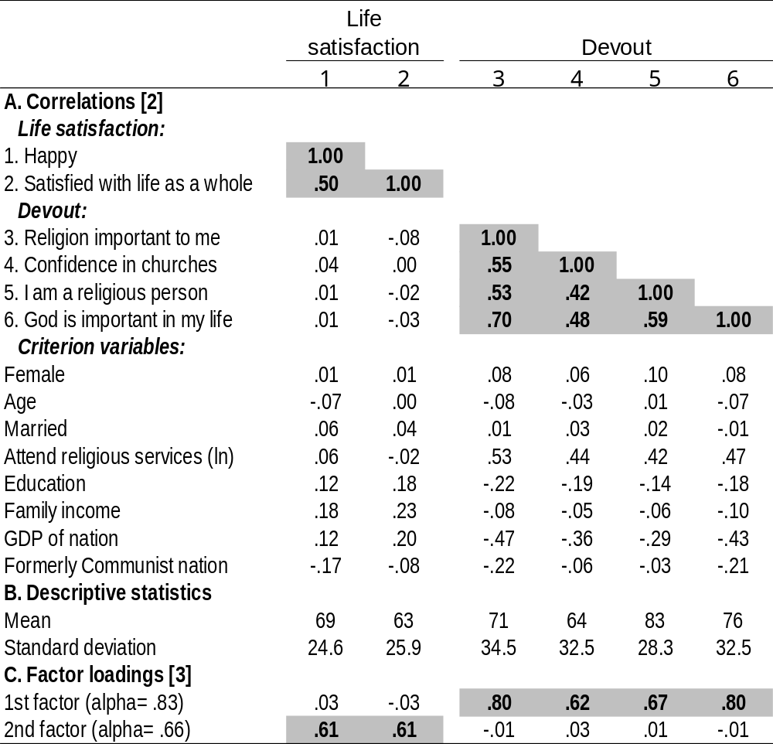
Measure-ment properties: Well-being scale
(and a control variable, religious devout-ness)

Slide 15
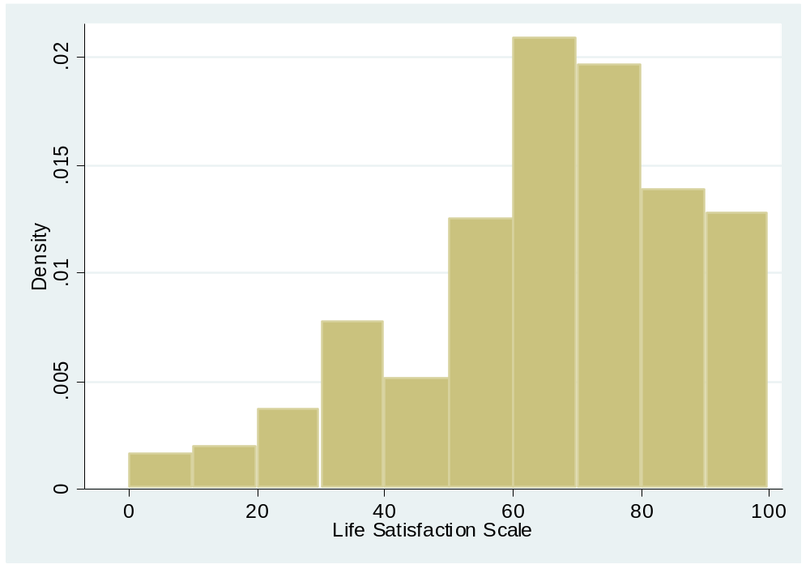
Distribution: Well-being scale
Mean: 66 points out of 100
Standard deviation: 22
Alpha reliability for the scale: .66

Slide 16
Effect of pride on well-being

Slide 17
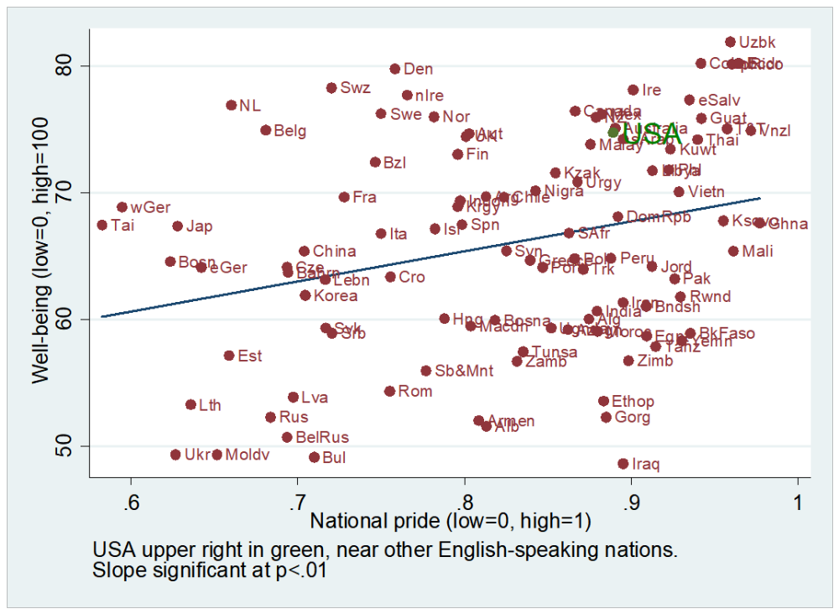

Slide 18
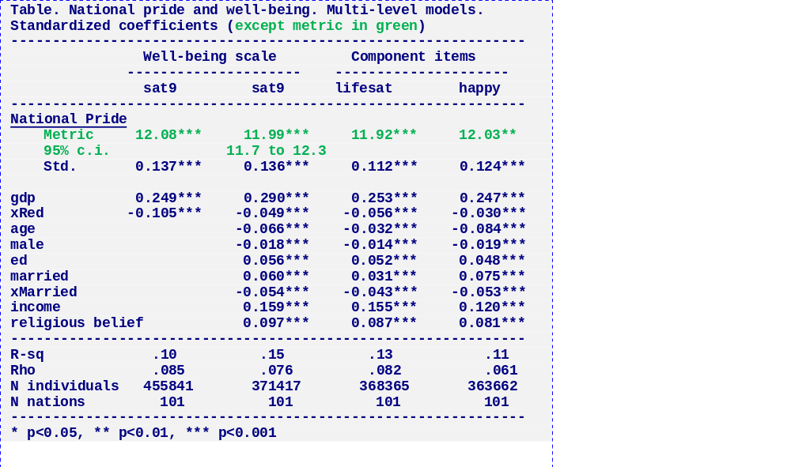
Pride’s big effect on well-being, net of other things

Slide 19
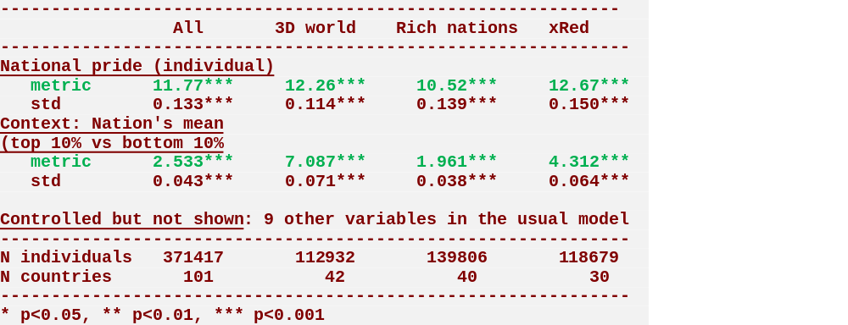
Effects on well-being: Contexts
Individual levels of national pride matter more or less equally everywhere
The nation’s context also matters a little (it helps to live in a nation other people are proud of ), especially so in the Third World.

Slide 20
Beautiful confidence band

Slide 21
The past: Does national pride explain the effect of history?

Slide 22
Model of happiness including pride in history, but not national pride, followed by one including national pride too. – especially what does this do to Germany & ex-reds?

Slide 23
The future: Does national pride explain the science effect?

Slide 24
Model of happiness including pride in science, but not national pride, followed by one including national pride too?

Slide 25
Conclusion

Slide 26
National pride is an important source of subjective wellbeing
Implications for identity theory
Implications for wellbeing theory

Slide 27
End

