Slide 1
Exploring the Trump Appeal
Comparing Two Methods to Estimate Missing Maximum Difference Utilities e
Edward “Paul” Johnson, Director, Advanced Analytics
Kelsey White, Junior Analyst, Advanced Analytics

Slide 2
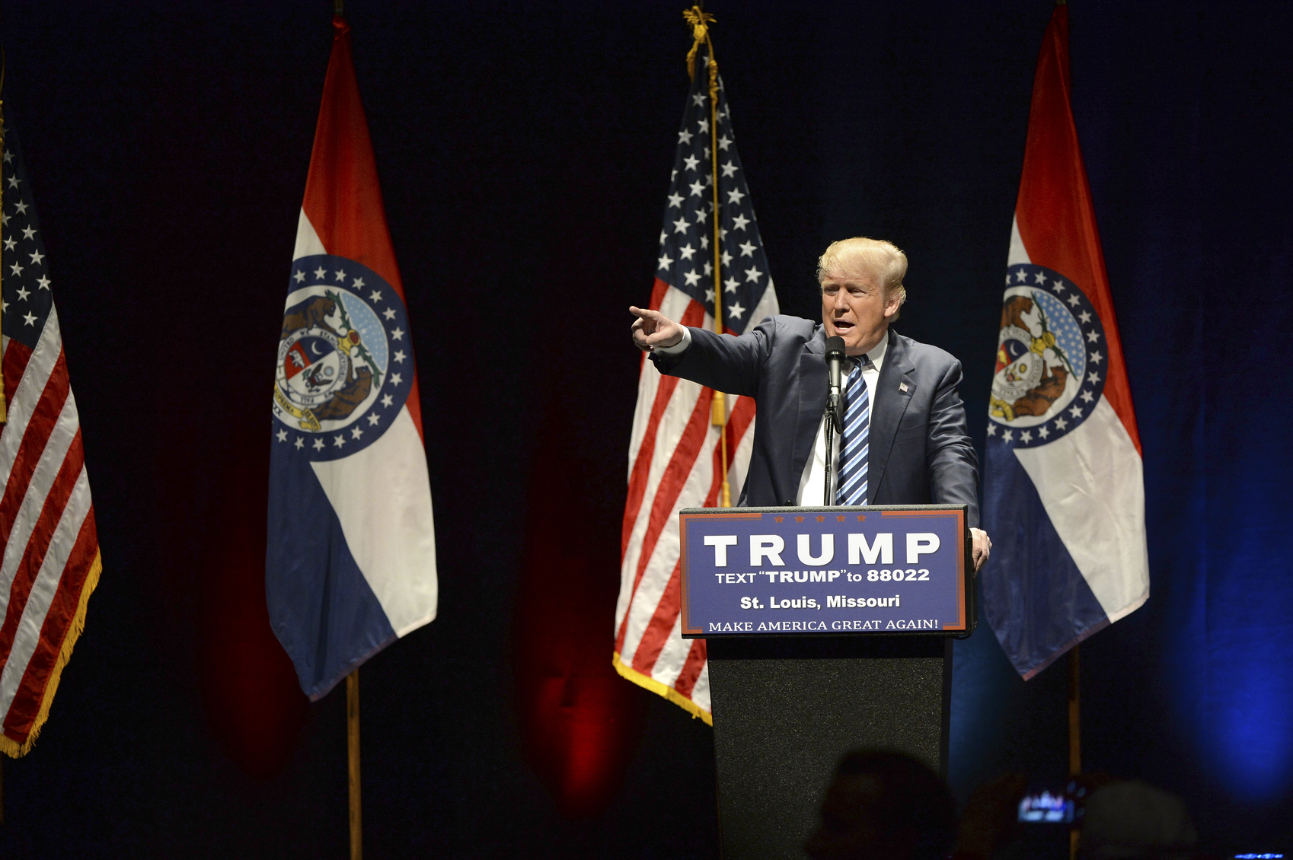
Subject Matter
Going for the outrageous!
  Test 200 statements
  Subject: Donald Trump
Methodology
  Selected 200 “policy statements” made by Donald Trump
      Variety of topics
      Both liberal and conservative stances
  Fielded a survey using SSI’s Online U.S. Voter Panel
      N=1,500 completes collected in March-April 2016
Statement Topics:
2nd Amendment
Corporate America
Criminal Justice Reform
Deficit/Spending
Discrimination
Education
Eminent Domain
Environment
Foreign Policy
Free speech/Media
Healthcare
Immigration
Jobs/Economy
Military/VA
Other candidates/politicians
Patriotic Statements
Religion
Social Issues
Social Programs
Taxes
Trade
Women
Quotas
Gender | Age | Party Affiliation
Male 47% | 18-34 23% | Republican 26%
Female 53% | 35-54 34% | Democrat 30%
 | 55+ 43% | Independent 43%

Slide 3
Our Approach
Survey Method
Respondent sees partial list of items in an Express MaxDiff
Ask direct binary threshold question
Ask if they want to continue
Estimation Approach 1
Estimation Approach 2
Estimate HB utilities
(Sawtooth Software)
Estimate HB utilities
(Sawtooth Software)
Remove HB utilities for items not shown
Estimate missing utilities with EM algorithm (R)
Notes:
We use the EM algorithm technique not to estimate tasks themselves, but to replace the estimation of the individual level utilities

Slide 4
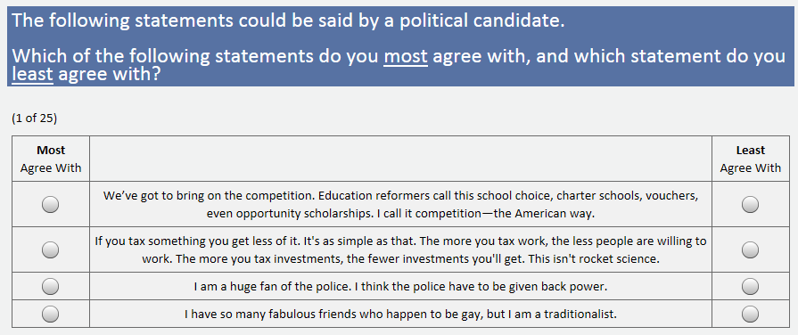
MaxDiff Exercise
All Respondents:
  30 statements (10 fixed, 20 random), 25 tasks, 4 items per screen

Slide 5
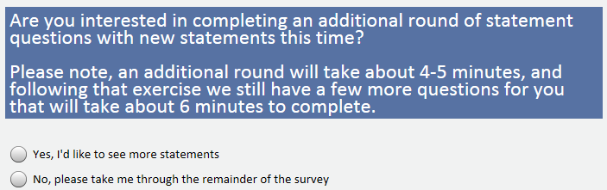
Modularization Opt-In
Up to 6 additional voluntary modules:
      30 random statements, 25 tasks, 4 items per screen
… Lots of missing data!

Slide 6
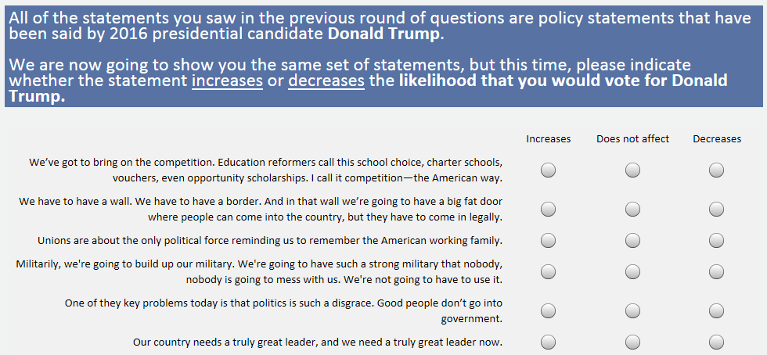
Anchor: Direct Binary Threshold
Following MaxDiff modules, all respondents saw the following question using the first 30 statements seen in the MaxDiff exercise
2 Thresholds: increase likelihood, decrease likelihood

Slide 7
Top & Bottom Statements – Total Sample
Top 5
Bottom 5
Our country needs a truly great leader, and we need a truly great leader now.
One of the key problems today is that politics is such a disgrace. Good people don’t go into government.
We need to once again have a government that is of the people, for the people and by the people.
I want to save Medicare and Social Security.
Too few Americans are working, too many jobs have been shipped overseas, and too many middle class families cannot make ends meet.
The concept of global warming was created by and for the Chinese in order to make U.S. manufacturing non-competitive.
The other thing with the terrorists, you have to take out their families.
Unions are about the only political force reminding us to remember the American working family.
The ideal Supreme Court Justice would be Scalia reincarnated.
I have so many fabulous friends who happen to be gay, but I am a traditionalist.

Slide 8
Top Statements – Republicans vs. Democrats
Republicans
Democrats
Our country needs a truly great leader, and we need a truly great leader now.
We have to have a wall. We have to have a border. And in that wall we’re going to have a big fat door where people can come into the country, but they have to come in legally.
Militarily, we're going to build up our military. We're going to have such a strong military that nobody, nobody is going to mess with us. We're not going to have to use it.
If you tax something you get less of it. It's as simple as that. The more you tax work, the less people are willing to work. The more you tax investments, the fewer investments you'll get. This isn't rocket science.
The way veterans are being treated in our country is a disgrace.
Our country needs a truly great leader, and we need a truly great leader now.
One of the key problems today is that politics is such a disgrace. Good people don’t go into government.
Unions are about the only political force reminding us to remember the American working family.
We need to once again have a government that is of the people, for the people and by the people.
We must have universal healthcare. We should not hear so many stories of families ruined by healthcare expenses.
Blue = Bottom 5 statements for Democrats

Slide 9
Aggregate Analysis
R2 is very high, indicating utilities are on average almost identical
y = 1.0263x
R² = 0.9921

Slide 10
Aggregate Analysis by Party Affiliation
Republicans love
Trump’s statements
on Immigration and
the opposition
Both like his economic
credentials and patriotic
statements.
Democrats love
Trump’s statements
on Unions

Slide 11
5 Segment Solutions on Anchored Utilities Very Consistent
More consistency across utility calculation method than segmentation method
Percent Segment Assignment Agreement
 | EM Clus | HB Clus | EM LC | HB LC
EM Clus | 100% | 96.4% | 93.8% | 92.3%
HB Clus | 96.4% | 100% | 93.6% | 94.1%
EM LC | 93.8% | 93.6% | 100% | 96.0%
HB LC | 92.3% | 94.1% | 96.0% | 100%
Trump Fanatics
12%
American interests come first
Obamacare is a disaster
Our unprotected border is a threat
Trump Leaners
30%
The way veterans are being treated in our country is a disgrace
It is time we imposed budget discipline
Undecided
Swing Vote
27%
Our government is failing us
The only special interest not being served … is the American people
Trump Skeptics
23%
We must have universal healthcare
Every Republican wants to do a big number on [social programs]. And we can’t do that.
Trump
Haters
7%
One of our … goals must be to induce a greater tolerance for diversity.
[Medicare] is actually a program that's worked

Slide 12
While Key Trends Exist,
Trump Had Support Across Wide Base

Slide 13
Trump Attitudes Didn’t Fall Under Normal Party Lines

Slide 14
Trump Was Not Top Pick Amongst Undecided Segment

Slide 15
Re-Contact Data to Test Predictive Capabilities
In early July we re-contacted 310 respondents for n=200 completes
  Same questionnaire
  Only one MaxDiff exercise with no modularization
  30 statements (not seen in previous fielding), 25 tasks, 4 items per screen
We compared imputed utilities (both HB and EM) with “real” tasks and calculated hit rates

Slide 16
No Statistical Difference in Prediction Accuracy*
Pretty good hit rates considering respondents didn’t previously see items
  EM Algorithm doesn’t change predictive accuracy
  Anchoring utilities doesn’t change predictive accuracy
Hit Rates by Calculation Type
 | Best Tasks | Worst Tasks
EM Anchored | 42.9% | 44.1%
EM Unanchored | 42.6% | 43.4%
HB Anchored | 42.3% | 44.0%
HB Unanchored | 42.7% | 43.4%
*Number of tasks is 5000, so standard error (ignoring within respondent correlation) is 1.4%.

Slide 17
Key Findings
The HB algorithm and EM algorithm perform equally well in imputing missing utilities
  There are no meaningful differences between average utilities imputed using the HB algorithm versus the EM algorithm
  Segmentation on the utilities yields similar results
  Hit rates with both models similar
Future Research
Use Sparse MaxDiff instead of Express MaxDiff
Cluster Ensemble unanchored segmentation

Slide 18
Thank You!
Edward.Johnson@surveysampling.com
Kelsey.White@surveysampling.com

