Slide 1
What’s the best size for matrix-style questions in online surveys?
Rebecca Hofstein Grady^{1,2}, Rachel Greenspan¹, and Mingnan Liu^{2,3}
[1] UC Irvine [2] SurveyMonkey (at time of research) [3] Facebook
PAPOR 2017 Presentation

Slide 2
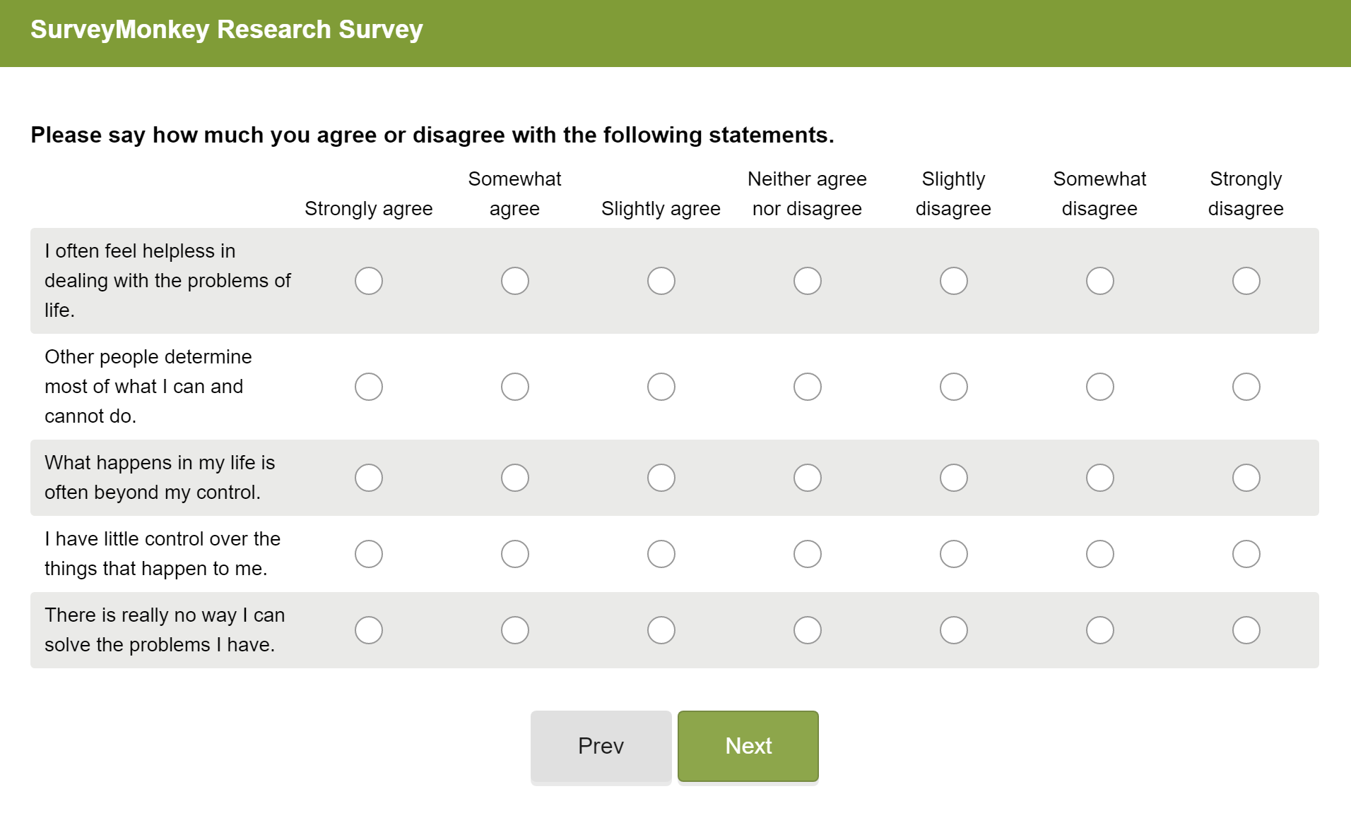

Slide 3
Mixed impact of matrix format over separate items
Positive effects
  Easier for researchers to program
  Decreases completion time
  Sometimes increase in inter-item reliability
Negative effects
  Sometimes rated worse by participants
  May lead to more missing data, straightlining and dropouts
  Large matrices can be overwhelming
Recommended to use optimized non-grid layout on smartphones
Liu & Cernat, 2016; Tourangeau, Couper, & Conrad, 2004; Toepoel, Das, & van Soest 2009; Callegaro, Shand-Lubbers, & Dennis 2009; Couper, Tourangeau, Conad, & Zhang, 2013; Couper, Antoun, & Mavletova, 2017; De Bruijne & Wijnant, 2014; AAPOR Task Force on Emerging Technologies in Public Opinion Research, 2014; Revilla, Toninelli, & Ochoa, 2017

Slide 4
Purpose of this research
Find optimal matrix size to increase positive outcomes and reduce negative outcomes
  Investigate the impact of the number of rows (items per page), number of columns (number of response options), and their interaction on data quality and survey experience outcomes
  Vary valence, typical inter-item reliability, and presence of reverse-coded items on scales
  Look at results separately for grid questions on a computer and smartphone-optimized multiple choice conversion

Slide 5
Study 1 methods
N = 2,801 Participants drawn from SurveyMonkey Audience
  1,710 on a computer
  782 on a phone
  309 on a tablet or other device (excluded from analyses)
All participants shown the following scales with the same question order
  Perceived Mastery (5 items no reverse coding)
  Perceived Constraints on Personal Control (5 items, no reverse coding)
  Self-Control/Impulsiveness (6 items, 2 reverse coded)
  Industriousness (4 items, 2 reverse coded)
Varied the number of rows and columns between-subjects (3x3)
  5, 10, 20 rows (leading to a 4, 2, or 1 page survey, respectively)
  3, 5, or 7 columns (with appropriate Likert rating scale point changes)

Slide 6


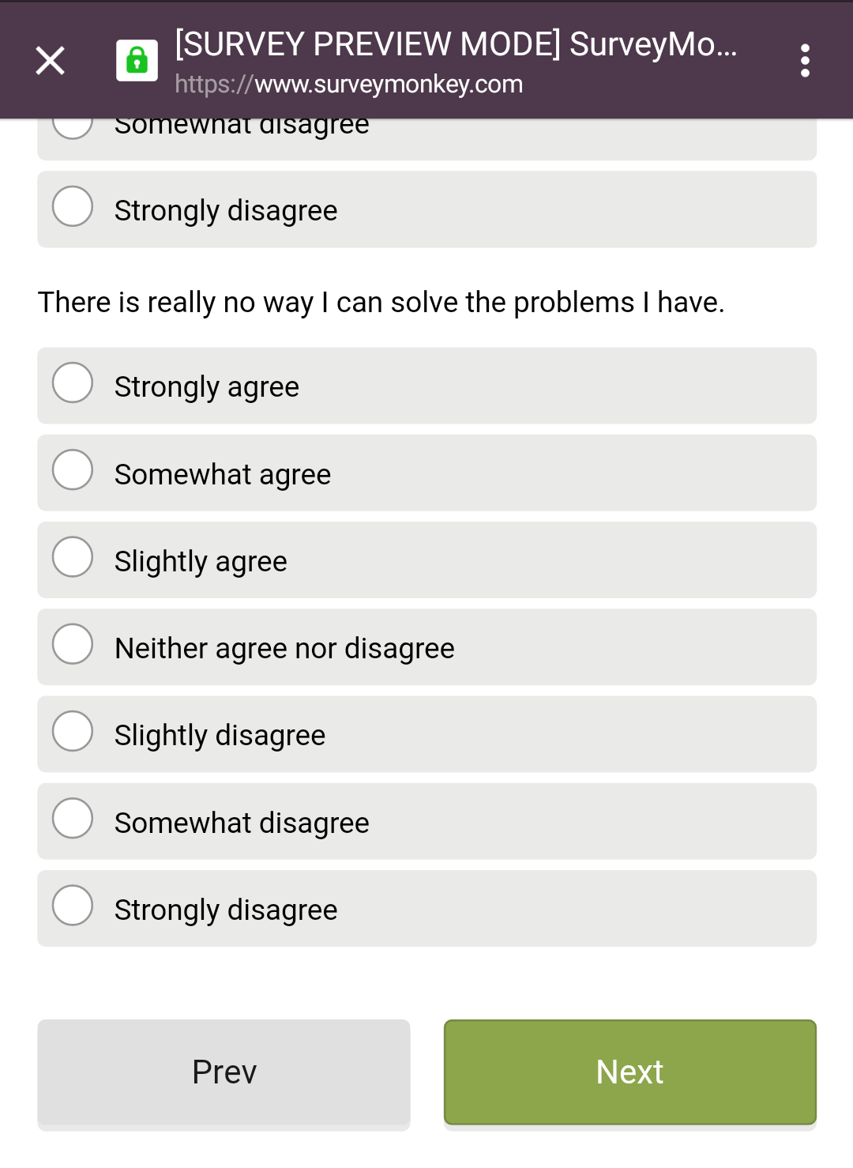
Examples of matrix layouts

Slide 7
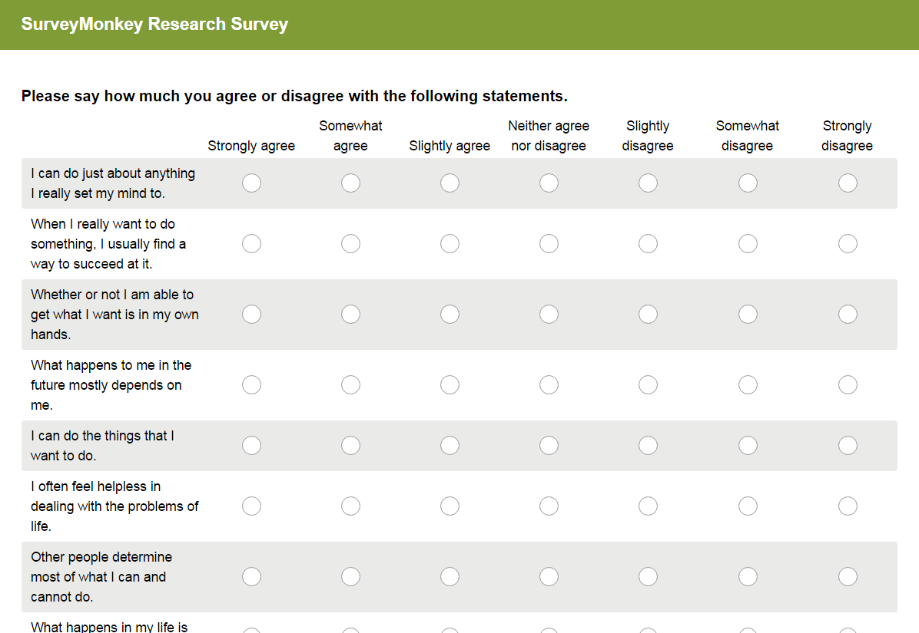



Main outcomes
Data quality outcomes
  Presence of straightlining
  Cronbach’s ɑ on each scale
  Missing items
Survey experience outcomes
  Dropout rate
  Completion time
  Subjective rating composite

Slide 8
Study 1 matrix size results - computer users
Best outcomes (Computer only) | Rows (5, 10, or 20) | Columns (3, 5, or 7)
Lowest straight-lining rate | n.s. | n.s.
Least number of items skipped | n.s. | n.s.
Lowest dropout rate | 5 rows | n.s.
Lowest completion time | n.s. | 3 or 5 columns
Highest subjective survey rating | 5 rows | n.s.
No significant interactions between rows and columns
No effects of rows and columns for mobile users

Slide 9

Study 1 dropout rate by device and condition

Slide 10
Study 1 Cronbach’s ɑs
 | 3 columns | 5 columns | 7 columns | 3 columns | 5 columns | 7 columns
Mastery* | 0.77 | 0.85 | 0.85 | 0.78 | 0.83 | 0.85
Constraints* | 0.82 | 0.88 | 0.88 | 0.81 | 0.83 | 0.90
Impulsiveness* | 0.55 | 0.68 | 0.66 | 0.60 | 0.63 | 0.71
Industriousness | 0.68 | 0.69 | 0.63 | 0.67 | 0.65 | 0.69
 | 3 columns | 5 columns | 7 columns
Mastery* | 0.77 | 0.85 | 0.85
Constraints* | 0.82 | 0.88 | 0.89
Impulsiveness* | 0.55 | 0.68 | 0.66
Industriousness | 0.68 | 0.69 | 0.63

Slide 11
Study 1 conclusions
Fewer items per page was the same or better for all outcomes
  5-row grids had the lowest dropout and best rated experience
  No negative outcomes in data quality or completion time
Moderate number of response options (5) led to the best balance of data quality and completion time
  3-columns had lower inter-item reliability
  7-columns had increased completion time
Mobile users showed few significant differences size conditions
  Likely due to matrix items being converted to multiple choice

Slide 12
Question remaining: What if the scale crosses pages?
Scales in previous study were (usually) on same page
Scale reliability may decrease when cross pages
May change row recommendation for longer scales

Slide 13
Study 2 methods
N = 3,329 Participants drawn from SurveyMonkey Audience
  1,866 on a computer
  1,096 on a phone
  367 on a tablet or other device (excluded from analyses)
Saw either 5, 10, 20 rows per page between-subjects
  Leading to a 4 page, 2 page, or 1 page survey, respectively
Participants shown one of the following two scales
  Shyness (20 questions, 6 reverse coded, one factor)
  Behavioral Approach/Inhibition (20 questions, 2 reverse coded, 4 factors)

Slide 14
Study 2 matrix size results – computer users
Best outcomes (Computer only) | Rows (5, 10, or 20)
Lowest straight-lining rate | n.s.
Least number of items skipped | n.s.
Lowest dropout rate | n.s.
Lowest completion time | n.s.
Highest subjective survey rating | 5 rows
Dropout rate same direction as previous study but not significant
5 rows still had highest survey rating with no data quality loss

Slide 15
Study 2 Cronbach’s ɑs
 | 5 rows | 10 rows | 20 rows | 5 row | 10 rows | 20 rows
Shyness | .93 | .94 | .94 | .94 | .94 | .94
BAS/BIS | .80 | .81 | .83 | .80 | .75 | .71
 | 5 rows | 10 rows | 20 rows
Shyness | .93 | .94 | .94
BAS/BIS | .80 | .81 | .83

Slide 16
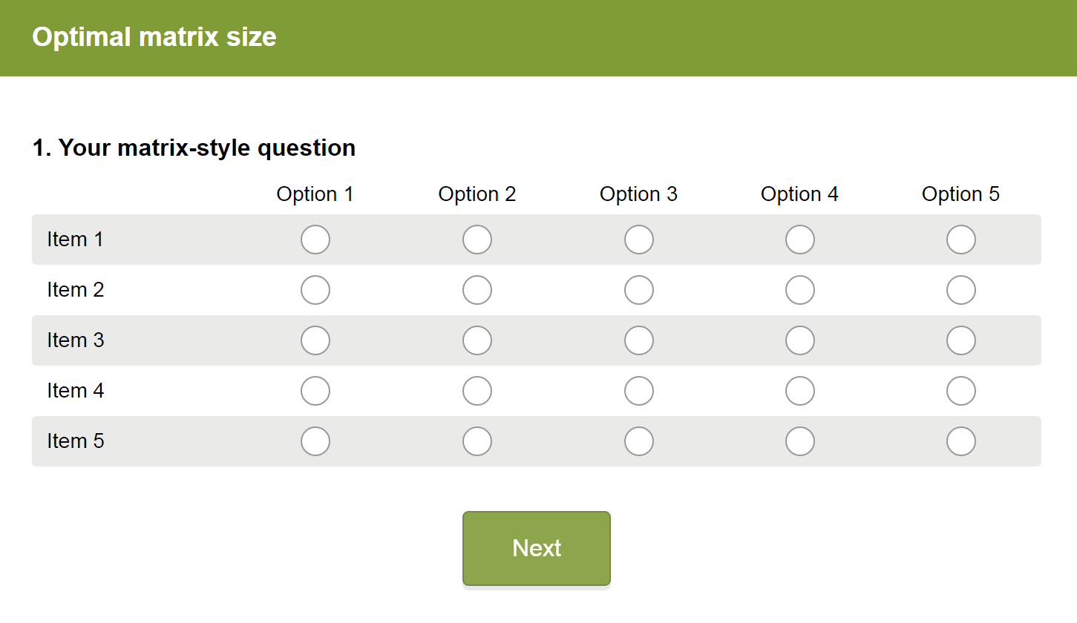
Discussion and next steps
Five by Five
Best experience and completion rate with 5 rows/items on a page
  No decrease in data quality outcomes
  Even when it makes scales cross pages
Best data quality and completion time with 5 columns/response options
  But may be decided based on scale
Specifically for matrices on computers
Future studies could randomly assign device type, size, and optimization
  Will mobile users be affected by large matrices when not optimized?
  Might computer users benefit from converted matrices as well?

Slide 17

Thank you!
Mick Couper
SurveyMonkey Research Team
  Sarah Cho
  Laura Wronski
  Jon Cohen
Contact information:
  Becky Hofstein Grady
  PhD student at UC Irvine, Psychology and Social Behavior
  grady.becky@gmail.com

Slide 18
Study 1 row results
 | Computers |  |  | Mobile
 | 5 rows | 10 rows | 20 rows | 5 rows | 10 rows | 20 rows
Dropout rate (C*) | 4.5% | 8.3% | 11.2% | 6.8% | 6.2% | 6.2%
Completion time | 3.02 | 2.99 | 2.92 | 3.66 | 3.68 | 3.53
Straight-lining rate | 2.8% | 3.9% | 4.4% | 2.8% | 4.9% | 3.3%
Number of items skipped | 0.21 | 0.12 | 0.18 | 0.06 | 0.02 | 0.07
Subjective survey rating (C*) | 3.77 | 3.71 | 3.63 | 3.84 | 3.81 | 3.86

Slide 19
Study 1 column results
 | Computers |  |  | Mobile
 | 3 columns | 5 columns | 7 columns | 3 columns | 5 columns | 7 columns
Dropout rate | 7.0% | 6.9% | 9.9% | 8.0% | 6.3% | 5.1%
Completion time (C*) | 2.89 | 2.86 | 3.20 | 3.49 | 3.59 | 3.78
Straight-lining rate | 3.6% | 4.2% | 3.1% | 4.7% | 4.2% | 2.3%
Number of items skipped | 0.16 | 0.16 | 0.19 | 0.06 | 0.04 | 0.06
Subjective survey rating | 3.71 | 3.73 | 3.68 | 3.87 | 3.78 | 3.85

Slide 20
Study 2 row results
 | Computers |  |  | Mobile
 | 5 rows | 10 rows | 20 rows | 5 rows | 10 rows | 20 rows
Dropout rate | 7.1% | 9.7% | 9.6% | 16.4% | 11.4% | 13.4%
Completion time (M*) | 3.05 | 3.03 | 3.02 | 3.35 | 3.36 | 3.09
Straight-lining rate | 2.5% | 3.1% | 4.1% | 3.0% | 7.1% | 4.7%
Number of items skipped | 0.18 | 0.13 | 0.28 | 0.02 | 0.05 | 0.13
Subjective survey rating (C*) | 3.67 | 3.55 | 3.47 | 3.70 | 3.84 | 3.69

Slide 21
 |  | Study 1 Demographics |  | Study 2 Demographics
 |  | Computer N=1,710 | Mobile N=782 | Computer N=1,866 | Mobile 1,096
Gender | Male | 33% | 27% | 31% | 22%
 | Female | 67% | 73% | 69% | 78%
Age | 18-29 | 18% | 32% | 15% | 24%
 | 30-44 | 22% | 30% | 20% | 38%
 | 45-59 | 36% | 28% | 34% | 28%
 | 60+ | 24% | 10% | 31% | 10%
Income | $0-$24,999 | 13% | 22% | 11% | 22%
 | $25,000 to $49,999 | 18% | 21% | 17% | 21%
 | $50,000 to $74,999 | 18% | 16% | 17% | 15%
 | $75,000 to $99,999 | 15% | 11% | 14% | 11%
 | $100,000 to $124,999 | 9% | 5% | 10% | 9%
 | $125,000 to $149,999 | 5% | 4% | 4% | 4%
 | $150,000 and up | 11% | 8% | 11% | 7%
 | Prefer not to answer | 11% | 13% | 16% | 10%
Region | New England | 6% | 6% | 7% | 4%
 | Middle Atlantic | 13% | 11% | 13% | 13%
 | East North Central | 15% | 15% | 15% | 18%
 | West North Central | 9% | 8% | 8% | 7%
 | South Atlantic | 17% | 18% | 16% | 19%
 | East South Central | 6% | 6% | 6% | 6%
 | West South Central | 8% | 10% | 9% | 10%
 | Mountain | 8% | 7% | 8% | 7%
 | Pacific | 17% | 19% | 18% | 18%

