Slide 1
Creating a Framework for Measuring Coverage Bias in Online Panels by Matching to Voter Files
Edward Paul Johnson, SSI

Slide 2

Voter File Sample Takes Work, but Gives a Great Frame
Every state has a different format/file structure/record keeping
Most states do not mandate phone number or email
  Just full name and address
Have to match to commercial databases for phone numbers
Could also match online panel for online data collection
Great Benefits
  Know Vote History
  Party Affiliation
  Political Geography
  Donor Records

Slide 3
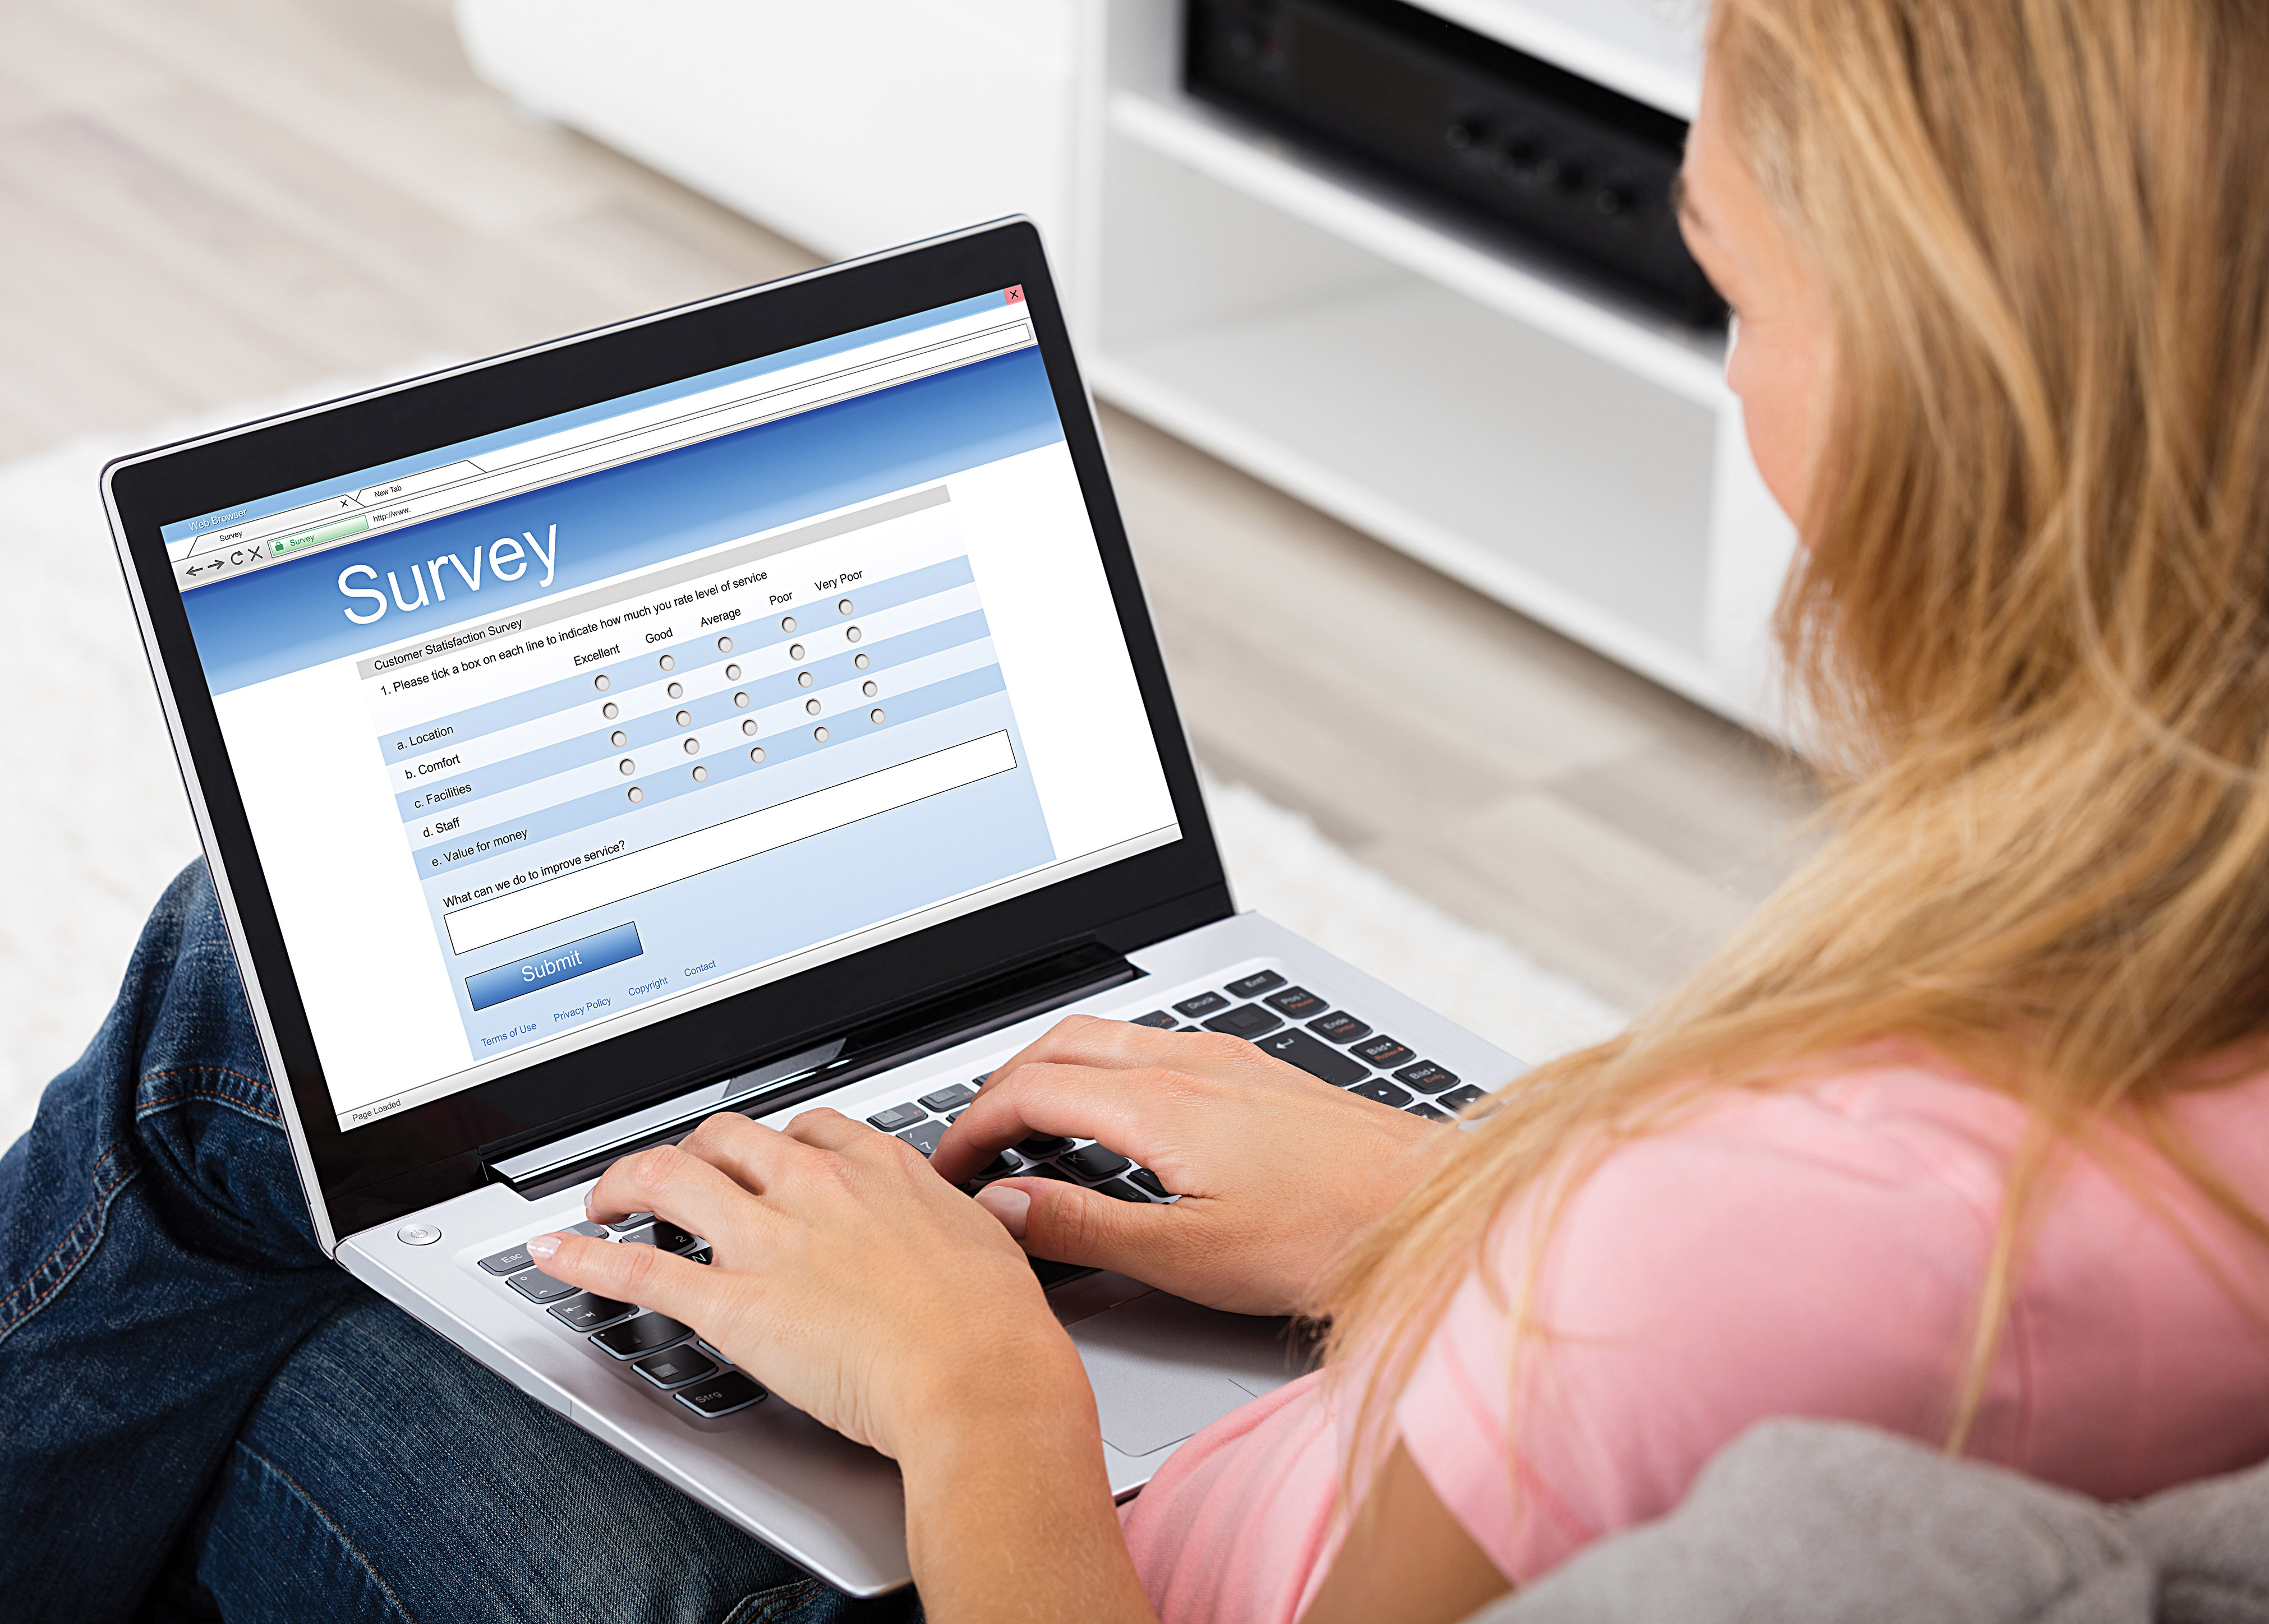



Online or Phone Data Collection on Voter Files Have Different Strengths
Coverage | 73% | <1%
Response Rates | <10% | Hard to Calculate
Interviewer/Social Desirability Bias | High Potential | Low Potential
Time Frame | Days | Days
Costs | Average | Low
Sampling Method

Slide 4

Match Criteria Matters When Comparing Files
Matched Panel Records to Aristotle Voter File
Match Criteria
  Individual Matches
      Full Name, Address (Zip+4), Year of Birth* (I)
      First Name, Address (Zip+4), Year of Birth (S)
      Full Name, Zip code, Year of Birth (M)
      Full Name, City, Year of Birth (N)
  Household Matches**
      Last Name, Address (Zip+4)
* Year of birth considered a match if within 1 year
** When matched to multiple records in voter file we take the one closest in age and gender

Slide 5
How Does Partisanship Line Up in the Matched Frame

Slide 6
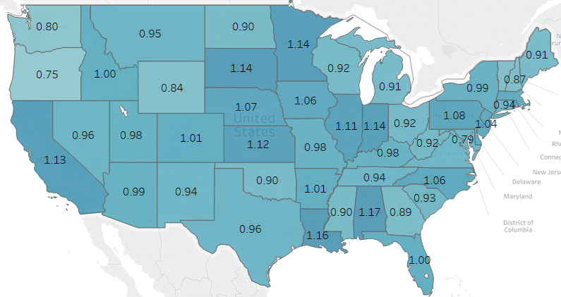
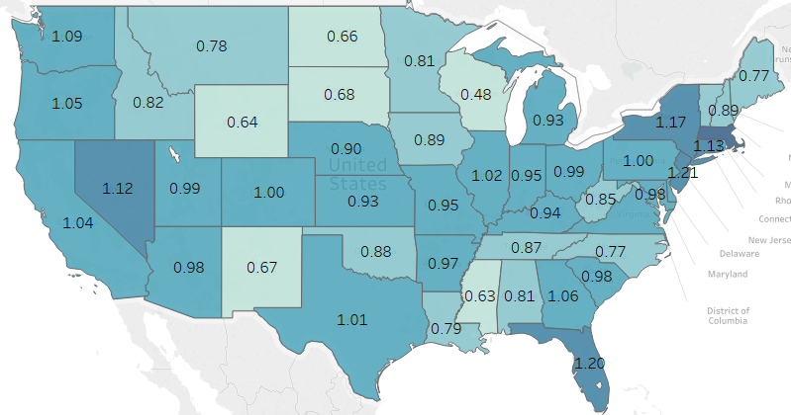
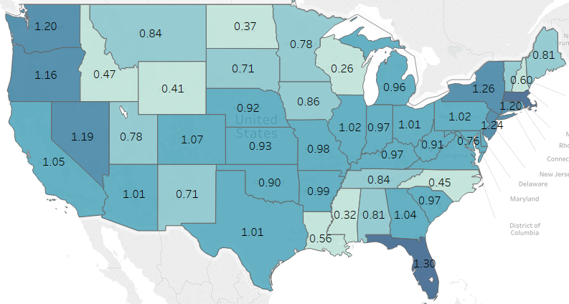
How Does Geography Compare in Matched File
Matched to Phone Number
Online Panel Total
Online Panel Individual Only

Slide 7
How Does Voting Propensity Compare in the Files

Slide 8
How Does Voting Propensity Compare in the Files

Slide 9
Key Summary and Future Research
Overall online matched panel similar to full file
  Only applies to observable data (still potential bias in others)
Make sure you know what your match criteria is
Potential multi-mode opportunities
  From same sample frame so overlap easy to deal with
  Allows visual stimulus rather than just auditory
Just the start to other administrative record appends
  Passive measurements

Slide 10
Thank You!

